Slide 1
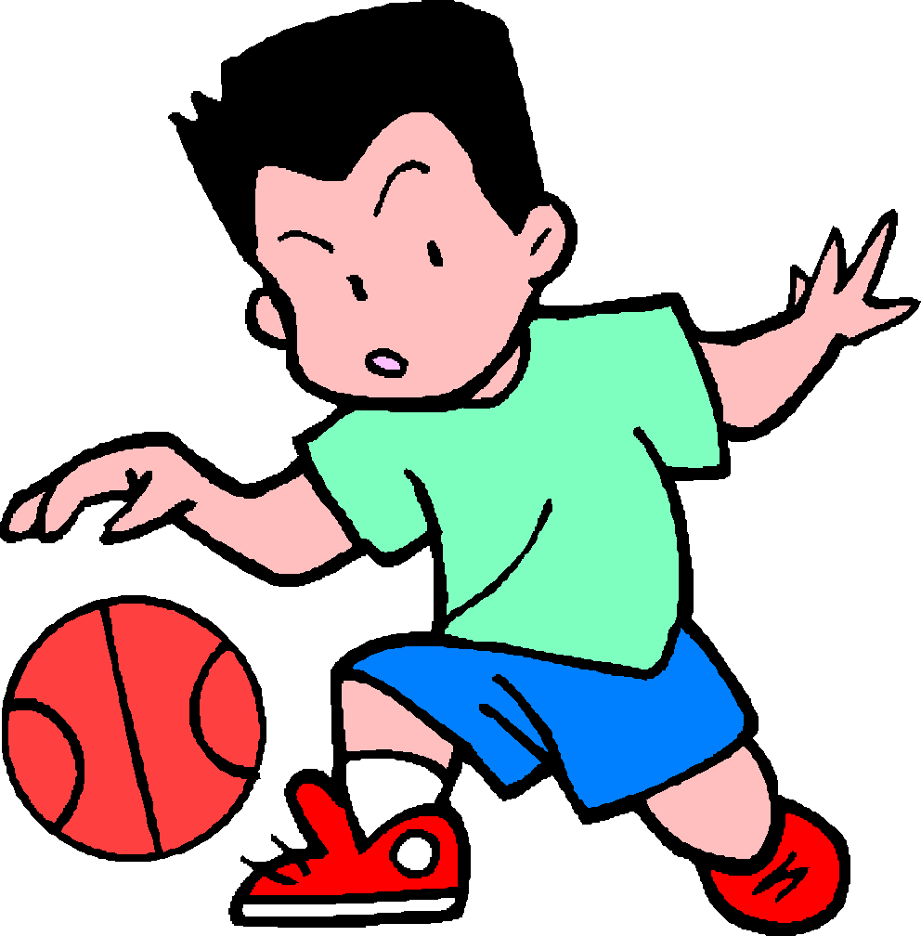
Name________________
Date_________________
Core_________________
Force Practice Problems
1. Harry the hippo decides to go skydiving for his birthday. Gravity is pulling him down with a force of 1000 N. Air resistance is pushing up on his parachute with a force of 800 N.
Draw and label the forces on the diagram.
What is the net force? __________________
In which direction is Harry moving? _________
2. Shaun is the star of his middle school basketball team. Unfortunately, while playing in the championship game, his foot slips on the floor. He slides to the left with a force of 200 N. The force of sliding friction between his shoe and the floor is 200 N.
Draw and label the forces on the diagram.
What is the net force? __________________
Will Shaun keep sliding? _________
If yes, what direction?
If no, why not?
Fill in the blanks below to complete each force diagram.
60 N
50N ____ N
Net force = 20 N
Direction: Up
60 N
200 N
150 N 125 N
Net force = _______
Direction: ________
Net force = _______
Direction: ________

