Slide 1
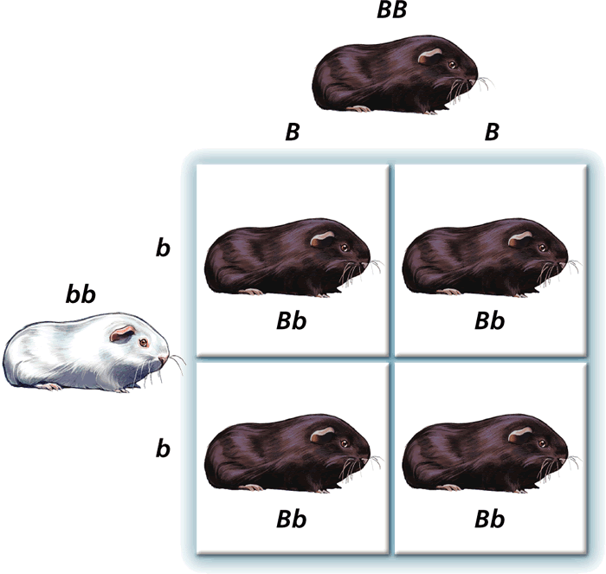
Dec. 9 2019
You need:
Clean paper (2)/ pencil
Bikini Bottom Genetics WS
Warm Up:
What’s the difference between genotype and phenotype?
I CAN: build a Punnett square

Slide 2
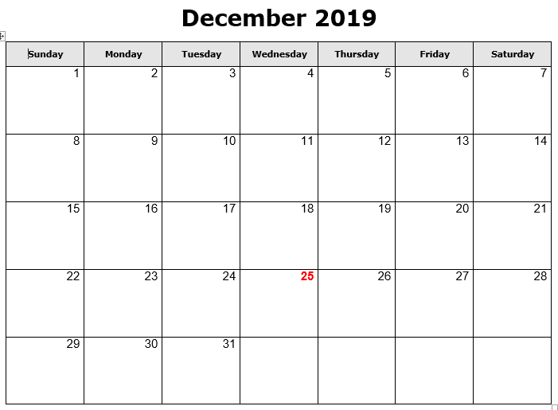
Progress reports
NJHS mtg @2:30
Early release / PLC
Chorus concert
Ugly sweater
Holiday Socks
Red for Ed Holiday
Holiday Pajamas
Holiday Hat
WINTER BREAK

Slide 3
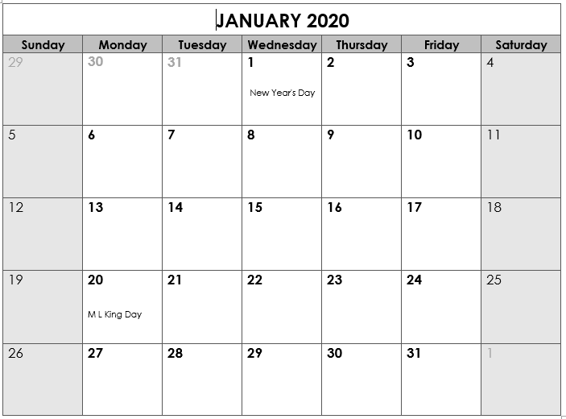
Back to School
“B” day
Benchmark testing in ELA and Math
SWAGbrrr
*End Qtr 2
School Holiday
Teacher Workday
Teacher Workday (Weather?)
SWAGbrrr
SWAGbrrr

Slide 4
Vocabulary
Chromosomes – DNA wound into cute pkg
Genes – section of DNA/chromosome that codes for a specific trait
Traits – an organism’s physical features
Phenotype – the way something looks on the outside (based on DNA)
Genotype – the genes inside (usually represented with two letters – LL, Ll, ll)

Slide 5
Vocabulary
Dominant allele – the version of a gene that WILL show if present.
Recessive allele – the version of a gene that may get hidden. Only shows if there is nothing to cover it.
HOMOzygous – an organism with two of the SAME alleles for a specific trait.
HETEROzygous – an organism with DIFFERENT alleles for a specific trait.

Slide 6
BrainPop
Heredity video
Quiz possible!!

Slide 7
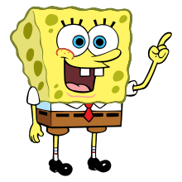
SpongeBob
HOMO-zygous = the letters are the SAME…Big B, Big B
HETERO-zygous = the letters are DIFFERENT…Big B, little b

Slide 8
SpongeBob
Yellow
PHENO-type = the way it looks on the outside (based on genetics)
GENO-type = the genes on the inside

Slide 9
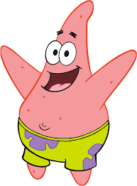
SpongeBob
TT
or Tt
Wait, so SpongeBob said
“GENO-type = the genes on the inside”
So I need to tell what genes are possible if they have a tall head?

Slide 10
SpongeBob

Slide 11
Parent 1
Parent 1: _______
Parent 2: _______
____ = __________
____ = __________
Parent 2

Slide 12
One more video…
Amoeba Sisters – Monohybrid and Punnett
https://youtu.be/i-0rSv6oxSY

Slide 13
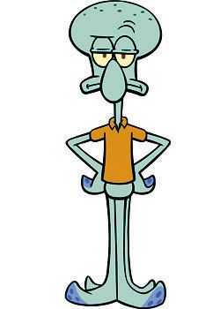
Parent 1
Parent 1: _______
Parent 2: _______
____ = __________
____ = __________
Parent 2

Slide 14
Parent 1
Parent 1: _______
Parent 2: _______
____ = __________
____ = __________
Parent 2

Slide 15
Parent 1
Parent 1: _______
Parent 2: _______
____ = __________
____ = __________
Parent 2

Slide 16
Probability & Heredity: Punnett Squares

Slide 17
How can we figure out which traits will be inherited?
To talk about inheritance, we need to use our new vocabulary…
We’ve learned about dominant & recessive alleles:
Dominant alleles are more powerful, and can “hide” a recessive trait.
Shown with an upper-case letter (“T” for tall stems)
Recessive alleles can be “hidden” when a dominant allele is present.
Shown with a lower-case letter (“t” for short stems)

Slide 18
How can we figure out which traits will be inherited?
You know the differences between genotype and phenotype:
Genotype describes which genes (alleles) are present.
TT = 2 dominant alleles
Tt = 1 dominant & 1 recessive
tt = 2 recessive alleles
Phenotype describes what the physical trait looks like.
Tall stems (TT and Tt)
Short stems (tt)

Slide 19
More vocabulary…
Geneticist use 2 terms to describe GENOTYPE:
Homozygous – the organism has 2 same alleles.
TT = 2 dominant alleles
tt = 2 recessive alleles
Heterozygous – the organism has 2 different alleles.
Tt = 1 dominant & 1 recessive allele

Slide 20
So, how do we know which genotype or phenotype the offspring will be?
We can use a tool called a punnett square to predict how likely it is for an offspring to inherit certain traits.
A PUNNETT SQUARE:
is a chart that shows ALL the possible combinations of a genetic cross.
shows genotype and phenotype of the offspring.
is also used to predict the probability (the chance) that an offspring will have a certain trait.

Slide 21
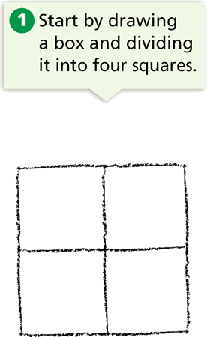
How do we draw a Punnett Square?

Slide 22
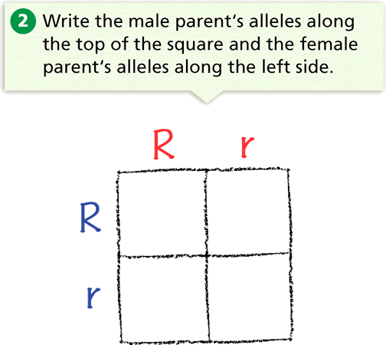
“R” is dominant for Round seeds.
“r” is recessive for wrinkled seeds.
Both parents are “heterozygous” and have round seeds.

Slide 23
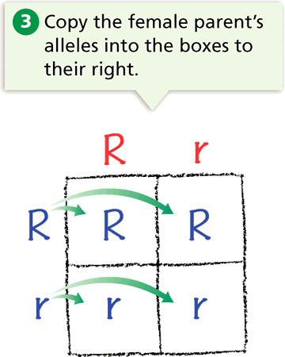

Slide 24
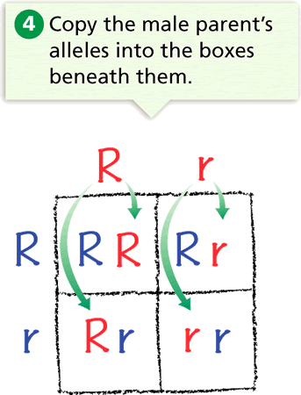

Slide 25
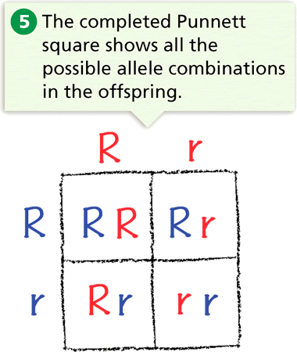

Slide 26
The two-letter combinations are the possible genotypes of the offspring.
They are RR, Rr, Rr, and rr genotypes.
From this it is possible to determine the “probability” (chance) that a seed will have:
a round seed phenotype (3/4 or 75%) OR
a wrinkled seed phenotype (1/4 or 25%)

Slide 27
Try one on your own…
Cross a homozygous guinea pig with black fur (BB) with a homozygous guinea pig with white fur (bb).
(Black fur is dominant over white fur).

Slide 28
Try one on your own…
Cross a homozygous guinea pig with black fur (BB) with a homozygous guinea pig with white fur (bb).
B
B
b
b

Slide 29
Try one on your own…
Cross a homozygous guinea pig with black fur (BB) with a homozygous guinea pig with white fur (bb).
B
B
B
B
B
B
b
b

Slide 30
Try one on your own…
Cross a homozygous guinea pig with black fur (BB) with a homozygous guinea pig with white fur (bb).
B
B
b
b
b
B
B
b
b
b
B
B

Slide 31
The result?
All 4 possible offspring will be heterozygous and have one dominant allele for black fur and 1 recessive allele for white fur.
All the guinea pigs will have the black fur phenotype; and Bb genotype.

Slide 32
More practice problems…
1) Cross a heterozygous tall pea plant (Tt) with a homozygous
short pea plant (tt).
Tall stems (T) are dominant over short stems (t).
What are the possible offspring from this cross?
2) Cross a rabbit who is heterozygous for short ears (Ee) with
another rabbit who is heterozygous for short ears (Ee).
Short ears (E) are dominant over long, floppy ears (e).
What are the possible offspring from this cross?

Slide 33
Parent 1
Parent 1: _______
Parent 2: _______
____ = __________
____ = __________
Parent 2

Slide 34
More practice problems…
Bikini Bottom Genetics!
#5 together
#6-8 on your own!!

Slide 35
Parent 1
Parent 1: _______
Parent 2: _______
____ = __________
____ = __________
Parent 2

Slide 36
Parent 1
Parent 1: _______
Parent 2: _______
____ = __________
____ = __________
Parent 2

Slide 37
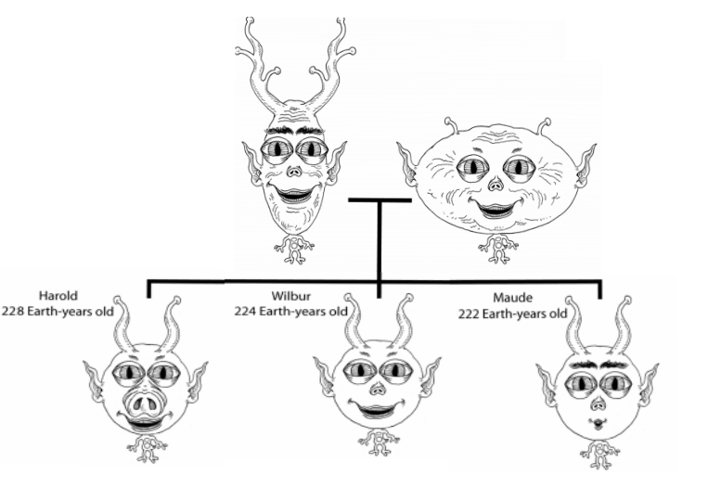
Omah and Opah
Omah
392 Earth years old
Opah
389 Earth years old

Slide 38
Review and vocabulary
Pedigree
Parent
Filial / offspring
Generations
Traits
Chromosomes
Dominant (gene)
Recessive (gene)
We will add more as we go.

