Slide 1
Dec. 19, 2019
You need:
Clean paper (2) / pencil
Bikini Bottom – codominance vs. incomplete
Warm Up:
How should I tell the difference between codominance and incomplete dominance?
I CAN: determine how traits are passed to specific genders.

Slide 2
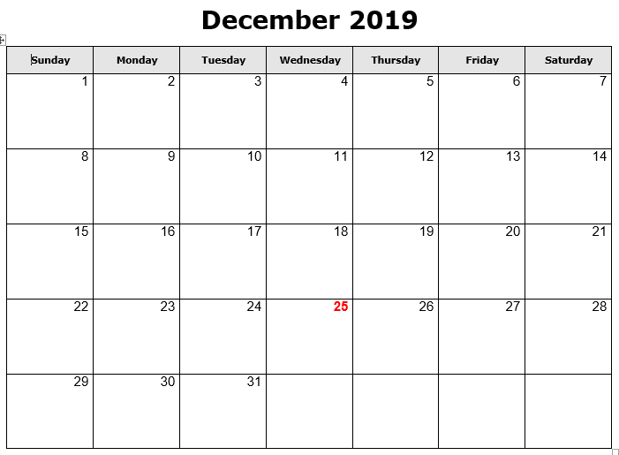
Progress reports
NJHS mtg @2:30
Early release / PLC
Chorus concert
Ugly sweater
Holiday Socks
Red for Ed Holiday
Holiday Pajamas
Holiday Hat
WINTER BREAK

Slide 3
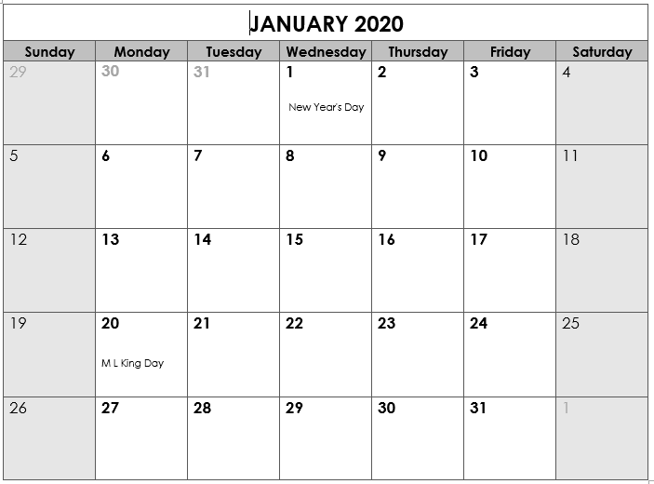
Back to School
TEST
TEST
“B” day
Benchmark testing in ELA and Math
SWAGbrrr
*End Qtr 2
Teacher Workday
Teacher Workday (Weather?)
School Holiday
SWAGbrrr
SWAGbrrr

Slide 4
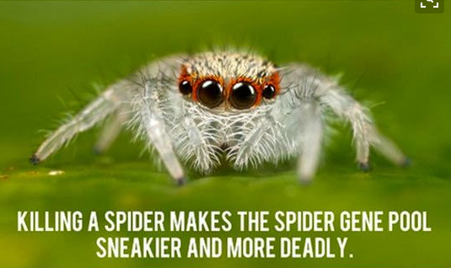

Slide 6
Today’s agenda
Review
Karyotype, sex-linked, pedigree
Pedigree practice
Genetic disorders

Slide 7
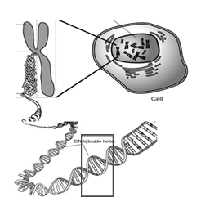
Nucleus
Chromosome
Cell
Gene
DNA

Slide 8
Vocabulary
Chromosomes – DNA wound into cute pkg
Genes – section of DNA/chromosome that codes for a specific trait
Traits – an organism’s physical features
Alleles – versions of a gene…
Dominant allele: the one that will always show
Recessive allele: the one that can be hidden

Slide 9
Vocabulary
HOMOzygous- two of the SAME alleles
HETEROzygous- two DIFFERENT alleles
Genotype – the genes or alleles inside (typically the letter combos)
Phenotype – the physical expression of those alleles (how they show up)

Slide 10
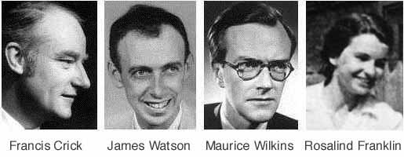

Slide 11
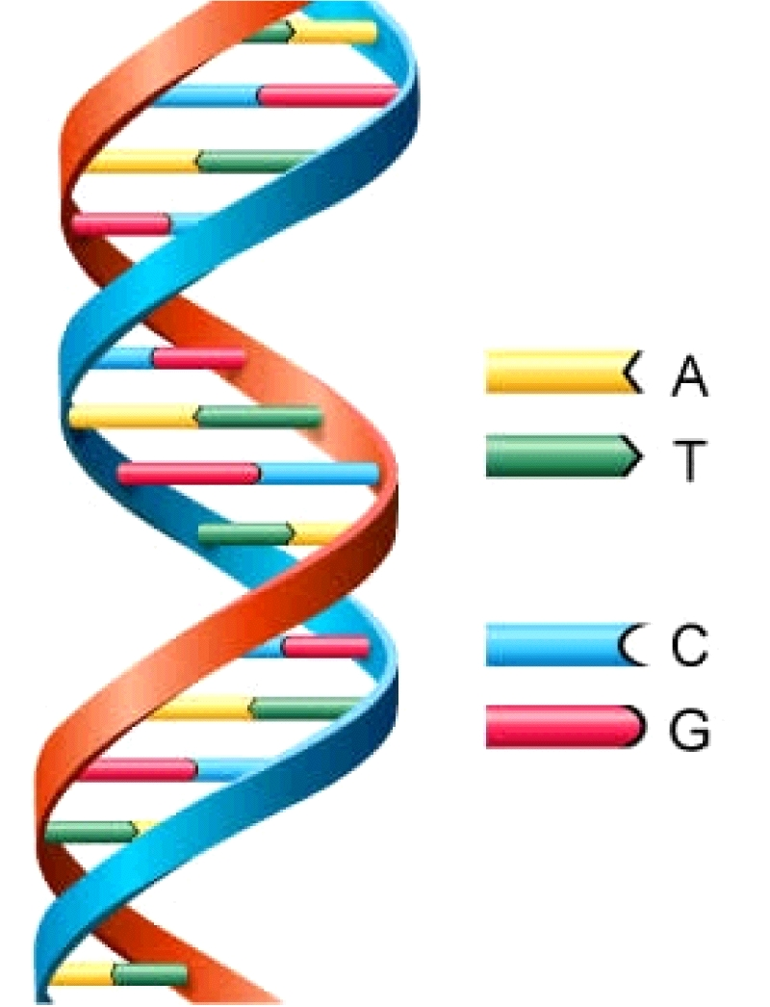
DNA
Deoxyribonucleic Acid
Double Helix (twisted ladder) shape

Slide 12
Complete Dominance = ONE WINNER

Slide 13
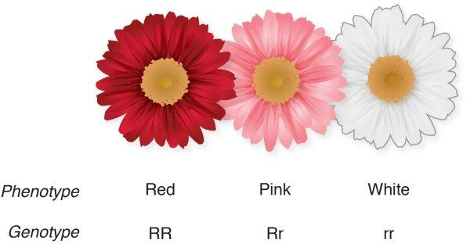
Incomplete Dominance = Blending

Slide 14
CoDominance = both show

Slide 15
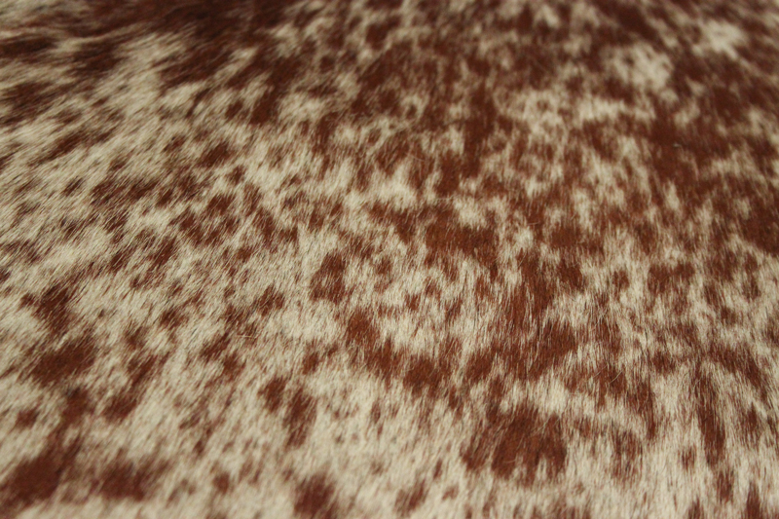
CoDominance = both show
ROAN

Slide 16
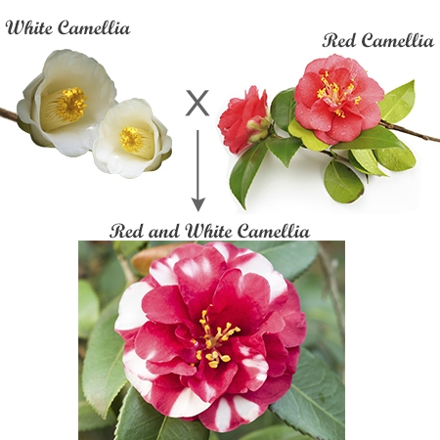
CoDominance = both show

Slide 17
CoDominance = both show
Blood type
Phenotype
Genotype
Type A
AA
AO
Type B
BB
BO
Type AB
AB
Type O
OO

Slide 18
Tell whether the following blood genotypes are homozygous (homo) or heterozygous (hetero).
AA _________ OO _________ BO ___________ BB __________ AB _________ AO __________
Which are purebred? ________________________ Which are hybrid? ____________________________

Slide 19
2. Determine the blood type (phenotype) for each genotype:
AA = type _____ AO = type _____ OO = type _____ BB = type _____ BO = type _____ AB = type ______

Slide 20
3. For each blood type (phenotype), give the genotypes possible:
Type A: ________ Type B: ________
Type O: ________ Type AB: _________

Slide 21
4. Sandy the Squirrel met Stewart the Squirrel at the water chestnut festival. They fell in love. Sandy is blood type AB and Stewart is type O.
Sandy Squirrel’s genotype: ________
Stewart Squirrel’s genotype: _________
Make a Punnett square to show the possible blood genotypes of their children.

Slide 22
O
O
A
A
O
A
O
B
B
O
B
O

Slide 23
A
A
B
B
A
B
A
O
O
A
O
A

Slide 24
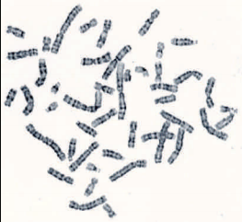
Karyotype – a picture of the actual chromosomes of an organism. Typically used for genetic research.

Slide 25
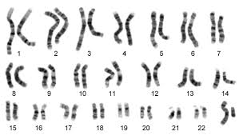
XY – sex chromosomes

Slide 26
Types of Chromosomes
Humans have 23 pairs of chromosomes
22 – autosomes
1 – sex chromosome (X & Y)

Slide 27
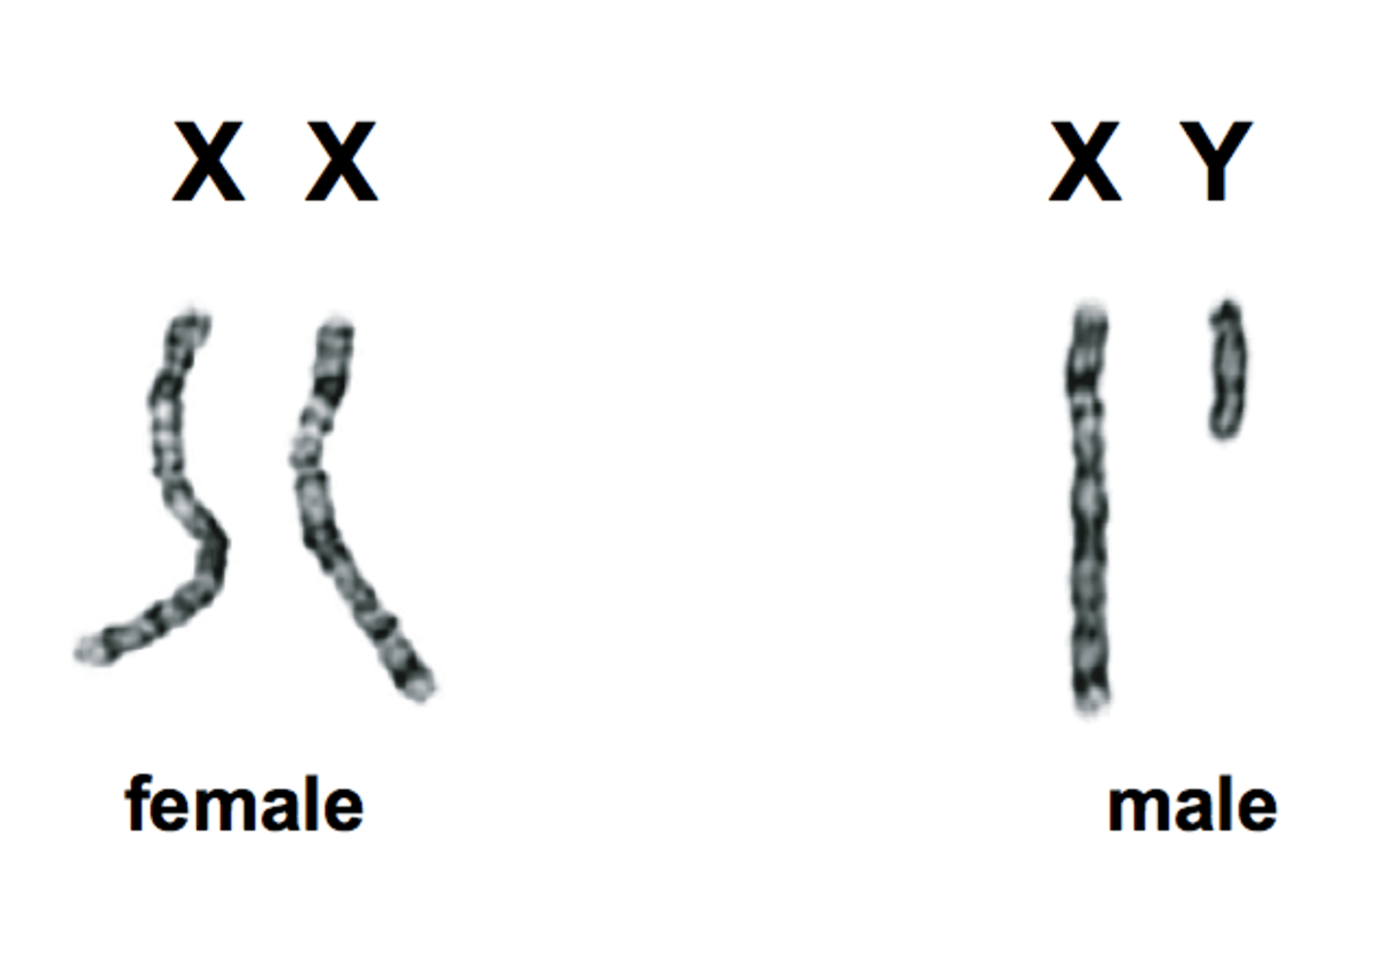

Slide 28
X
Y
X
X
X
X
Y
X
X
X
X
Y

Slide 29
Amoeba Sisters - Punnett squares and Sex-linked traits

Slide 30
X
Y
X
X
X
X
Y
X
X
X
X
Y

Slide 31
X
Y
X
X
X
X
Y
X
X
X
X
Y

Slide 32
X
Y
X
X
X
X
Y
X
X
X
X
Y

Slide 33
X
Y
X
X
X
X
Y
X
X
X
X
Y

Slide 34
Tell whether or not the following are “carriers” …are “showing the trait.”
Remember = “Carrier” means they have the allele, but do not show the trait.
If someone is showing the trait, they have the allele AND show it.
 | X^{K}X^{k} | X^{k}X^{k} | X^{K}Y | X^{K}X^{K} | X^{k}Y
Boy/Girl
Carrier
Has trait

Slide 35
Sex-Linked Traits
Traits that affect genes on the X chromosome
Females: XX Males: XY
There are X-linked dominant and X-linked recessive traits
Males only have to inherit one version for it to show
Females can have a copy of the affected allele on 1 X chromosome and NOT have the disorder (carrier)
Examples of X-linked dominant disorders: Vitamin D rickets
Examples of X-linked recessive disorders: Color blindness, hemophilia, Duchenne muscular dystrophy

Slide 36
X-linked Recessive

Slide 37
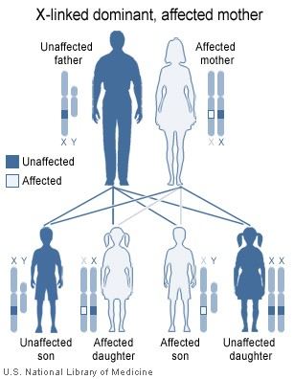
X-linked Dominant

Slide 38
Are you colorblind??

Slide 39
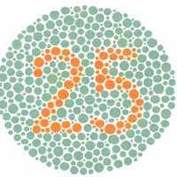
What do you see?
Answer: 25

Slide 40
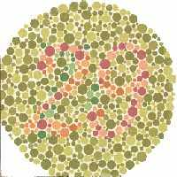
What do you see?
Answer: 29

Slide 41
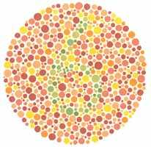
What do you see?
Answer: 32
Just kidding – the answer is 6

Slide 42
Punnett Squares for the sex-linked trait hemophilia
Cross a heterozygous (carrier) female for hemophilia with a normal male:
X^{N}X^{n} x X^{N}Y
N = Normal
n = hemophilia
X^{N}
X^{n}
X^{N}
X^{N}
X^{N}
X^{N}
X^{n}
Girl - Normal
Girl – Normal/carrier
X^{n}
Y
Y
X^{N}
Y
Boy - Normal
Boy - Hemophilia

Slide 43
Colorblindness is inherited as a sex-linked recessive disease. An affected male marries a heterozygous female. Draw a Punnett square of the possible offspring. What is the chance that they will have an affected child? Could any of their daughters be affected?
You try!

Slide 44
Colorblindness is inherited as a sex-linked recessive disease. An affected male marries a heterozygous female. Draw a Punnett square of the possible offspring. What is the chance that they will have an affected child? Could any of their daughters be affected?
50%
50%
Yes – homozygous recessive
X^{B}
X^{b}
Daughter - hetero
Daughter – homo/rec
X^{b}
X^{B}
X^{b}
X^{b}
X^{b}
Colorblind
NORMAL -carrier
Son - hetero
Son – homo/rec
Y
X^{B}
Y
X^{b}
Y
NORMAL
Colorblind

Slide 45
A certain form of muscular dystrophy is inherited as a sex-linked, recessive gene. Jack has muscular dystrophy. Jane, Jack’s wife, is a carrier for muscular dystrophy. What fraction of their daughters would you expect to have muscular dystrophy? Sons?
CARRIER = Heterozygous = “carries” the allele without having the disorder.
X^{D}
X^{d}
Daughter - hetero
Daughter – homo/rec
X^{D}
X^{d}
X^{d}
X^{d}
X^{d}
NORMAL
Muscular dystrophy
Son – hetero
Son – homo/rec
Y
X^{D}
Y
X^{d}
Y
NORMAL
Muscular dystrophy

Slide 46
Sex-Linked Practice Problems
A father with hemophilia (recessive) crossed with a normal mother.
A carrier mother for colorblindness crossed with a colorblind father.

Slide 47
A normal father crossed with a mother that is a carrier for muscular dystrophy.
A father with hemophilia crossed with a normal mother.
If you write out
these problems (1-4)
and get them right,
I will offer a
free HW pass!

Slide 48
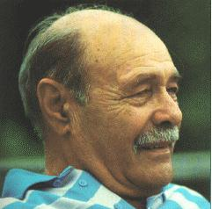
Sex-Influenced Traits
Trait expressed differently in males and females
Not X-linked
Ex: Male-pattern baldness
BB – full hair
bb – bald
Bb – hair for girl, bald for guy

Slide 49
External factors?

Slide 50
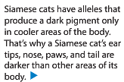
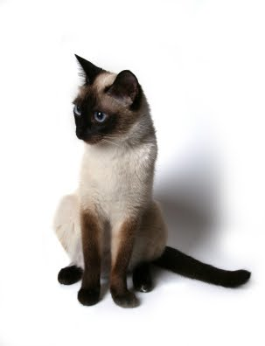
External factors?

Slide 51
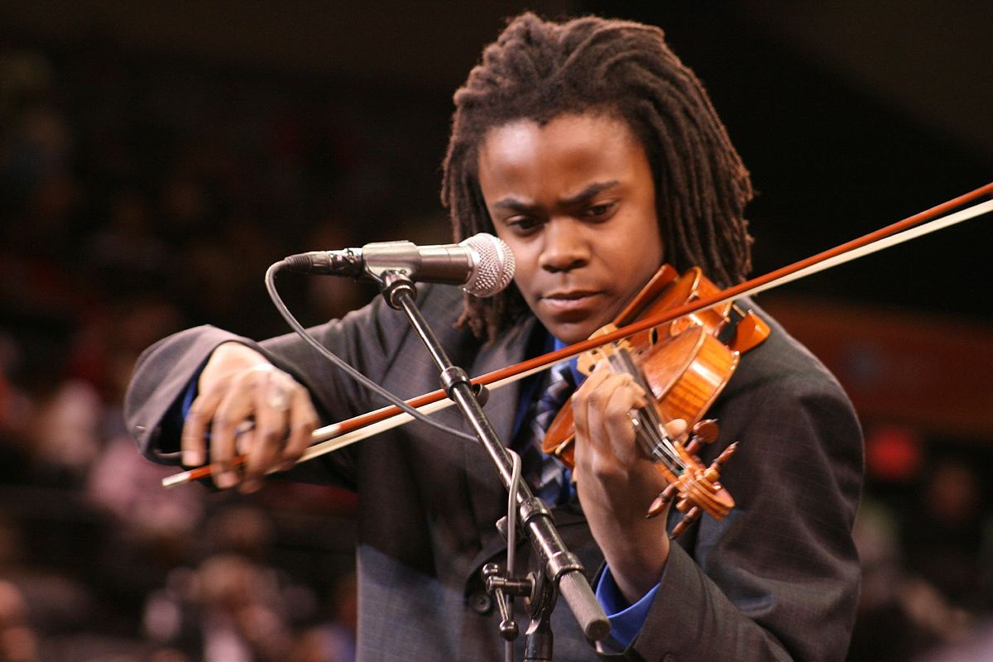
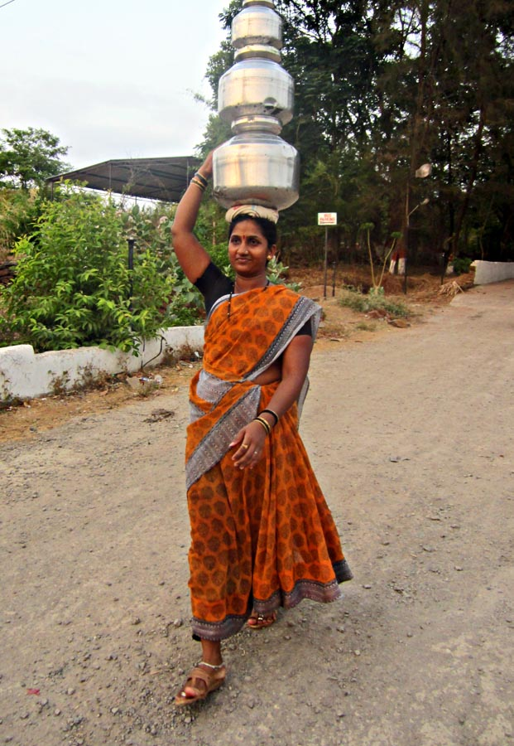
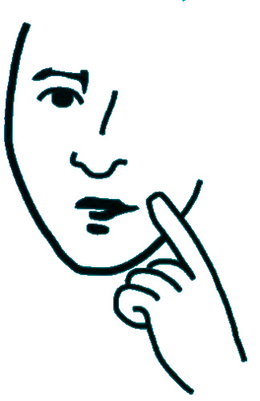
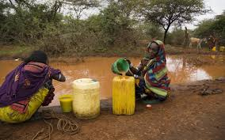
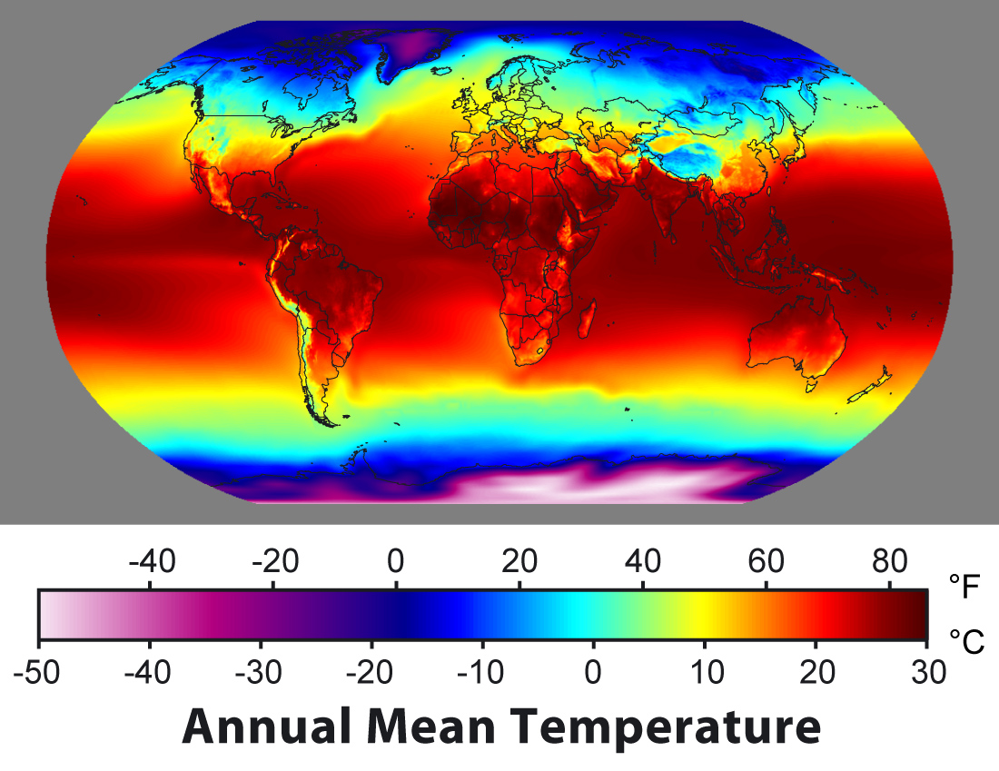
External factors?
Are there external factors that may have influenced human development?

Slide 52
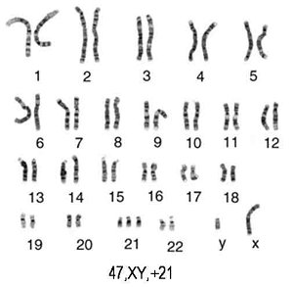

Slide 53
Trisomy 21 = Down Syndrome
Trisomy 18 = Edwards Syndrome
Trisomy 13 = Patau Syndrome

Slide 54
Pedigree Notes
Follow along and fill in your notes.

Slide 55
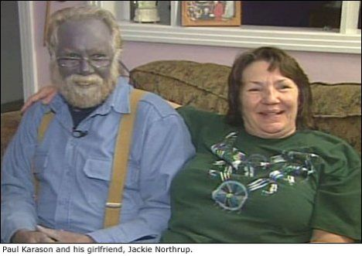
Pedigree – chart to show relationships AND track genetic traits.
Notes:
Please note that Paul Karason is NOT suffering from methemoglobinemia – he turned himself blue by drinking a silver solution. It makes a good attention getting picture for the “Blue People of Kentucky” which IS the genetic disorder methemoglobinemia.

Slide 56
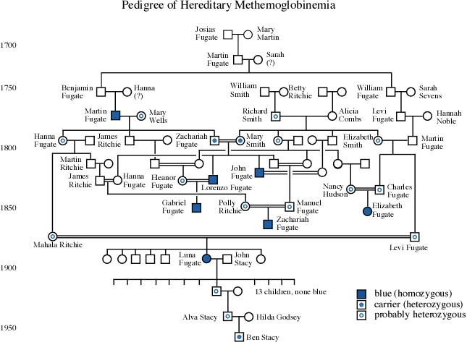

Slide 57
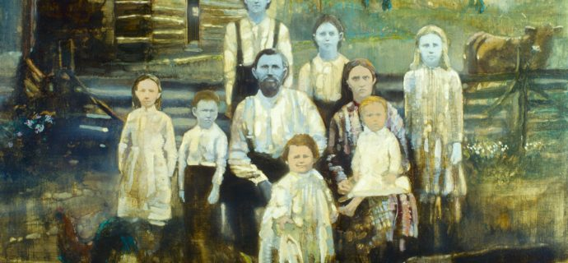
The Blue People of Kentucky – the Fugates
Methemoglobinemia

Slide 59
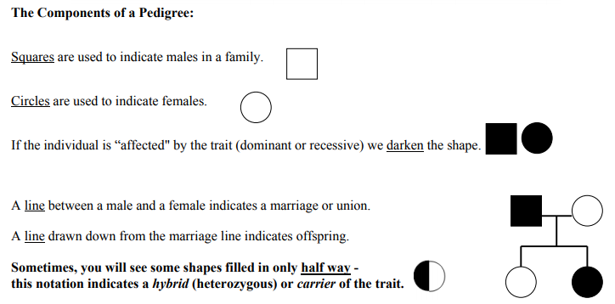

Slide 60
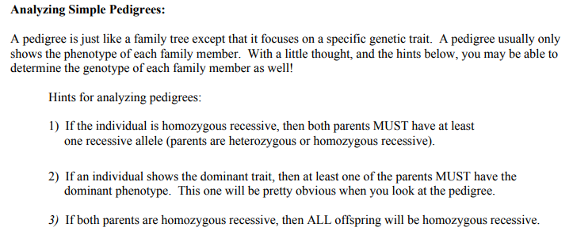
ff
Ff
ff
Ff
ff
Ff

Slide 61
ff
ff
ff
ff
ff
ff

Slide 62
NOTE:
In a pedigree, the trait of interest can be dominant or recessive. The majority of harmful genetic conditions are only seen when an individual is homozygous recessive – examples of conditions caused by recessive alleles include Cystic Fibrosis (a disease of the secretory glands, including those that make mucus and sweat), Falconi anemia (a blood disorder), and albinism (a lack of pigmentation).
Some genetic conditions are caused by dominant alleles (and may therefore be expressed in HOMOZYGOUS DOMINANT or HETEROZYGOUS individuals). For example, achondaplasia (dwarfism).
Cystic Fibrosis
Dwarfism
ff
GG
Gg

Slide 63
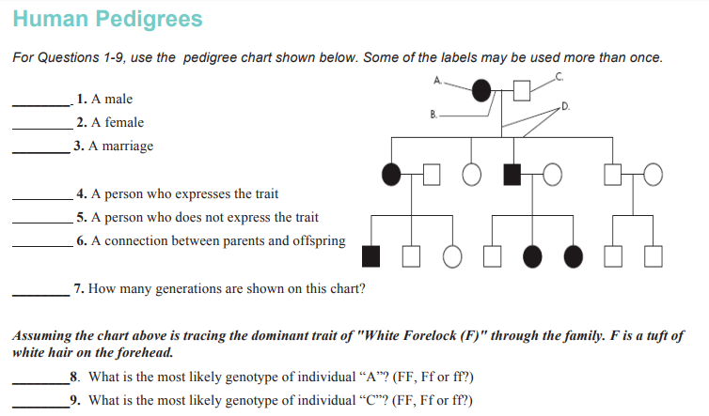
C
A
B
A
C
D
3
Ff
ff

Slide 64
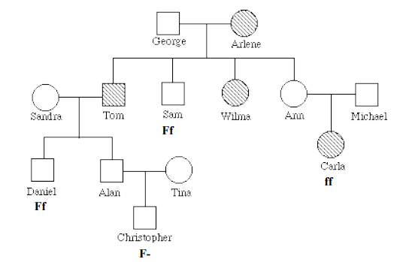

Slide 65
