Slide 1
Dec. 17, 2019
You need:
Clean paper (2) / pencil
Snowman Genetics
Warm Up:
Which snowman genetics were NOT following the pattern of COMPLETE DOMINANCE?
I CAN: apply knowledge of Punnett squares to determine genotypes and phenotypes.

Slide 2

Progress reports
NJHS mtg @2:30
Early release / PLC
Chorus concert
Ugly sweater
Holiday Socks
Red for Ed Holiday
Holiday Pajamas
Holiday Hat
WINTER BREAK

Slide 3
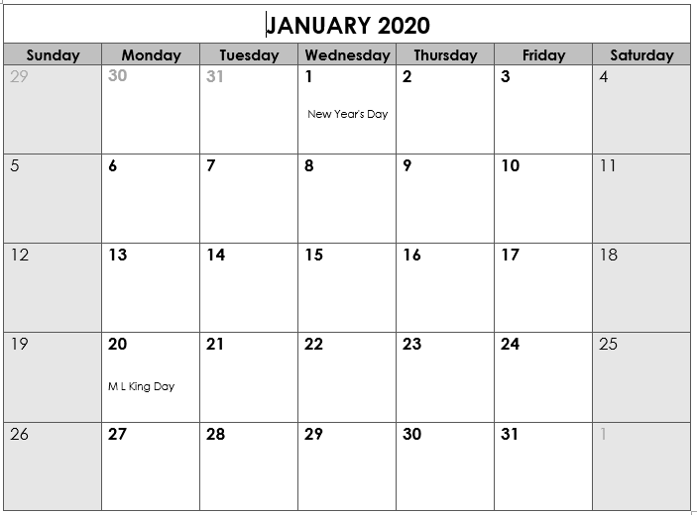
Back to School
“B” day
Benchmark testing in ELA and Math
SWAGbrrr
*End Qtr 2
Teacher Workday
Teacher Workday (Weather?)
School Holiday
SWAGbrrr
SWAGbrrr

Slide 4
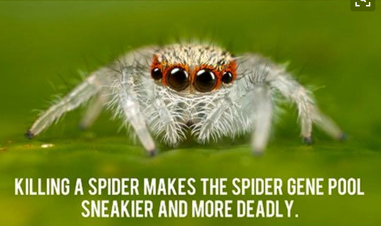

Slide 5
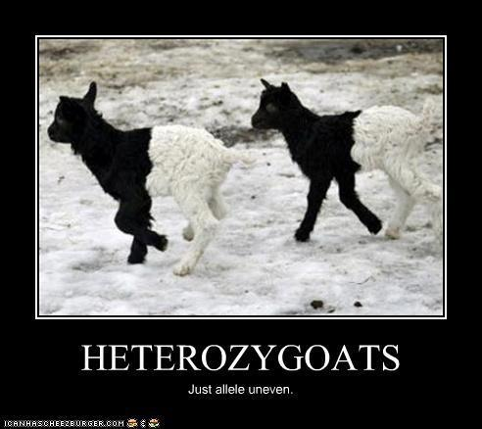

Slide 6
Today’s agenda
Review notes on genetics (double helix)
Snowman PROJECT
Complete vs. Incomplete

Slide 7
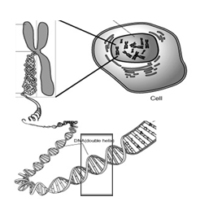
Nucleus
Chromosome
Cell
Gene
DNA

Slide 8
Vocabulary
Chromosomes – DNA wound into cute pkg
Genes – section of DNA/chromosome that codes for a specific trait
Traits – an organism’s physical features
Phenotype – the way something looks on the outside (based on DNA)
Genotype – the genes inside (usually represented with two letters – LL, Ll, ll)

Slide 9
Vocabulary
Dominant allele – the version of a gene that WILL show if present.
Recessive allele – the version of a gene that may get hidden. Only shows if there is nothing to cover it.
HOMOzygous – an organism with two of the SAME alleles for a specific trait.
HETEROzygous – an organism with DIFFERENT alleles for a specific trait.

Slide 10
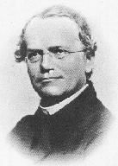
Gregor Mendel
1822-1884
“Father of Genetics”

Slide 11
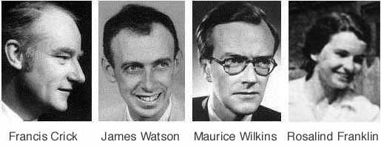

Nobel Prize 1962
1920-1958

Slide 12
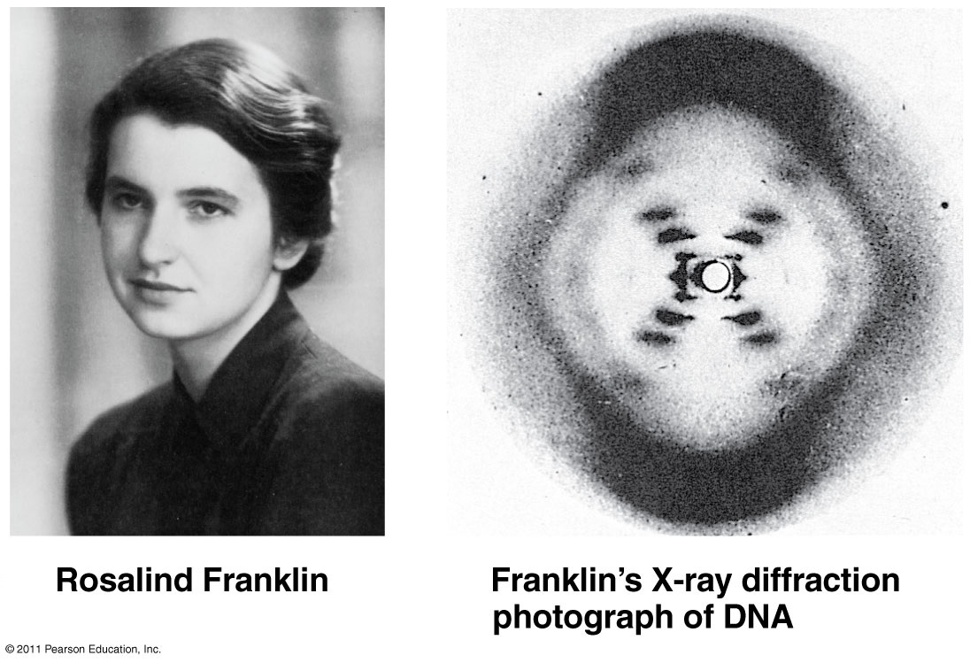

Slide 13
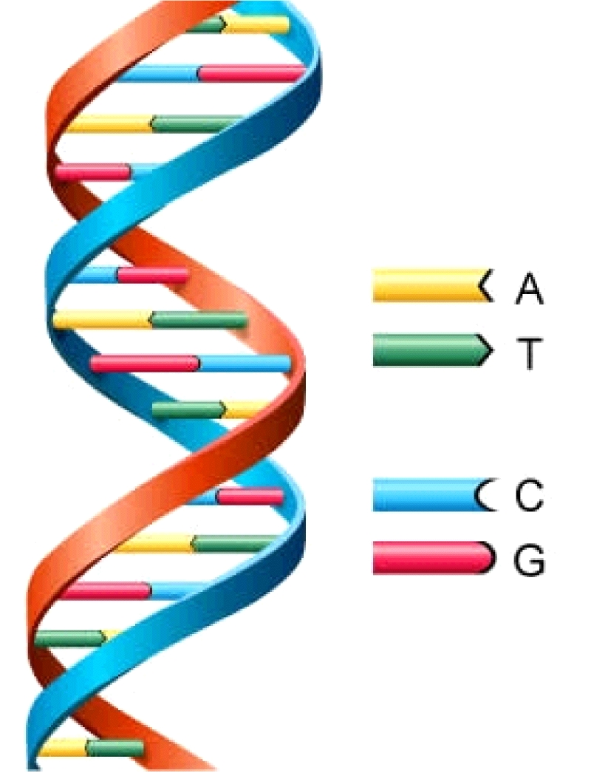
DNA
Deoxyribonucleic Acid
Double Helix (twisted ladder) shape

Slide 14
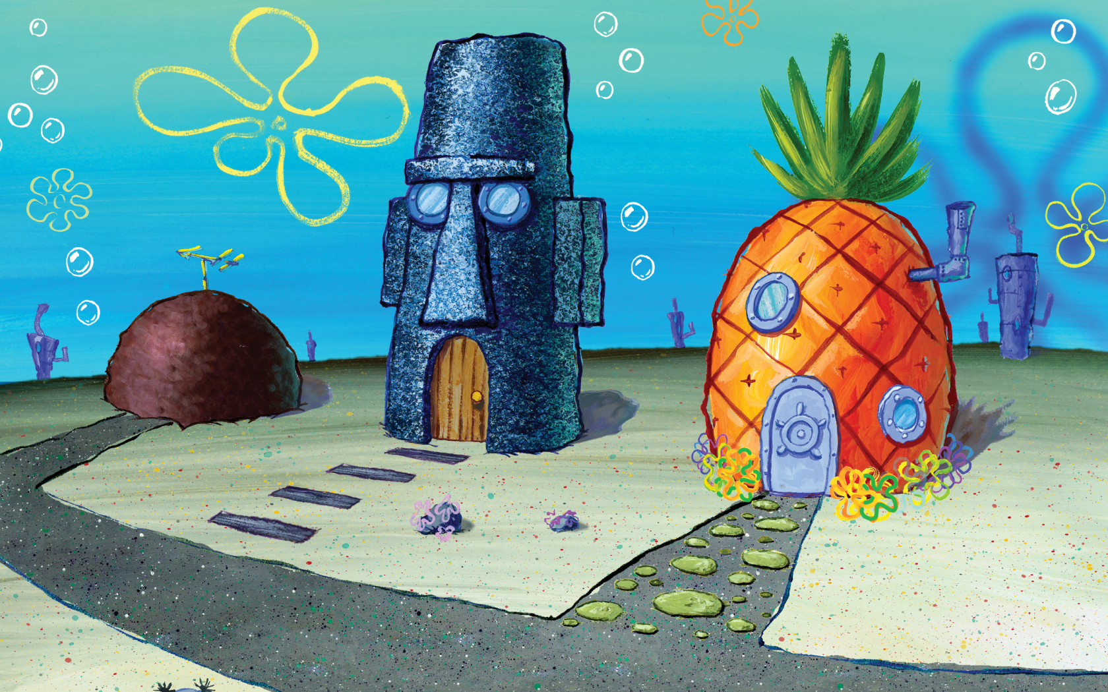

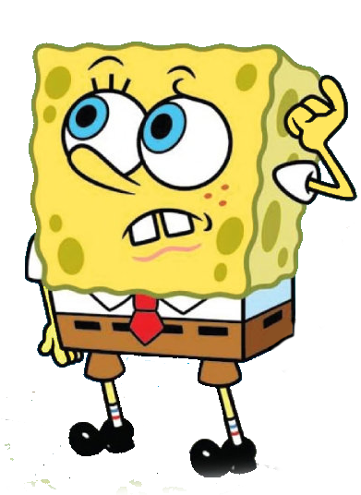
More practice problems…
Bikini Bottom Genetics!

Slide 15
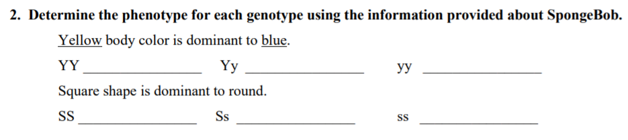

SpongeBob
YELLOW
YELLOW
blue
PHENO-type = the way it looks on the outside (based on genetics)
GENO-type = the genes on the inside

Slide 16
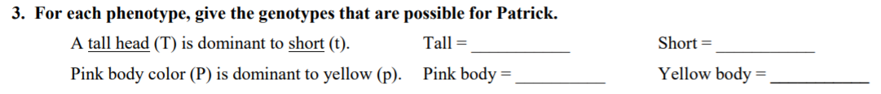

SpongeBob
TT
or Tt
Wait, so SpongeBob said
“GENO-type = the genes on the inside”
So I need to tell what genes are possible if they have a tall head?

Slide 17
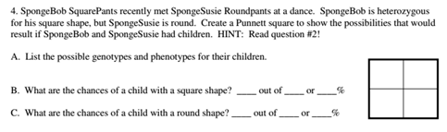

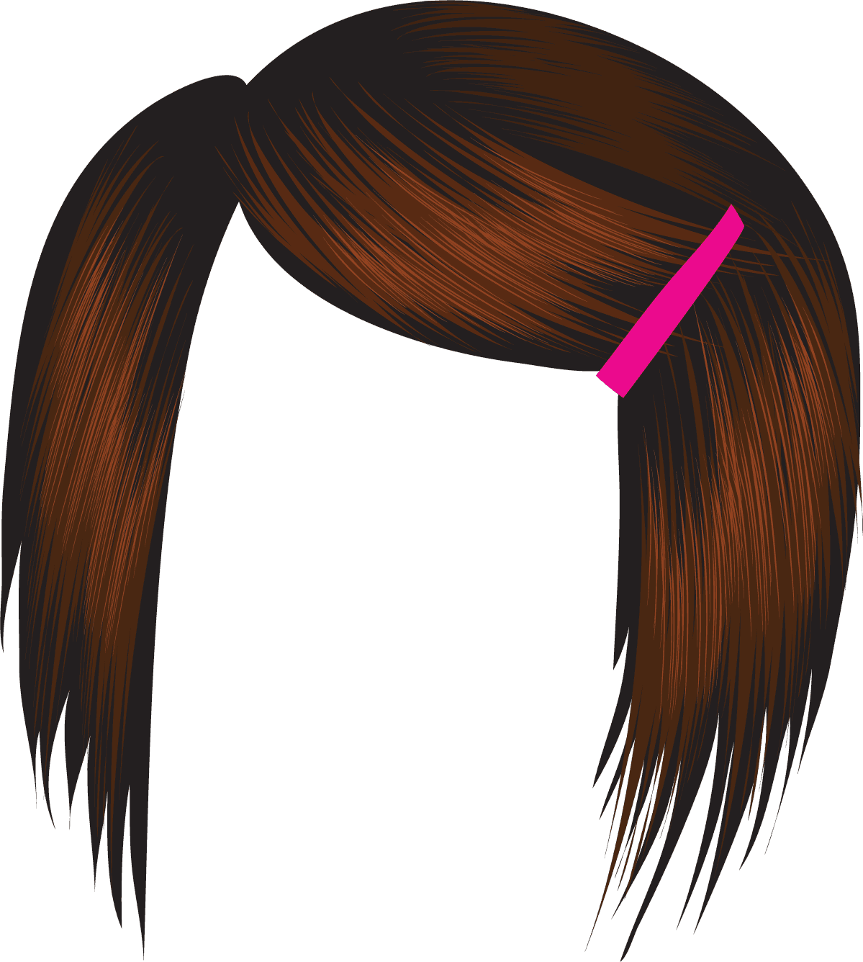
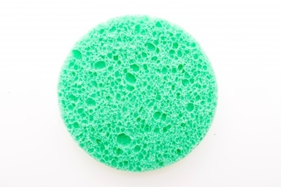
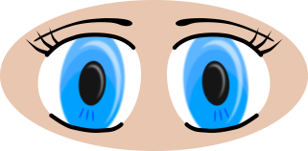

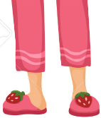
Susie = ss
Bob = Ss

Slide 18
s
S
Bob
Heterozygous
Homozygous
recessive
s
s
s
s
S
Square
Round
Homozygous
recessive
Heterozygous
s
s
s
s
S
Square
Round
Susie

Slide 19
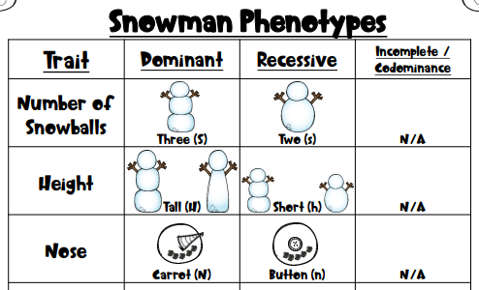

Slide 20
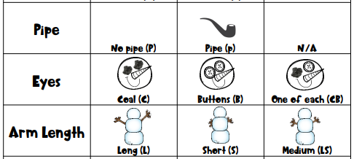

Slide 21
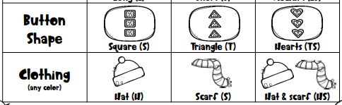
COMPLETE dominance
INcomplete dominance
Snowballs
Height
Nose
pipe
Arm length
Buttons
CO-dominance
Eyes
Clothing

Slide 22
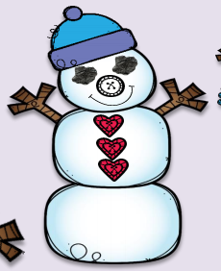

Slide 23
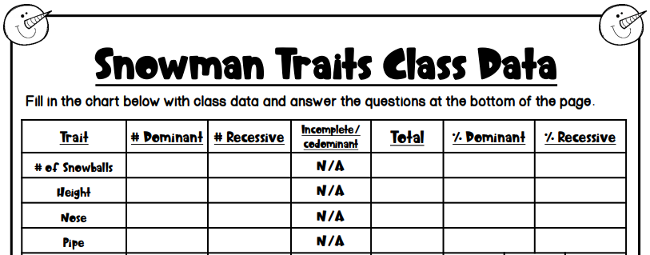

Slide 24
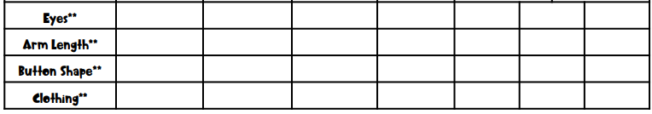

Slide 25
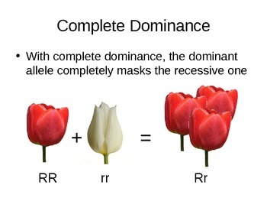
Complete Dominance = ONE WINNER

Slide 26
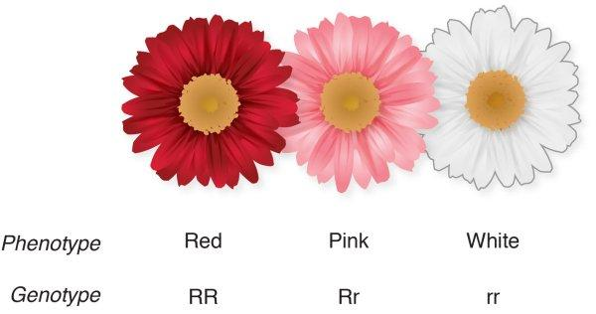
Incomplete Dominance = Blending

Slide 27
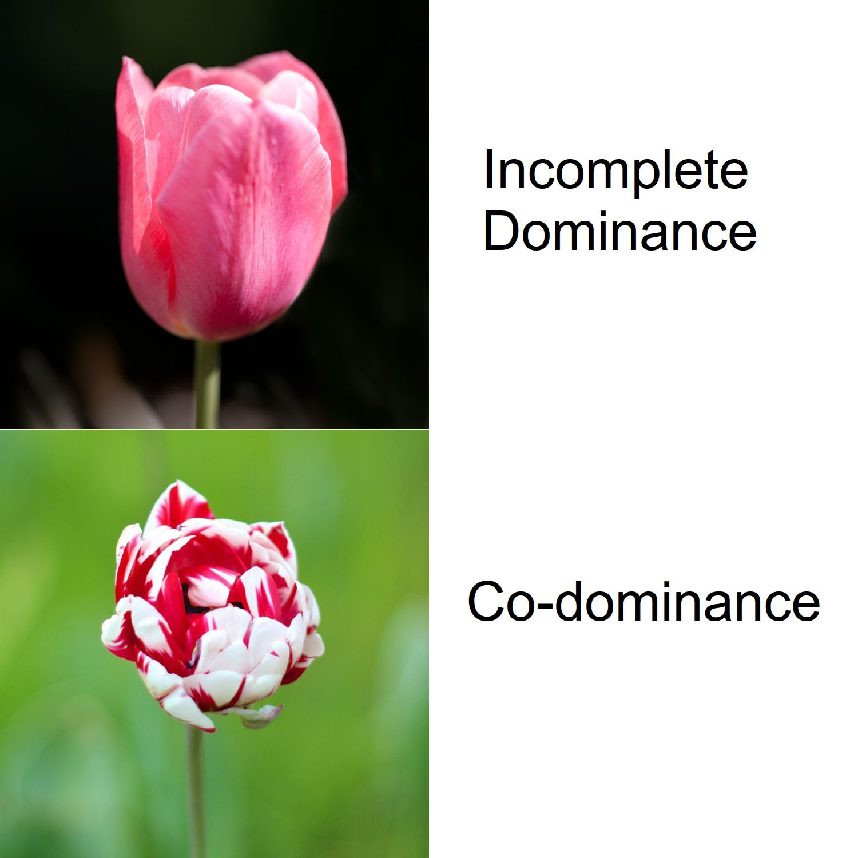

Slide 28
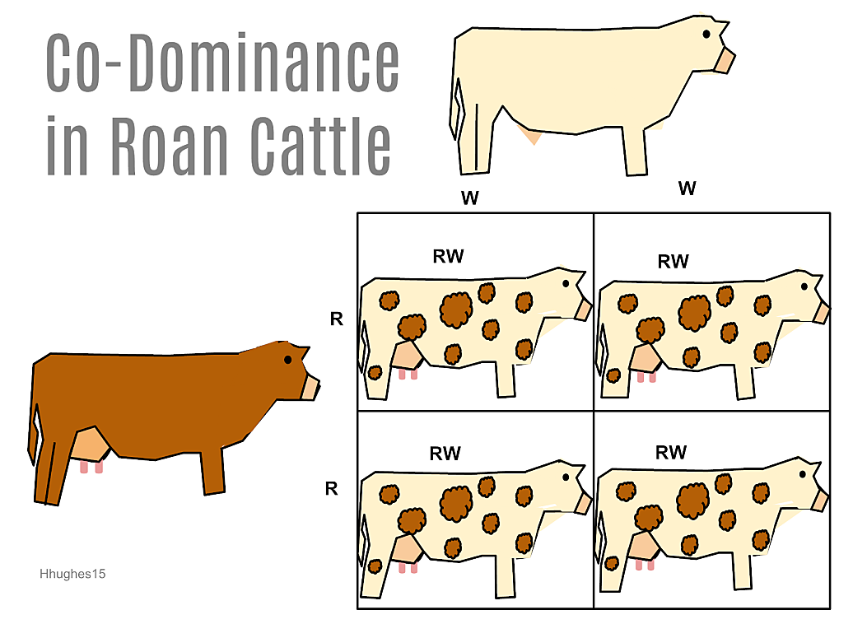
CoDominance = both show

Slide 29
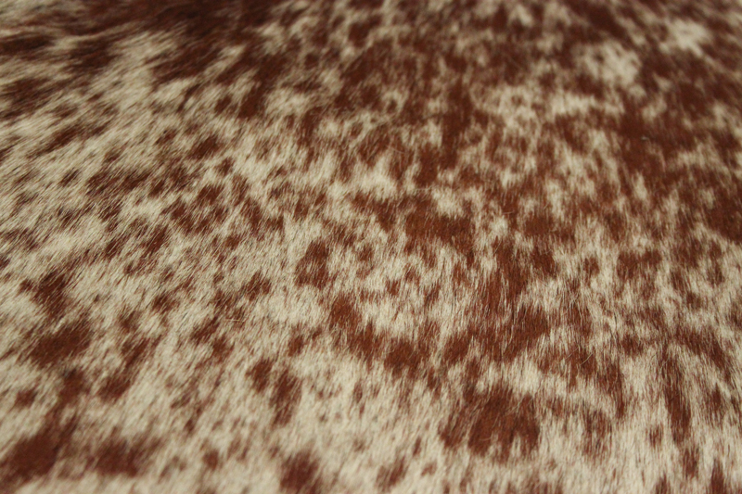
CoDominance = both show
ROAN

Slide 30
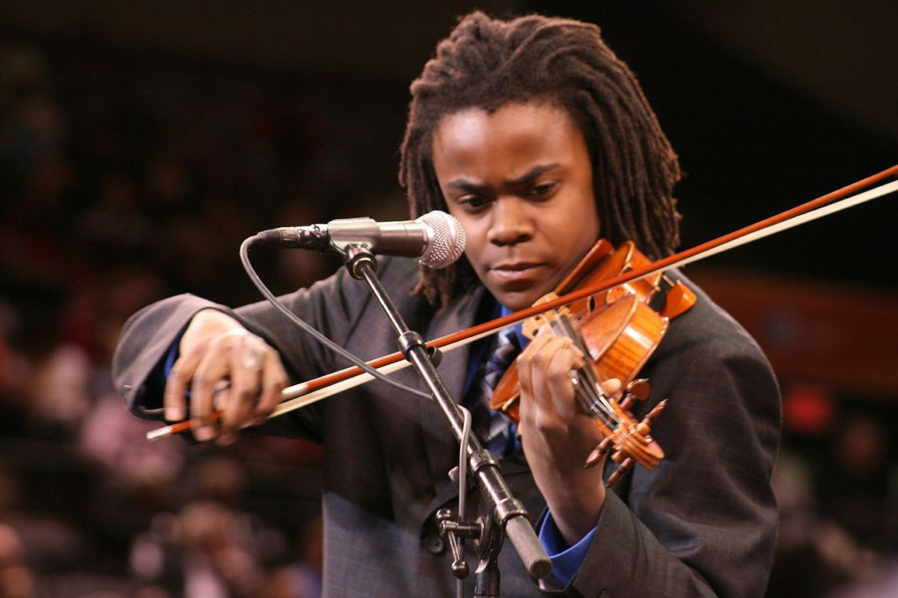
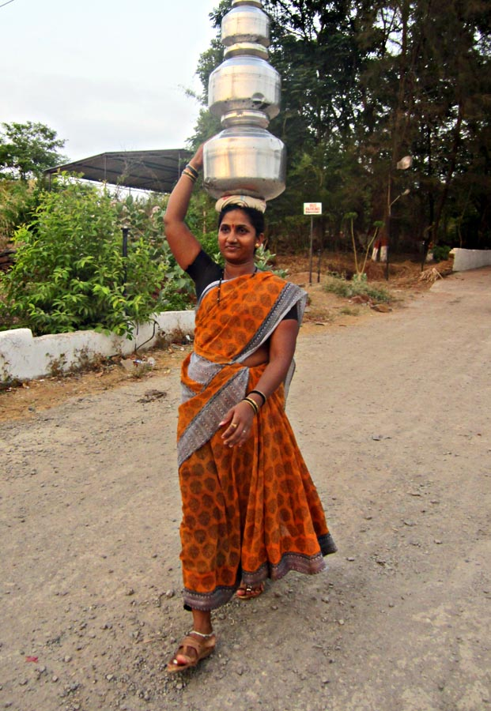


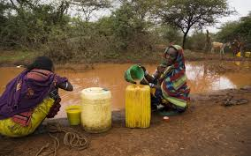
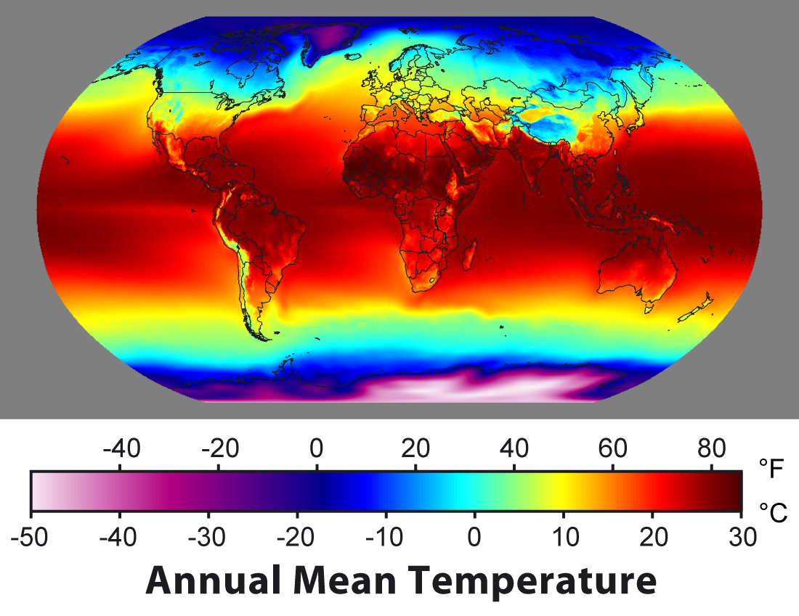
External factors?
Are there external factors that may have influenced human development?

Slide 31


External factors?

Slide 32
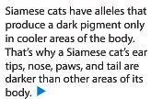
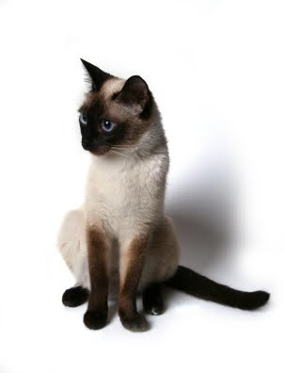
External factors?

Slide 33
Bikini Bottom – CoDominance vs. Incomplete Dominance

Slide 34
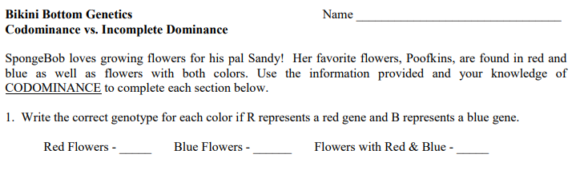
RR
BB
BR
RB
How do you know if we should follow the rules of complete dominance, codominance, or incomplete dominance?
Short answer? – you don’t. But the teacher or the question should specify!

Slide 35
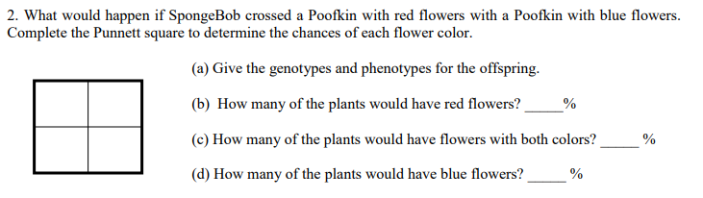
R
R
B
BR
BR
B
BR
BR
Red = RR
Blue = BB
Red & Blue = RB
Now that we have done #1 and #2 together, try to do #3 and #4 on your own. Remember, you are following the rule of co-dominance.

Slide 36
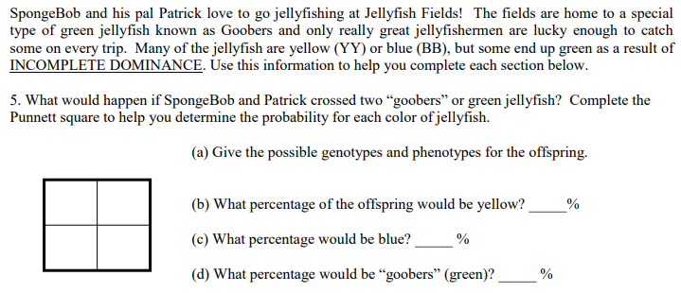
Y
B
B
BY
BY
0
Y
0
BY
BY
100
Remember, incomplete dominance is the same as blending. So, yellow and blue would blend to make green…a “goober” jellyfish.
YY = Yellow
BB = Blue
So, green would have to be BY or YB.

Slide 37
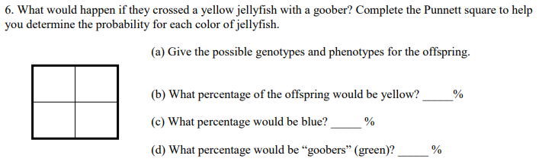
Again – be reminded that we are now dealing with INCOMPLETE dominance – which is BLENDING. Use that information to try 6, 7, and 8 – on your own.

Slide 38
Inheriting a
Genetic Disorder

Slide 39
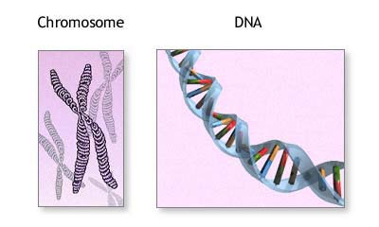
What are genetic disorders?
A genetic disorder is an abnormal condition that a person inherits through their genes or chromosomes.

Slide 40
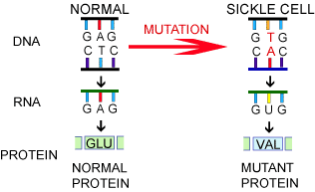
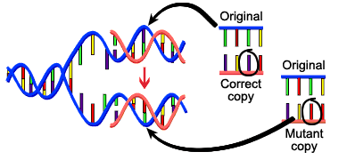
What are genetic disorders?
Some are caused by mutations in DNA.
For example, sickle cell disease which you learned about yesterday!

Slide 41
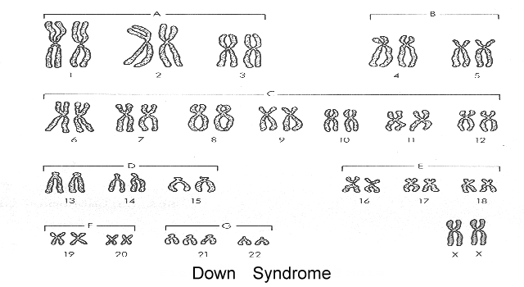
What are genetic disorders?
This is a picture of ALL your chromosomes called a “karyotype”.
Others are caused by bigger changes in the chromosome.
For example, having too many chromosomes – Down Syndrome.

Slide 42
Cystic Fibrosis
Let’s take a closer look at a genetic disorder called Cystic Fibrosis.

Slide 43

How do you get a genetic disorder?
Genetic disorders like Cystic Fibrosis are NOT contagious! You can’t catch them from someone else who is sick!
You inherit them from your parents.
How do you know which children are at risk for inheriting Cystic Fibrosis?

Slide 44
Who is affected by Cystic Fibrosis?
Overall, the probability (% chance) of inheriting CF if BOTH parents are carriers is 25% (1 in 4).

Slide 45
Can Cystic Fibrosis be cured?
People hope that gene therapy can one day provide a cure for genetic disorders like cystic fibrosis.
Gene Therapy - involves removing the mutated gene and replacing it with a healthy gene.

Slide 46
Pedigree Notes
Follow along and fill in your notes.

Slide 47
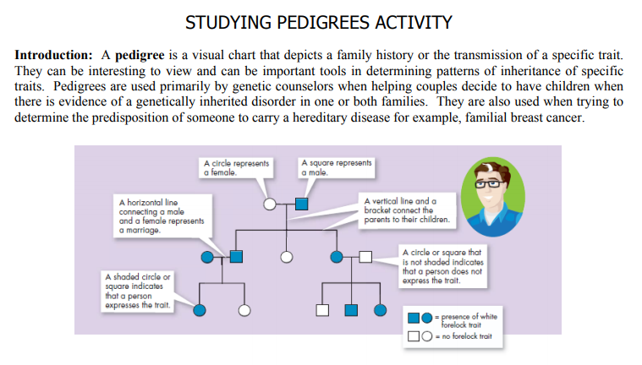

Slide 48
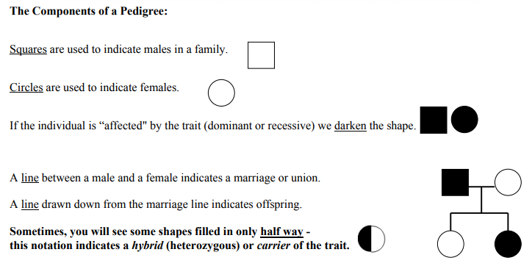

Slide 49
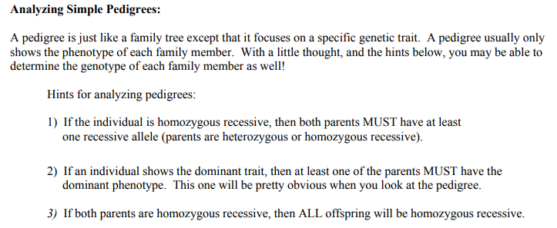
ff
Ff
ff
Ff
ff
Ff

Slide 50
NOTE:
In a pedigree, the trait of interest can be dominant or recessive. The majority of harmful genetic conditions are only seen when an individual is homozygous recessive – examples of conditions caused by recessive alleles include Cystic Fibrosis (a disease of the secretory glands, including those that make mucus and sweat), Falconi anemia (a blood disorder), and albinism (a lack of pigmentation).
Some genetic conditions are caused by dominant alleles (and may therefore be expressed in HOMOZYGOUS DOMINANT or HETEROZYGOUS individuals). For example, achondaplasia (dwarfism).
Cystic Fibrosis
Dwarfism
ff
GG
Gg

Slide 51
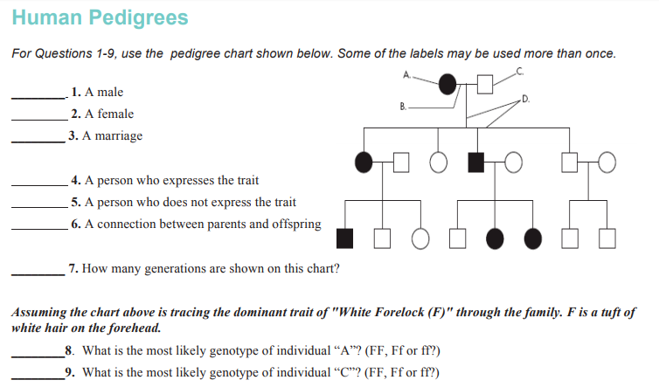

Slide 52
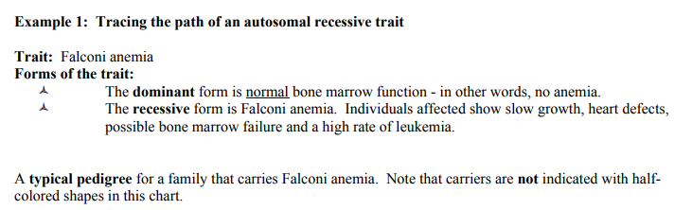
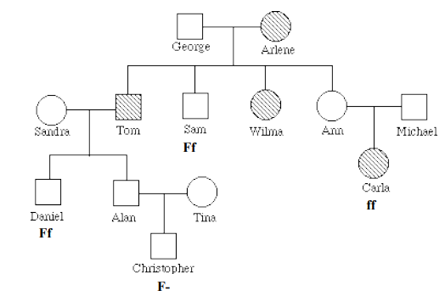

Slide 53
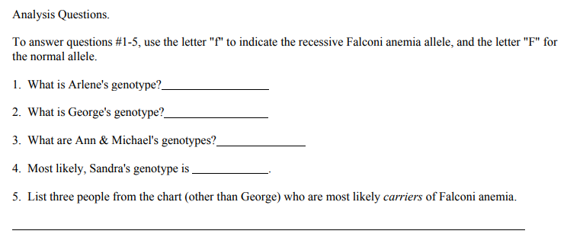

Slide 54
Remember, test Friday (11/2) – and we still have to learn about sex-linked traits.

