Slide 1
Dec. 12, 2019
You need:
Clean paper (2) / pencil
Bikini Bottom Genetics TWO!!
Warm Up:
Draw out a Punnett square showing the cross of #8 on your Bikini Bottom TWO homework.
I CAN: apply knowledge of Punnett squares to determine genotypes and phenotypes.

Slide 2
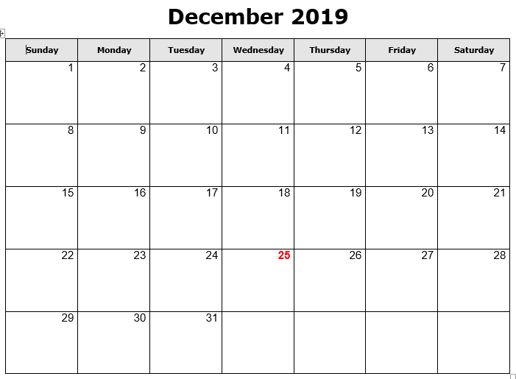
Progress reports
NJHS mtg @2:30
Early release / PLC
Chorus concert
Ugly sweater
Holiday Socks
Red for Ed Holiday
Holiday Pajamas
Holiday Hat
WINTER BREAK

Slide 3
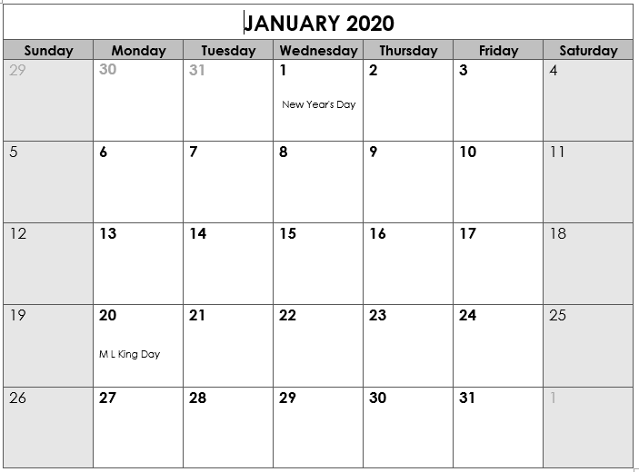
Back to School
“B” day
Benchmark testing in ELA and Math
SWAGbrrr
*End Qtr 2
Teacher Workday
Teacher Workday (Weather?)
School Holiday
SWAGbrrr
SWAGbrrr

Slide 4
Today’s agenda
Review notes on genetics (double helix)
Return/review Vocabulary Quiz
Test grade on Bikini Bottom 2
Snowman PROJECT
Complete vs. Incomplete

Slide 5
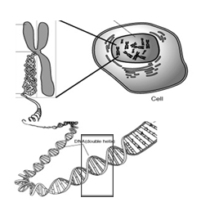
Nucleus
Chromosome
Cell
Gene
DNA

Slide 6
Vocabulary
Chromosomes – DNA wound into cute pkg
Genes – section of DNA/chromosome that codes for a specific trait
Traits – an organism’s physical features
Phenotype – the way something looks on the outside (based on DNA)
Genotype – the genes inside (usually represented with two letters – LL, Ll, ll)

Slide 7
Vocabulary
Dominant allele – the version of a gene that WILL show if present.
Recessive allele – the version of a gene that may get hidden. Only shows if there is nothing to cover it.
HOMOzygous – an organism with two of the SAME alleles for a specific trait.
HETEROzygous – an organism with DIFFERENT alleles for a specific trait.

Slide 8
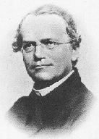
Gregor Mendel
1822-1884
“Father of Genetics”

Slide 9
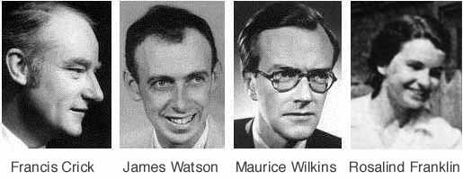

Nobel Prize 1962
1920-1958

Slide 10
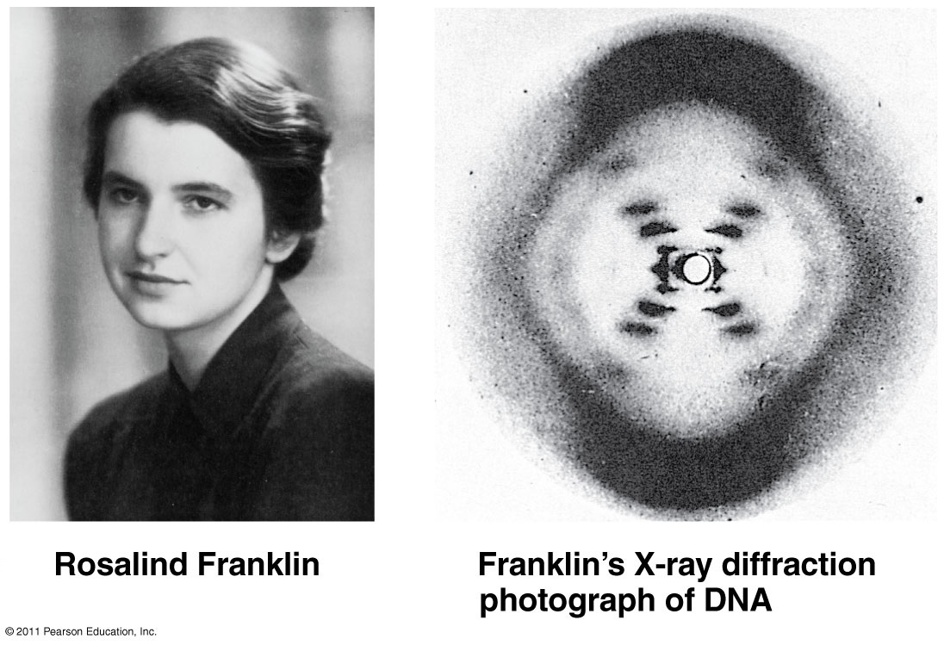

Slide 11
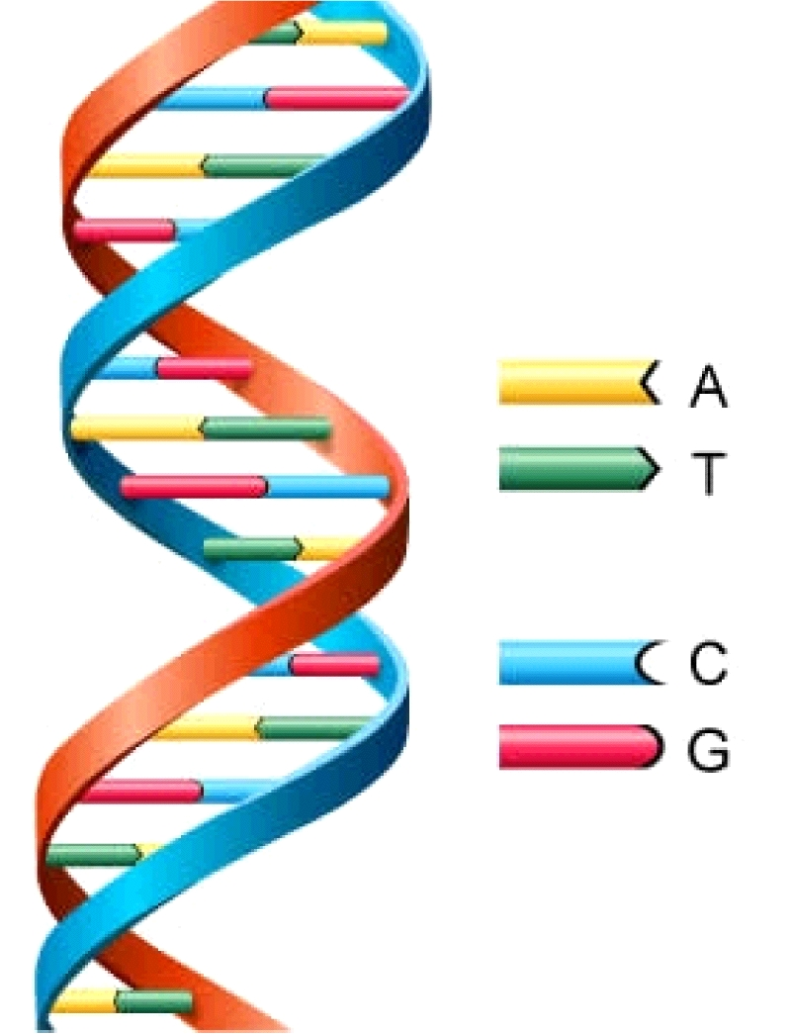
DNA
Deoxyribonucleic Acid
Double Helix (twisted ladder) shape

Slide 12
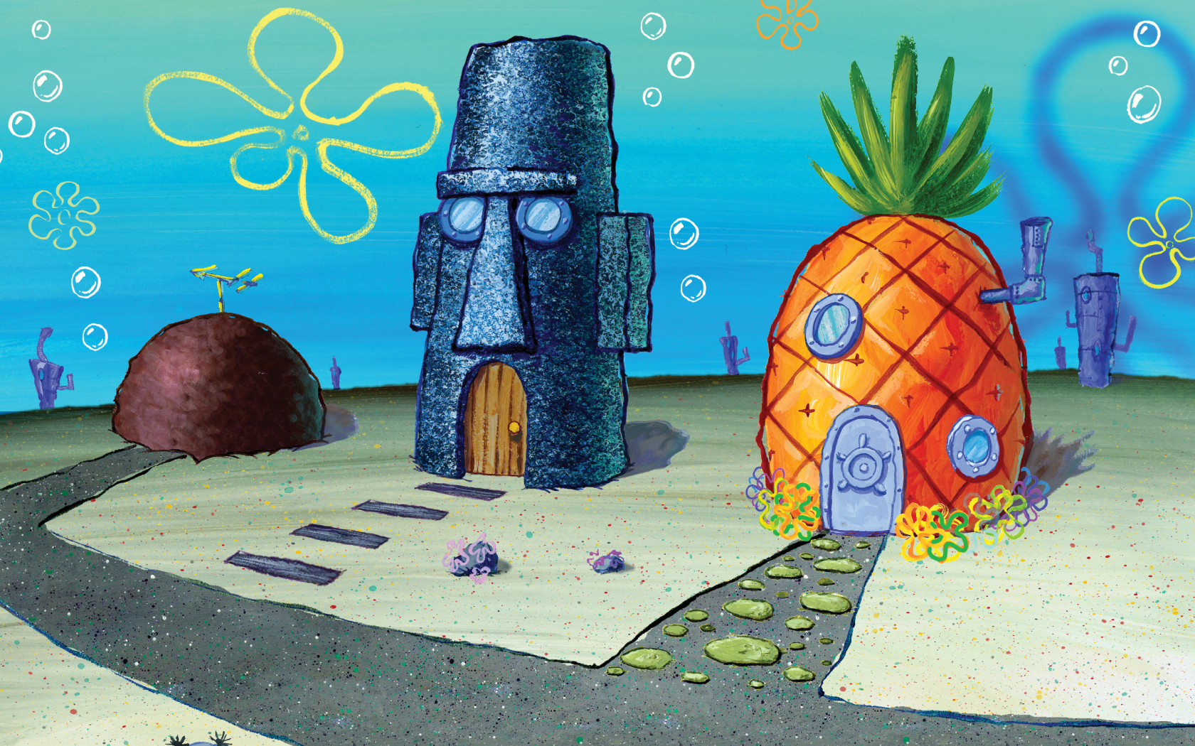
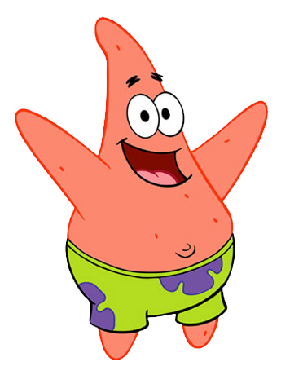
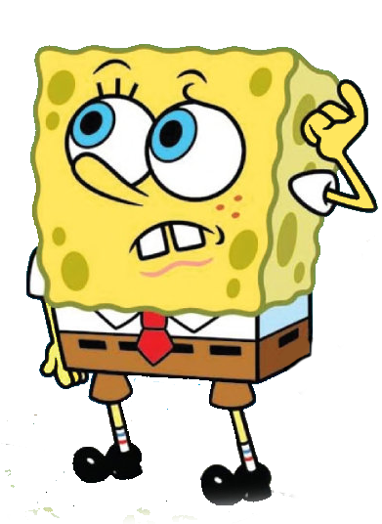
More practice problems…
Bikini Bottom Genetics!

Slide 13
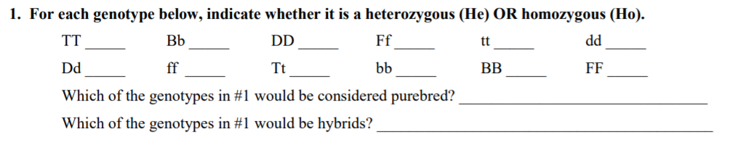
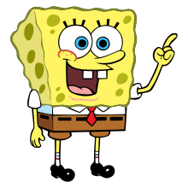
SpongeBob
HOMO-zygous = the letters are the SAME…Big B, Big B
HETERO-zygous = the letters are DIFFERENT…Big B, little b

Slide 14
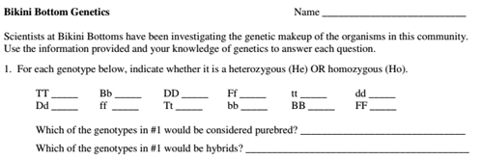

Homo
Hetero
Homo
Hetero
Homo
Homo
Hetero
Homo
Hetero
Homo
Homo
Homo
All Homozygous
All Heterozygous

Slide 15
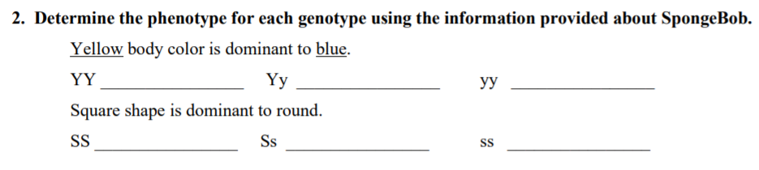
SpongeBob
YELLOW
YELLOW
blue
PHENO-type = the way it looks on the outside (based on genetics)
GENO-type = the genes on the inside

Slide 16
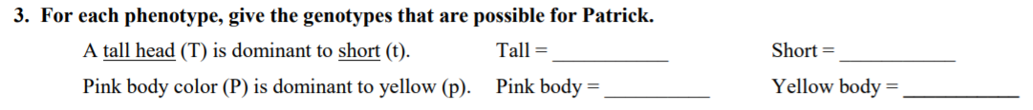
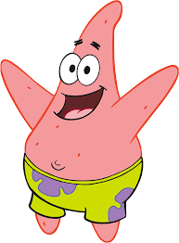
SpongeBob
TT
or Tt
Wait, so SpongeBob said
“GENO-type = the genes on the inside”
So I need to tell what genes are possible if they have a tall head?

Slide 17
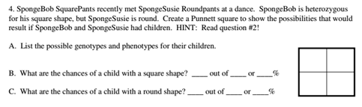
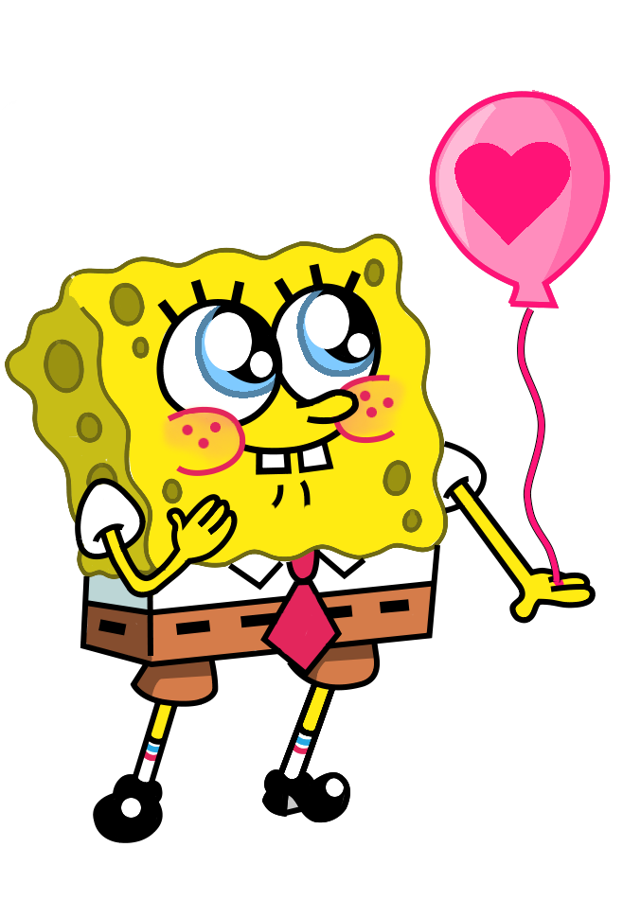
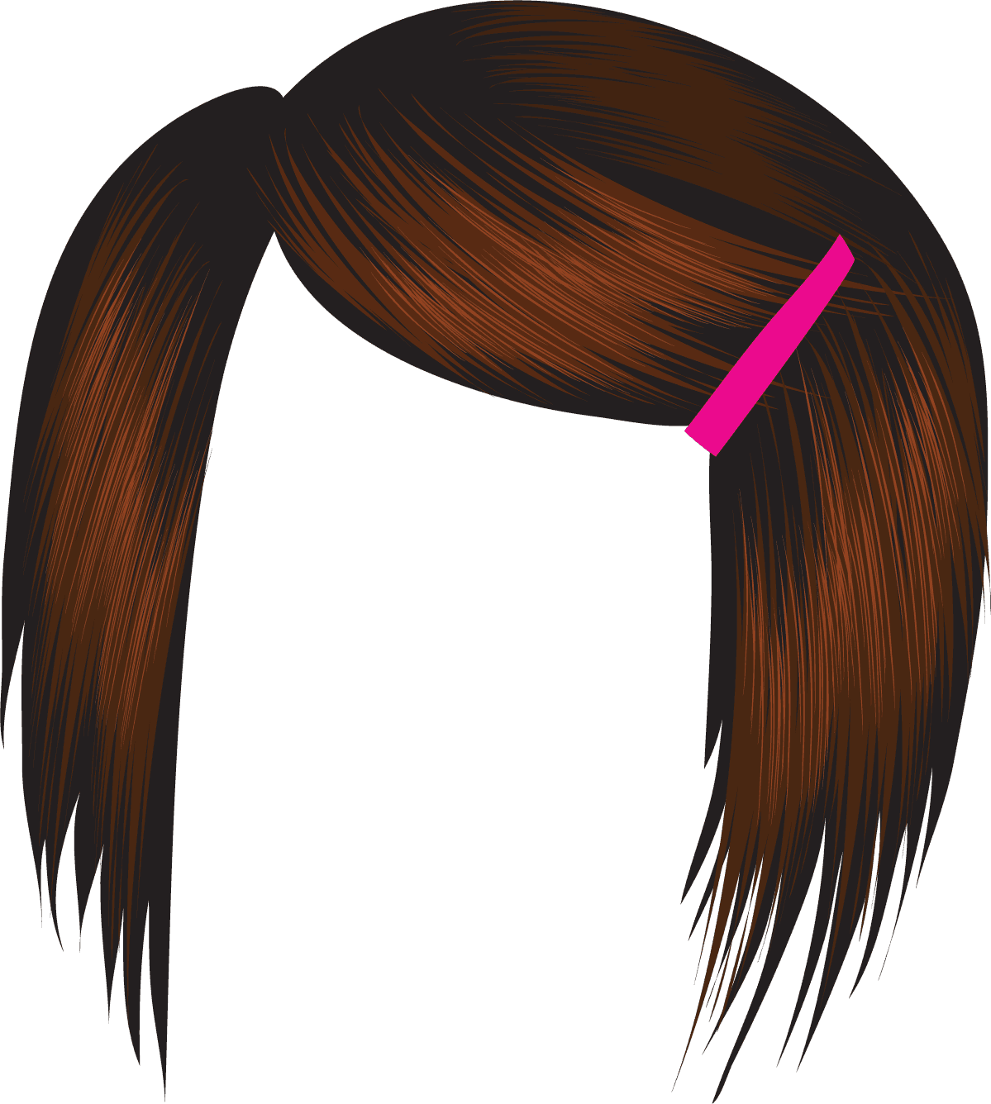
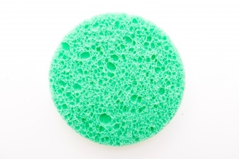
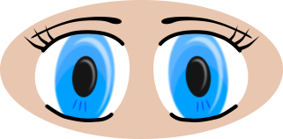

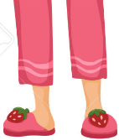
Susie = ss
Bob = Ss

Slide 18
s
S
Bob
Heterozygous
Homozygous
recessive
s
s
s
s
S
Square
Round
Homozygous
recessive
Heterozygous
s
s
s
s
S
Square
Round
Susie

Slide 19
Parent 1
Parent 1: _______
Parent 2: _______
____ = __________
____ = __________
Parent 2

Slide 20
Vocabulary Quiz
Put the letter of the best definition into the circle of each word on the left.
Flip to the back.
Read the definition and write in the correct term.
Find that term in the word search/snowman.
You may turn in when done…and move to Bikini Bottom Genetics 2
Return and Review

Slide 21
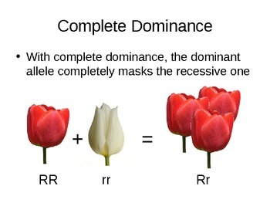
Complete Dominance = ONE WINNER

Slide 22
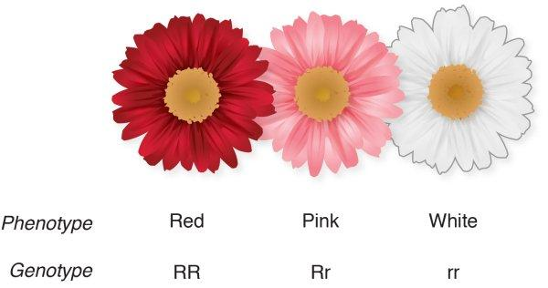
Incomplete Dominance = Blending

Slide 23
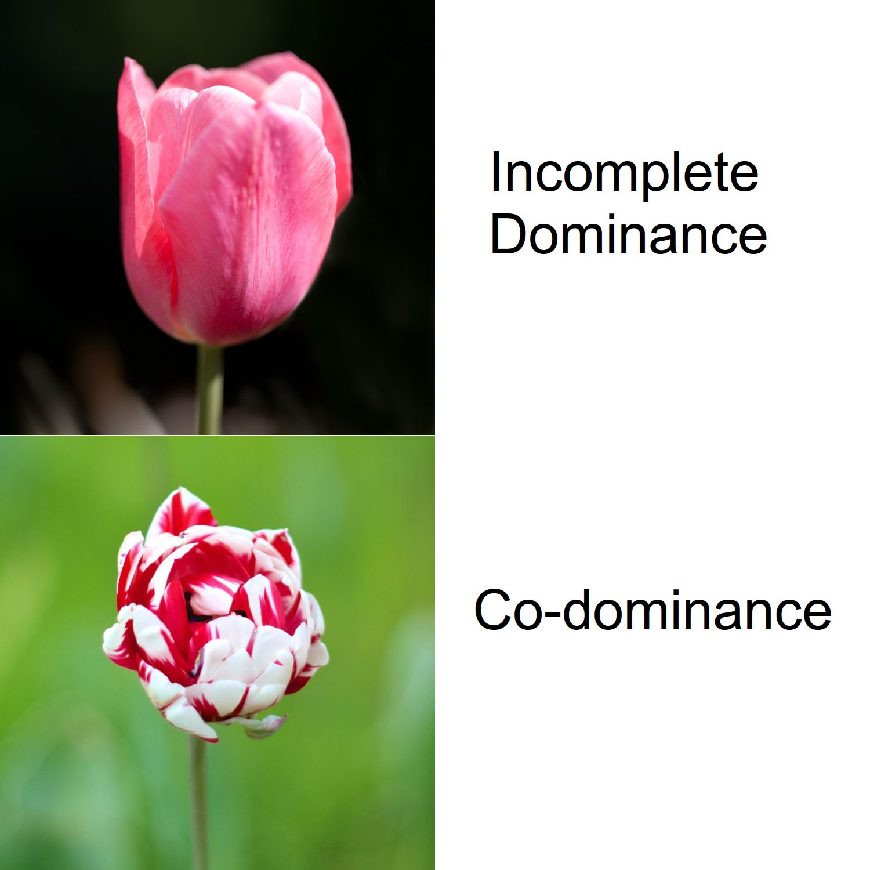

Slide 24
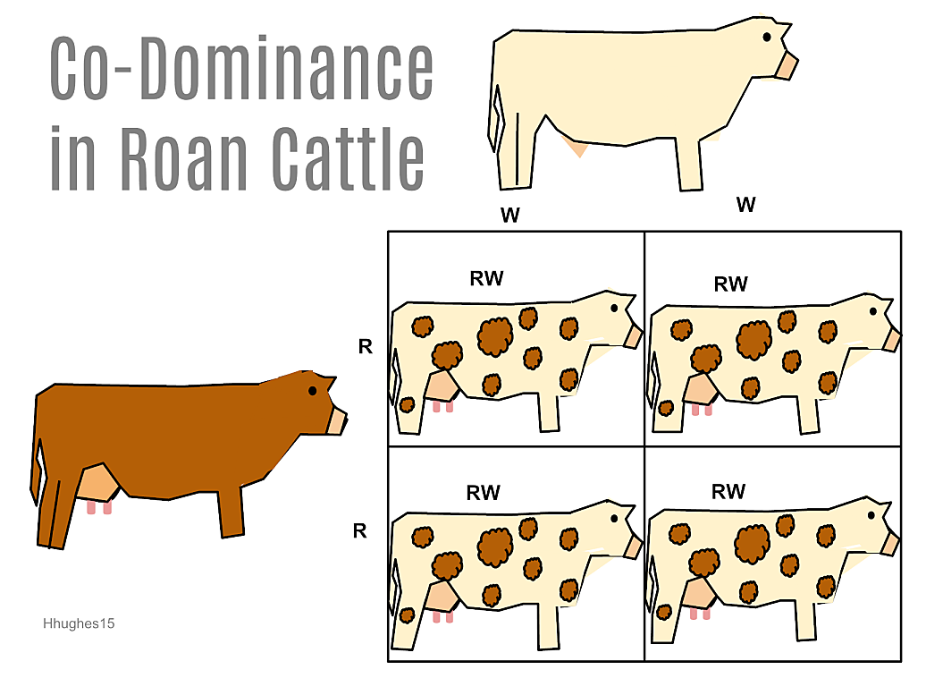
CoDominance = both show

Slide 25
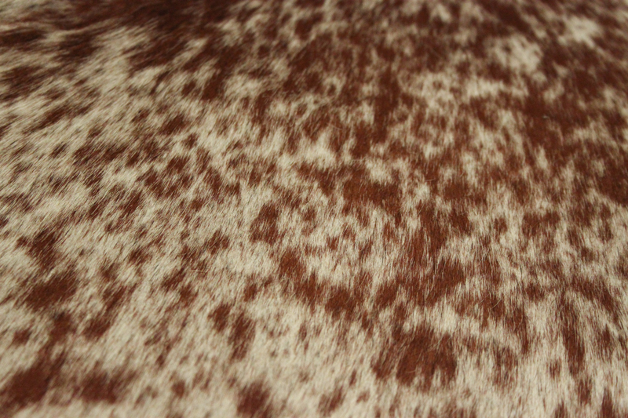
CoDominance = both show
ROAN

Slide 26
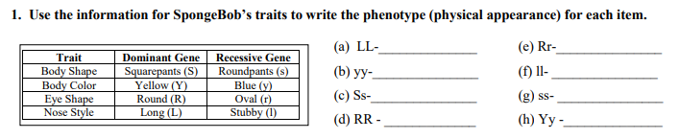
Bikini Bottom Genetics 2

Slide 27
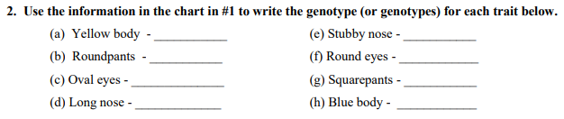
Bikini Bottom Genetics 2

Slide 28

Bikini Bottom Genetics 2

Slide 29
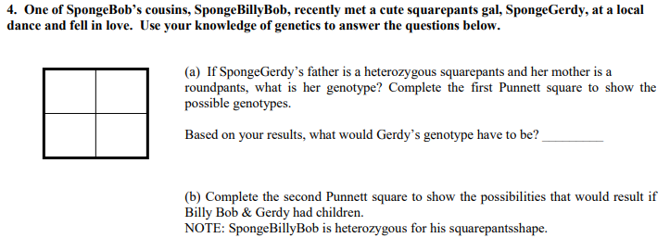
Bikini Bottom Genetics 2

Slide 30
s
S
Dad
Heterozygous
Homozygous
recessive
s
s
s
s
S
Square
Round
Homozygous
recessive
Heterozygous
s
s
s
s
S
Square
Round
Mom

Slide 31
s
S
Homozygous
dominant
Heterozygous
s
S
S
S
S
Square
Square
Homozygous
recessive
Heterozygous
s
s
s
s
S
Square
Round

Slide 32
Bikini Bottom – CoDominance vs. Incomplete Dominance

Slide 33
Snowman Genetics
First – find a partner…any “buddy” but make sure you are working or you’ll have to work alone.
Two – determine who is “Parent 1” and who is “Parent 2” (we aren’t using Mom and Dad – and there’s a reason!)

Slide 34
Snowman Genetics
Each parent will flip a coin to determine alleles for the offspring (2 parents so each offspring must have TWO alleles – one from each parent). If you flip heads, circle the dominant allele. If you flip tails, circle the recessive allele.
Based on the alleles, determine the traits for your snowman.
Draw/color your creation – it will be a PROJECT.

Slide 35
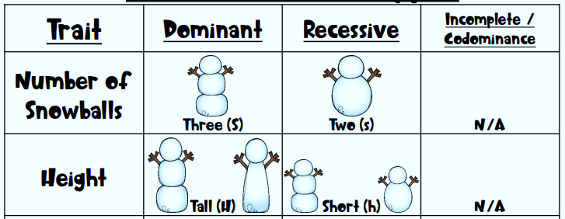


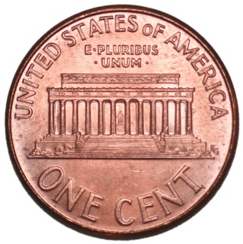
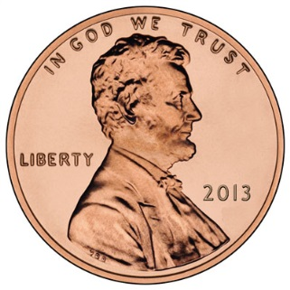
Snowman Genetics
Three – body segments
Flip a coin
Heads = Dominant
Tails = Recessive
Circle what you “flipped” into the Genotype box.
Repeat

Slide 36
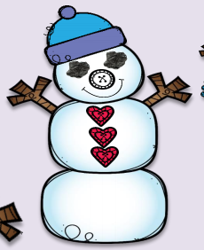

Slide 37
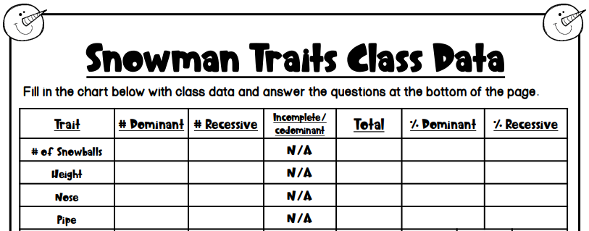

Slide 38
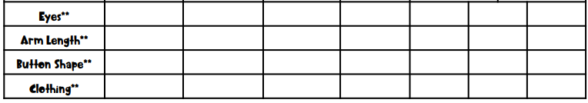

Slide 39
Now – using the genotype you were flipping coins to create, use the known phenotype to create a drawing of your pumpkin / jack o’lantern. Be sure to add color and do your best efforts as this will be a project grade.

Slide 40


External factors?

Slide 41
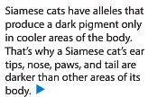
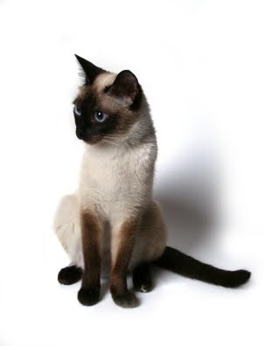
External factors?

Slide 42
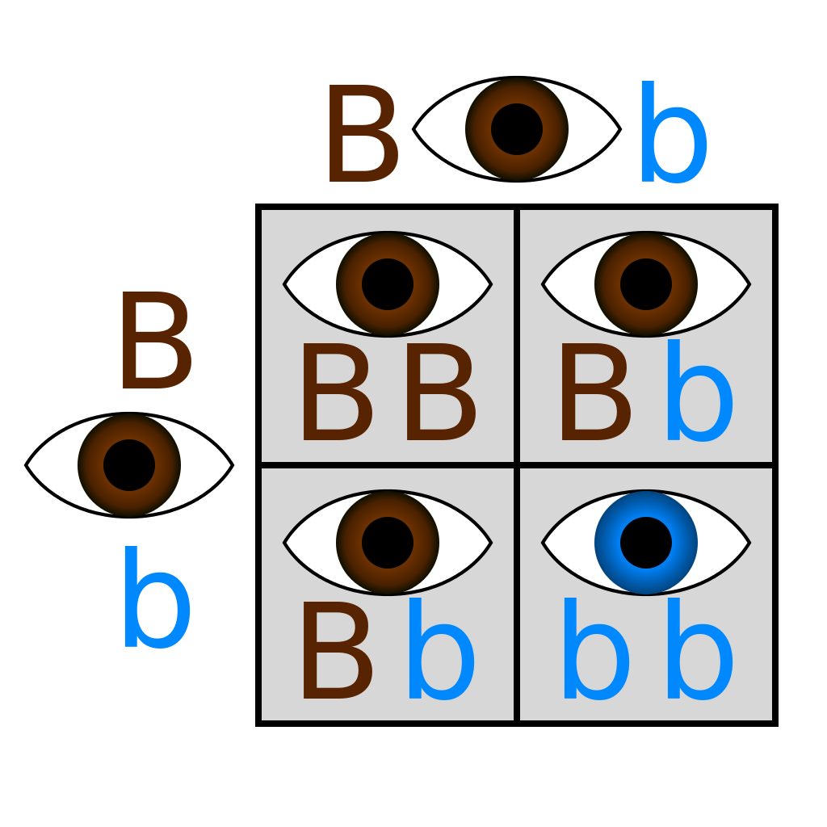
Bikini Bottom –
Dihybrid crosses
Monohybrid = ONE trait…crossed
-Punnett with FOUR boxes

Slide 43
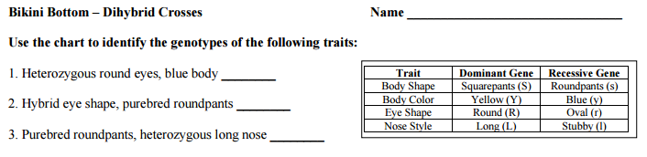
Bikini Bottom-
Dihybrid crosses

Slide 44
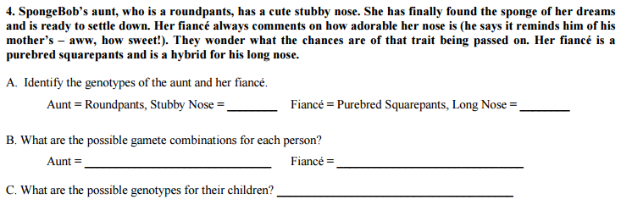
Bikini Bottom-
Dihybrid crosses

Slide 45
Bikini Bottom-
Dihybrid crosses
Dihybrid = TWO traits…crossed
-Punnett with _________________boxes
SIXTEEN

Slide 46
Inheriting a
Genetic Disorder

Slide 47
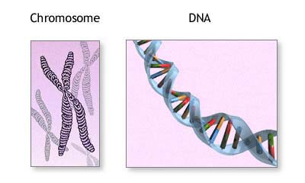
What are genetic disorders?
A genetic disorder is an abnormal condition that a person inherits through their genes or chromosomes.

Slide 48
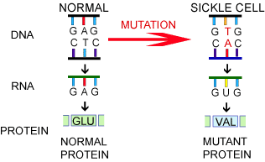
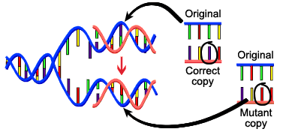
What are genetic disorders?
Some are caused by mutations in DNA.
For example, sickle cell disease which you learned about yesterday!

Slide 49
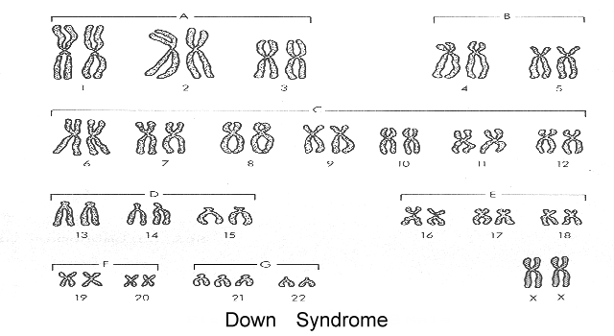
What are genetic disorders?
This is a picture of ALL your chromosomes called a “karyotype”.
Others are caused by bigger changes in the chromosome.
For example, having too many chromosomes – Down Syndrome.

Slide 50
Cystic Fibrosis
Let’s take a closer look at a genetic disorder called Cystic Fibrosis.

Slide 51

How do you get a genetic disorder?
Genetic disorders like Cystic Fibrosis are NOT contagious! You can’t catch them from someone else who is sick!
You inherit them from your parents.
How do you know which children are at risk for inheriting Cystic Fibrosis?

Slide 52
Who is affected by Cystic Fibrosis?
Overall, the probability (% chance) of inheriting CF if BOTH parents are carriers is 25% (1 in 4).

Slide 53
Can Cystic Fibrosis be cured?
People hope that gene therapy can one day provide a cure for genetic disorders like cystic fibrosis.
Gene Therapy - involves removing the mutated gene and replacing it with a healthy gene.

Slide 54
Pedigree Notes
Follow along and fill in your notes.

Slide 55
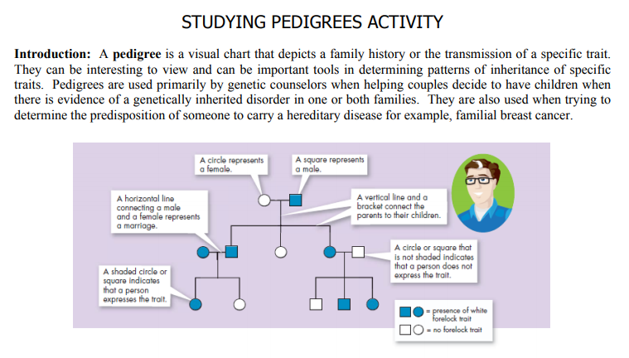

Slide 56
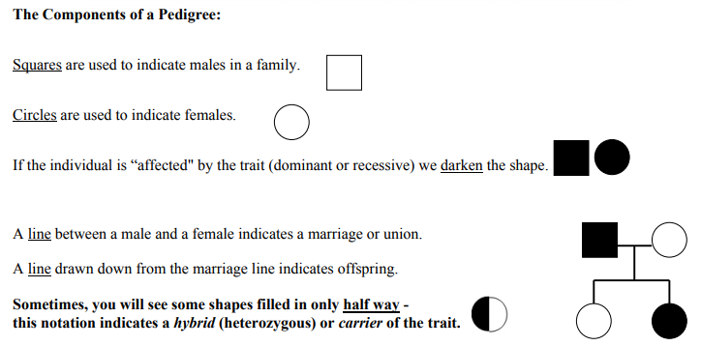

Slide 57
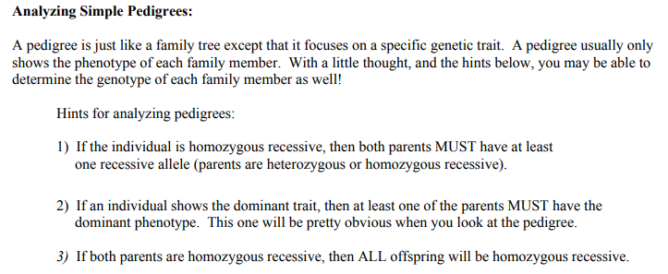
ff
Ff
ff
Ff
ff
Ff

Slide 58
NOTE:
In a pedigree, the trait of interest can be dominant or recessive. The majority of harmful genetic conditions are only seen when an individual is homozygous recessive – examples of conditions caused by recessive alleles include Cystic Fibrosis (a disease of the secretory glands, including those that make mucus and sweat), Falconi anemia (a blood disorder), and albinism (a lack of pigmentation).
Some genetic conditions are caused by dominant alleles (and may therefore be expressed in HOMOZYGOUS DOMINANT or HETEROZYGOUS individuals). For example, achondaplasia (dwarfism).
Cystic Fibrosis
Dwarfism
ff
GG
Gg

Slide 59
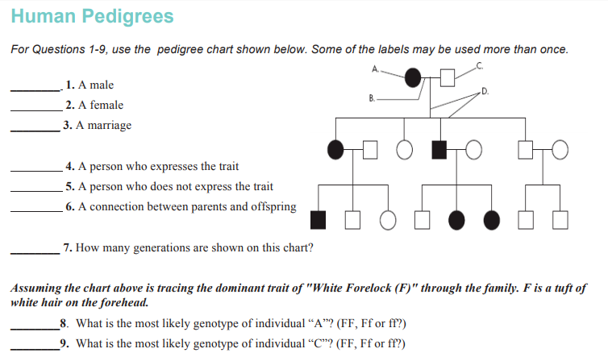

Slide 60
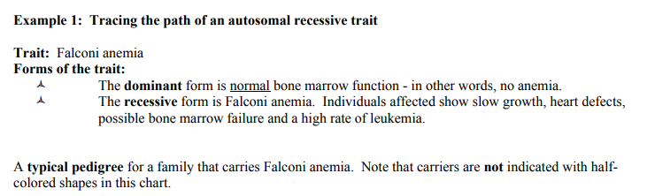


Slide 61


Slide 62
Remember, test Friday (11/2) – and we still have to learn about sex-linked traits.

