Slide 1
Dec. 10, 2019
You need:
Clean paper (2) / pencil
Bikini Bottom WS
Warm Up:
Draw out a Punnett Square crossing a heterozygous RED flower (Rr) with another heterozygous RED flower (Rr).
I CAN: apply knowledge of Punnett squares to determine genotypes and phenotypes.

Slide 2
Today’s agenda
Review vocabulary
Check HW, practice Punnett Squares
New notes on genetics (double helix)
Complete vs. Incomplete
Test grade on Bikini Bottom 2
Snowman PROJECT

Slide 3
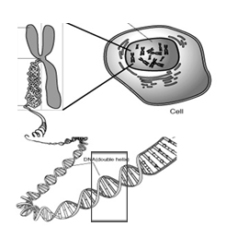
Nucleus
Chromosome
Cell
Gene
DNA

Slide 4
Vocabulary
Chromosomes – DNA wound into cute pkg
Genes – section of DNA/chromosome that codes for a specific trait
Traits – an organism’s physical features
Alleles – versions of a gene…
  Dominant allele: the one that will always show
  Recessive allele: the one that can be hidden

Slide 5
Vocabulary
HOMOzygous- two of the SAME alleles
HETEROzygous- two DIFFERENT alleles
Genotype – the genes or alleles inside (typically the letter combos)
Phenotype – the physical expression of those alleles (how they show up)

Slide 6
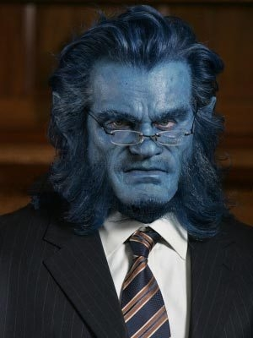
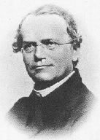
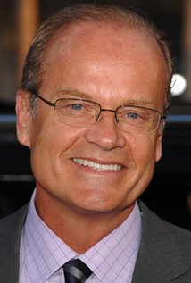
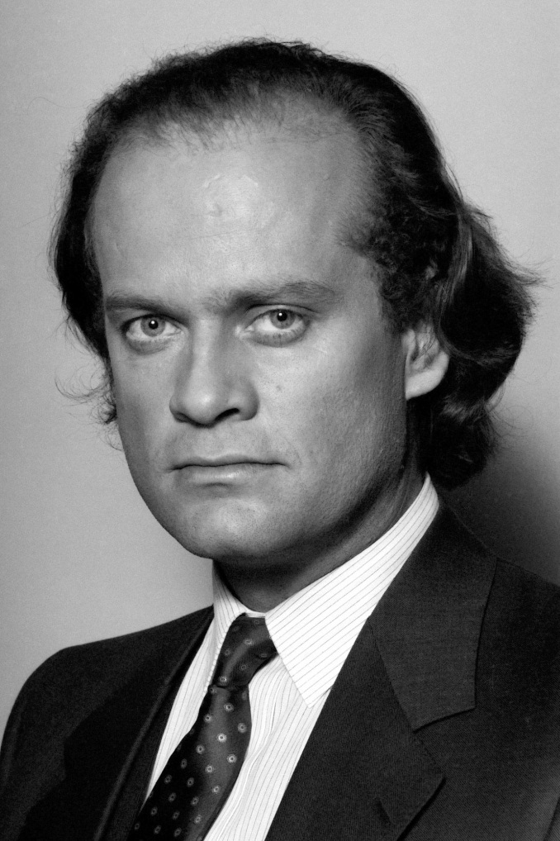

Slide 7
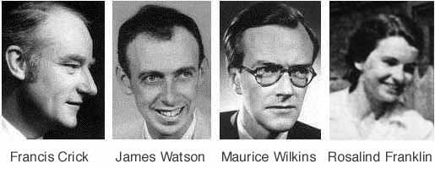

Nobel Prize 1962
1920-1958

Slide 8
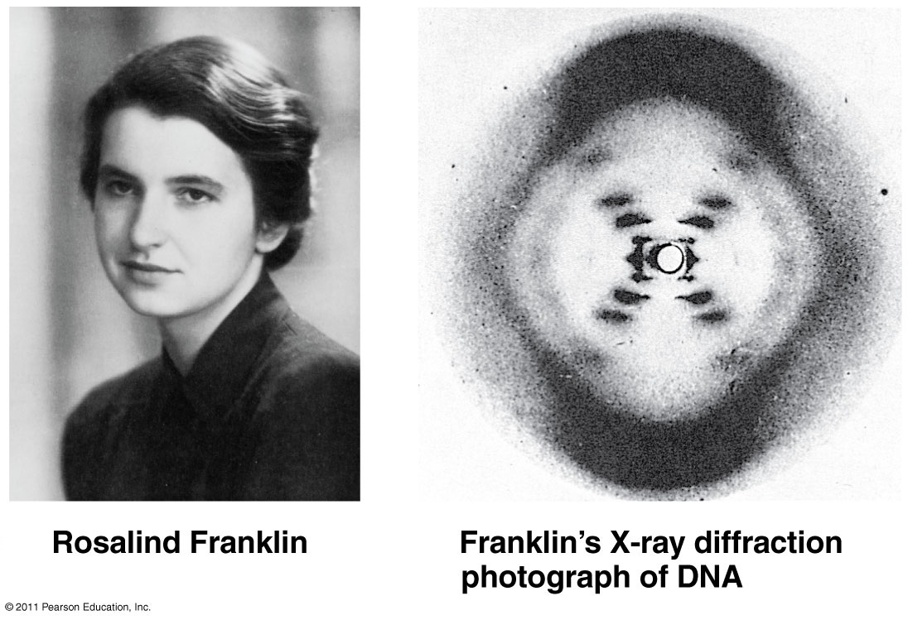

Slide 9
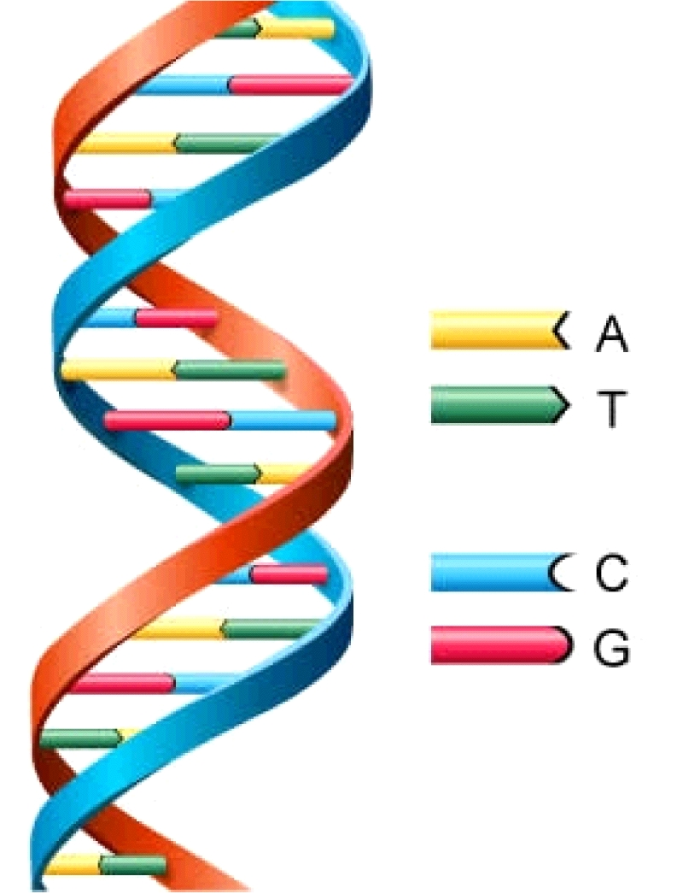
DNA
Deoxyribonucleic Acid
Double Helix (twisted ladder) shape

Slide 10
Mendel:
Understanding Inheritance
Gregor Mendel
“The father of genetics”
1822-1864

Slide 11
How can we figure out which
traits will be inherited?
We’ve learned about dominant & recessive alleles:
    Dominant alleles are more powerful, and can “hide” a recessive trait.
      Shown with an upper-case letter (“T” for tall stems)
    Recessive alleles can be “hidden” when a dominant allele is present.
      Shown with a lower-case letter (“t” for short stems)

Slide 12
How can we figure out which
traits will be inherited?
You know the differences between genotype and phenotype:
    Genotype describes which genes (alleles) are present.
        TT = 2 dominant alleles
        Tt = 1 dominant & 1 recessive
        tt = 2 recessive alleles
    Phenotype describes what the physical trait looks like.
        Tall stems (TT and Tt)
        Short stems (tt)

Slide 13
More vocabulary…
Geneticist use 2 terms to describe GENOTYPE:
    Homozygous – the organism has 2 same alleles.
        TT = 2 dominant alleles
        tt = 2 recessive alleles
    Heterozygous – the organism has 2 different alleles.
        Tt = 1 dominant & 1 recessive allele

Slide 14
So, how do we know which genotype or phenotype the offspring will be?
We can use a tool called a punnett square to predict how likely it is for an offspring to inherit certain traits.
A PUNNETT SQUARE:
    is a chart that shows ALL the possible combinations of a genetic cross.
    shows genotype and phenotype of the offspring.
    is also used to predict the probability (the chance) that an offspring will have a certain trait.

Slide 15
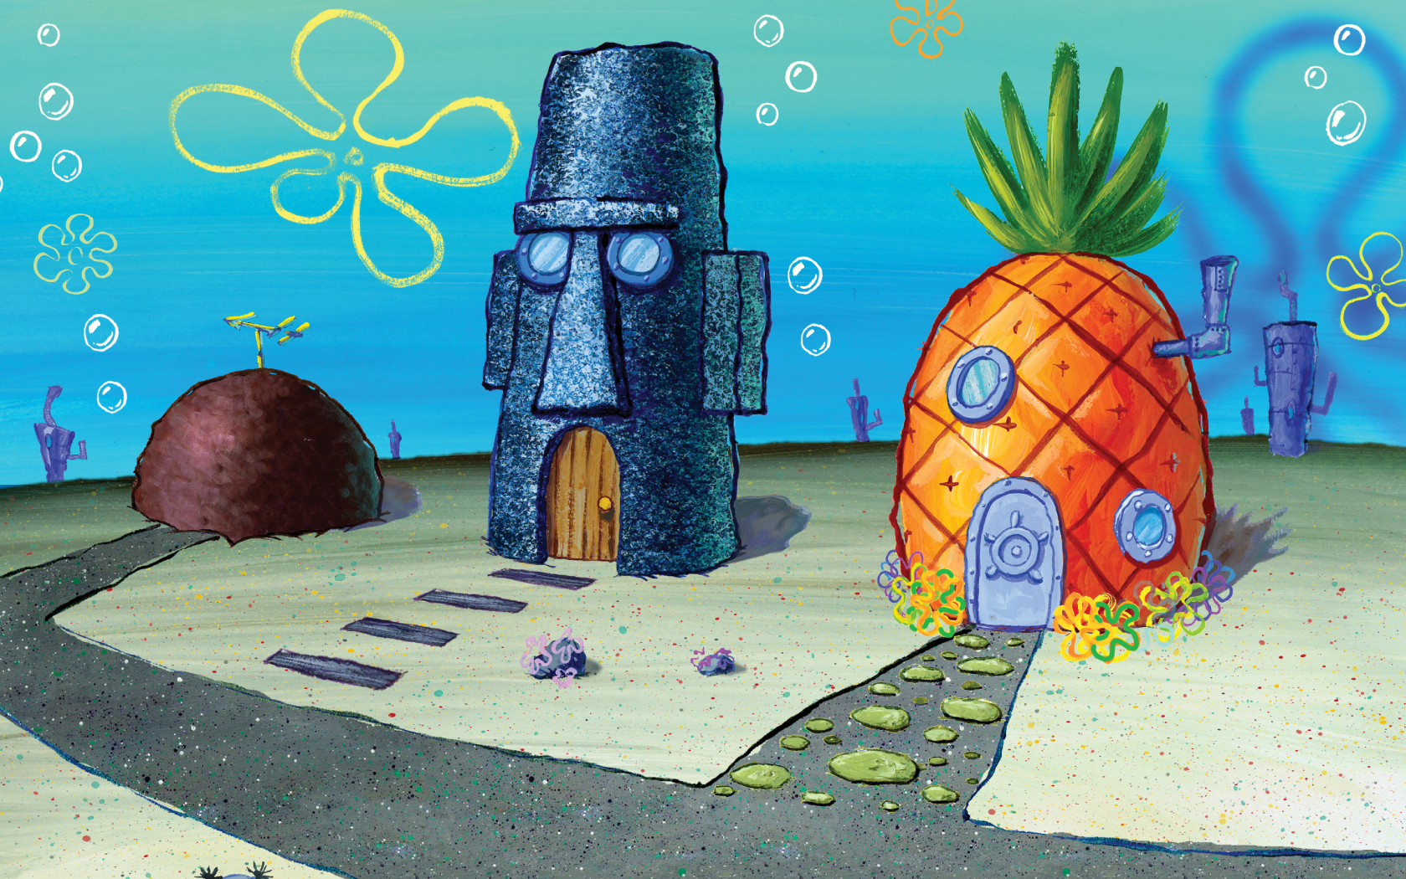
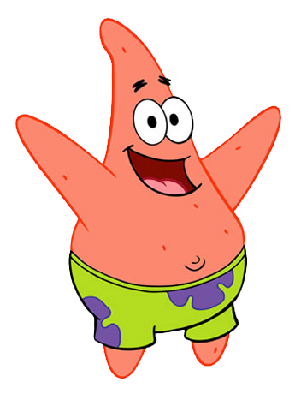
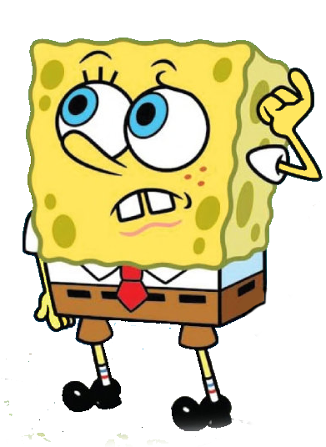
More practice problems…
Bikini Bottom Genetics!

Slide 16
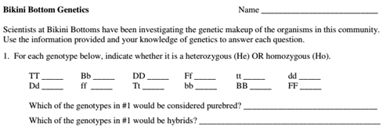

Homo
Hetero
Homo
Hetero
Homo
Homo
Hetero
Homo
Hetero
Homo
Homo
Homo
Alll Homozygous
All Heterozygous

Slide 17

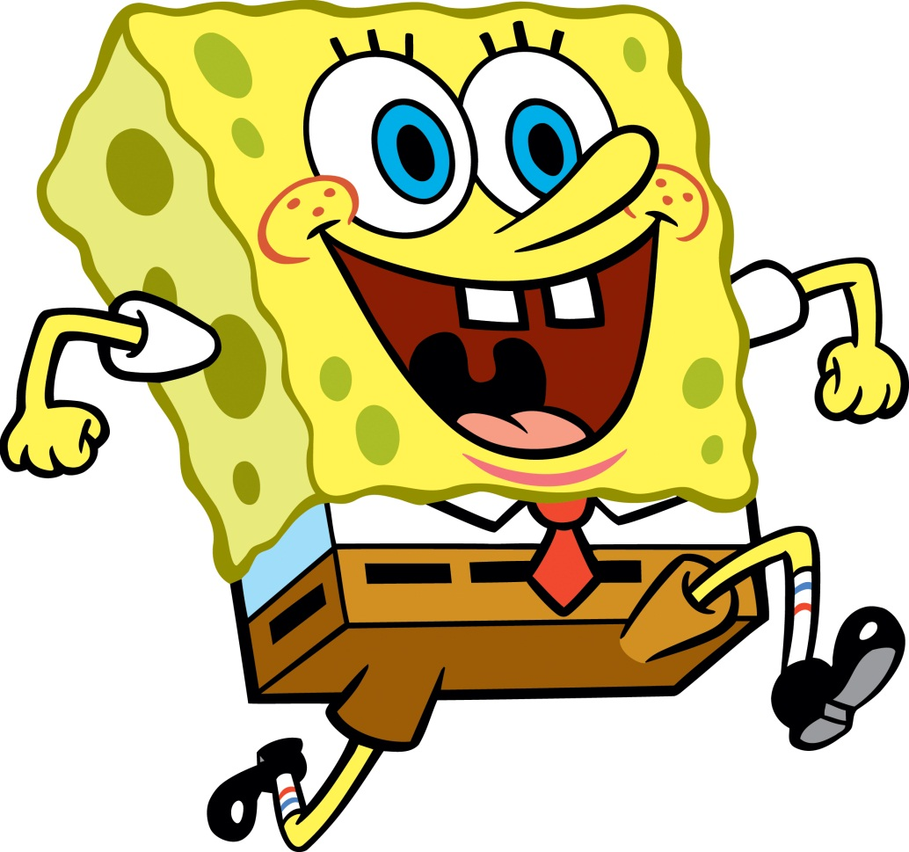
YELLOW
YELLOW
blue
SQUARE
SQUARE
round

Slide 18

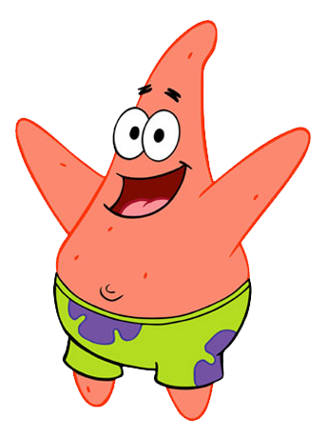
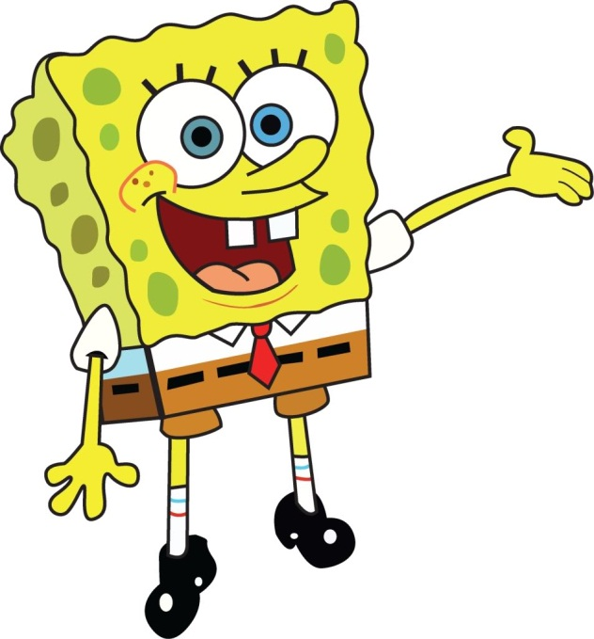
tt
TT , Tt
PP , Pp
pp

Slide 19
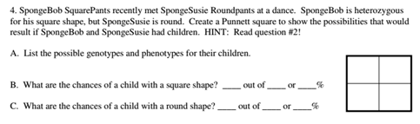
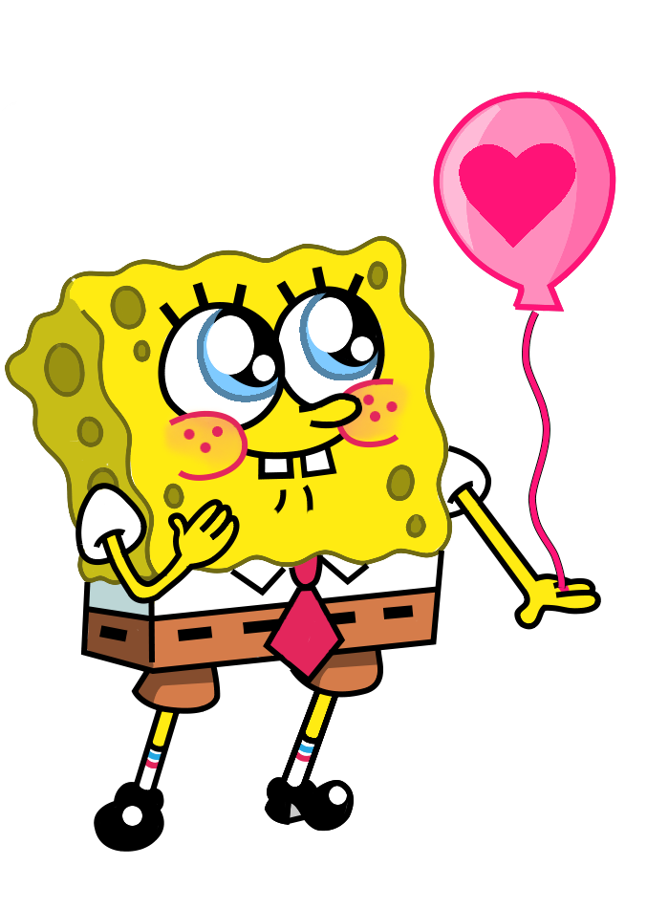
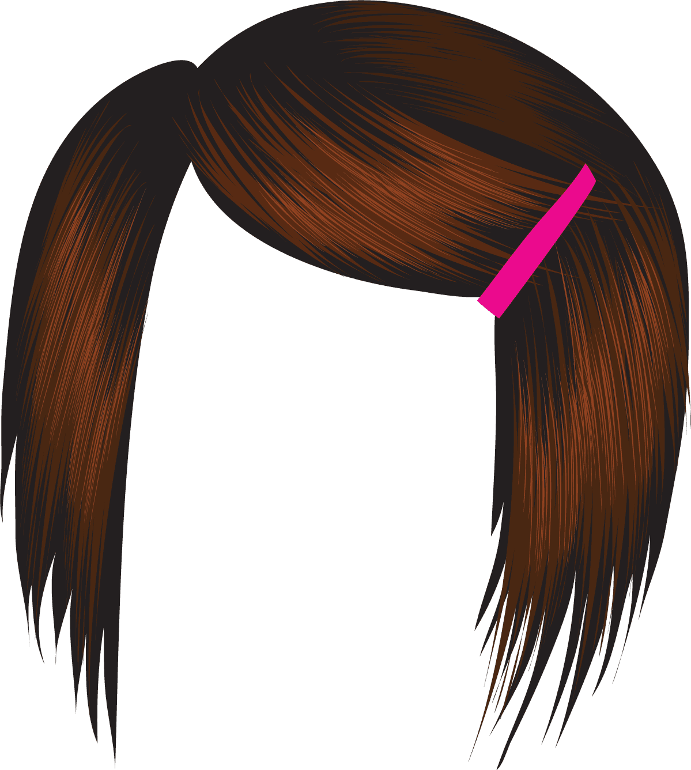
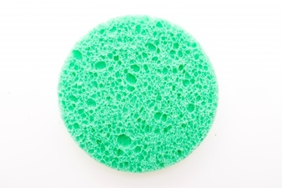
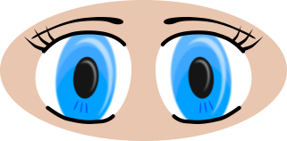

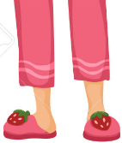
Susie = ss
Bob = Ss

Slide 20
s
S
Bob
Heterozygous
Homozygous
recessive
s
s
s
s
S
Square
Round
Homozygous
recessive
Heterozygous
s
s
s
s
S
Square
Round
Susie

Slide 21
Genotypes: Ss, ss
Phenotypes: Square, round
Square shape = 2/4 or 50%
Round shape = 2/4 or 50%

Slide 22
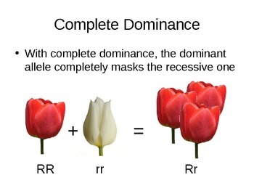
Complete Dominance = ONE WINNER

Slide 23
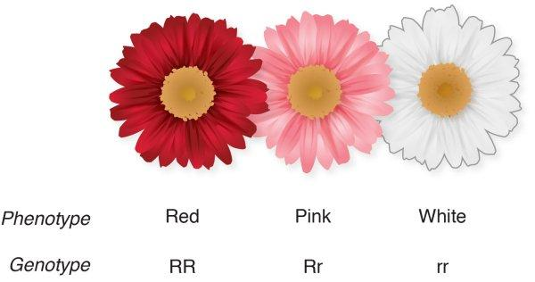
Incomplete Dominance = Blending

Slide 24
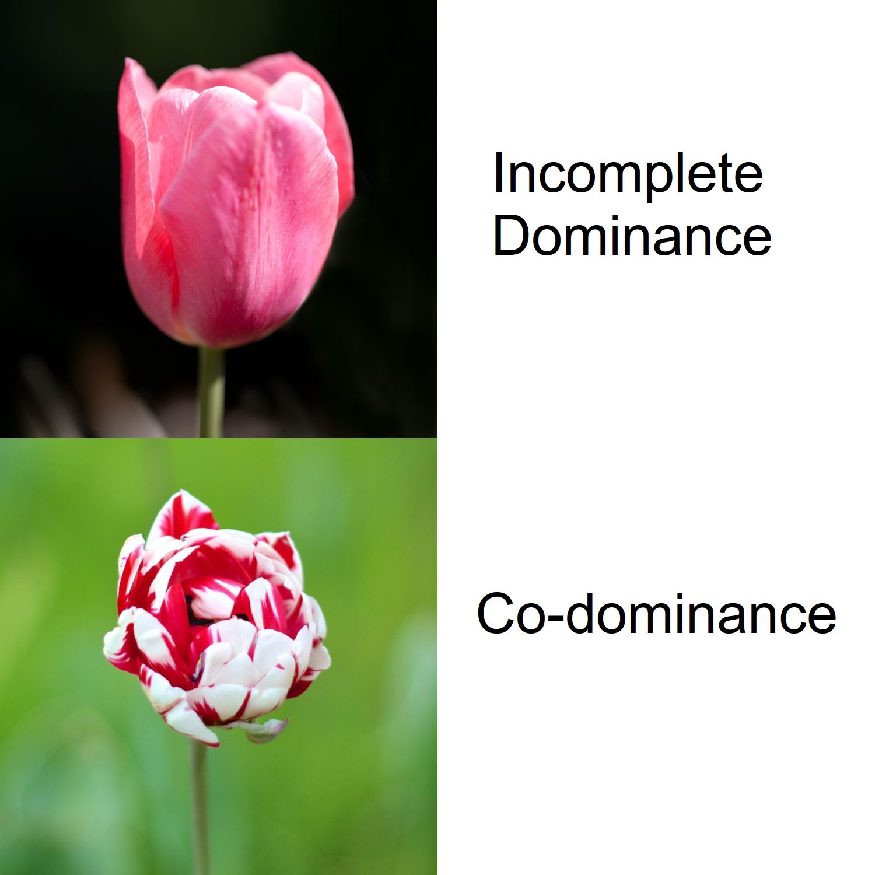

Slide 25
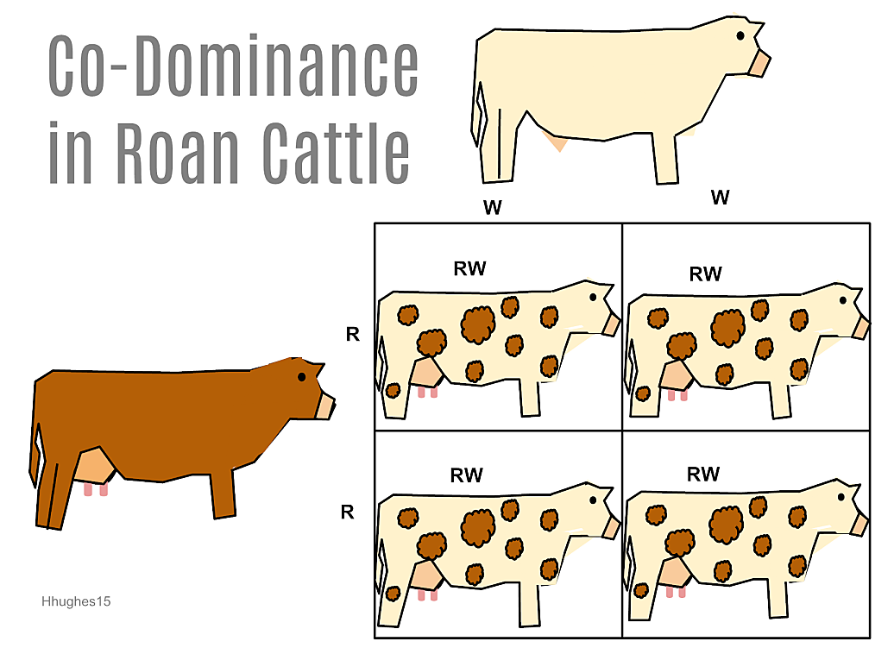
CoDominance = both show

Slide 26
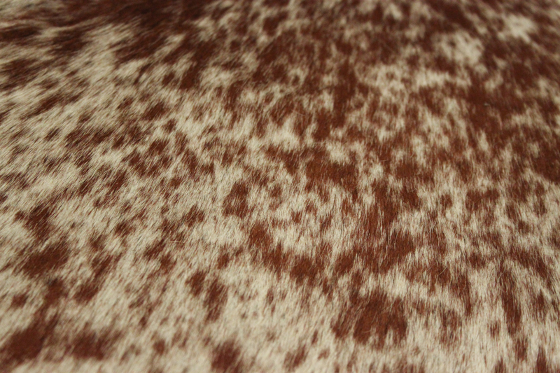
CoDominance = both show
ROAN

Slide 27
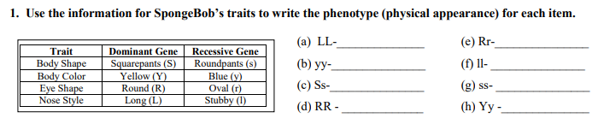
Bikini Bottom Genetics 2

Slide 28
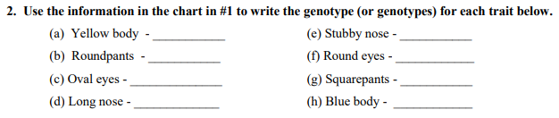
Bikini Bottom Genetics 2

Slide 29

Bikini Bottom Genetics 2

Slide 30
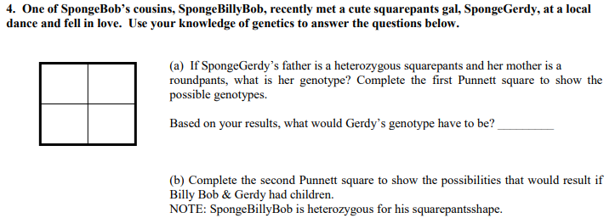
Bikini Bottom Genetics 2

Slide 31
s
S
Dad
Heterozygous
Homozygous
recessive
s
s
s
s
S
Square
Round
Homozygous
recessive
Heterozygous
s
s
s
s
S
Square
Round
Mom

Slide 32
s
S
Homozygous
dominant
Heterozygous
s
S
S
S
S
Square
Square
Homozygous
recessive
Heterozygous
s
s
s
s
S
Square
Round

Slide 33
Bikini Bottom – CoDominance vs. Incomplete Dominance

Slide 34
Snowman Genetics
You must first determine the GENES or ALLELES of your pumpkin…two for each TRAIT.
Flip a coin (twice) to determine alleles. If you flip heads, write the dominant allele. If you flip tails, write the recessive allele.
Based on the alleles, determine the traits for your pumpkin.
Draw/color your creation – it will be a PROJECT.

Slide 35
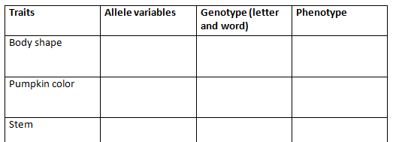
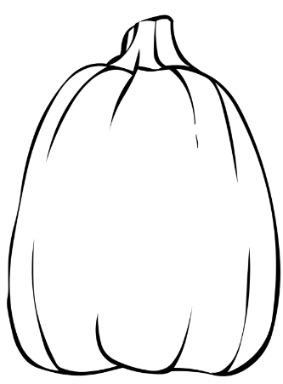
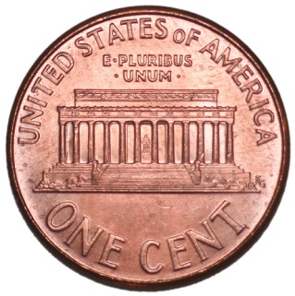
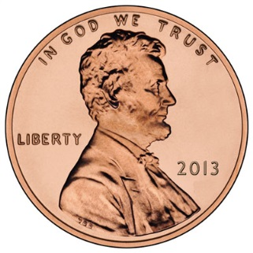
Jack O’Lantern Genetics
T
t
T = Tall, thin
T = short, round
Complete Dominance
hetero
Tall, thin
Flip a coin
Heads = Dominant
Tails = Recessive
Write what you “flipped” into the Genotype box.
Repeat

Slide 36
Now – using the genotype you were flipping coins to create, use the known phenotype to create a drawing of your pumpkin / jack o’lantern. Be sure to add color and do your best efforts as this will be a project grade.

Slide 37


External factors?

Slide 38
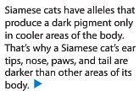
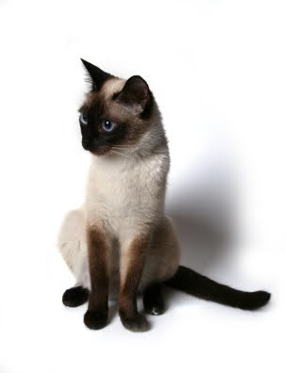
External factors?

Slide 39
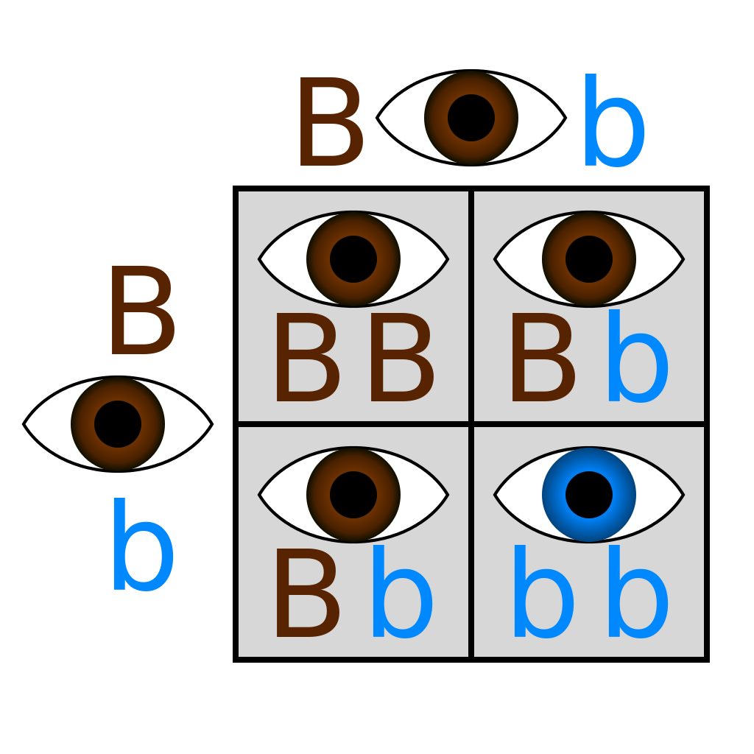
Bikini Bottom –
Dihybrid crosses
Monohybrid = ONE trait…crossed
-Punnett with FOUR boxes

Slide 40
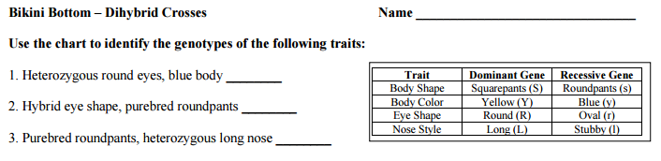
Bikini Bottom-
Dihybrid crosses

Slide 41
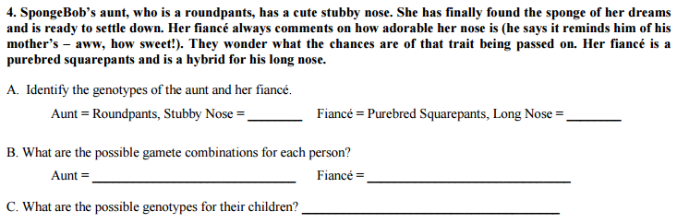
Bikini Bottom-
Dihybrid crosses

Slide 42
Bikini Bottom-
Dihybrid crosses
Dihybrid = TWO traits…crossed
-Punnett with _________________boxes
SIXTEEN

Slide 43
Inheriting a
Genetic Disorder

Slide 44
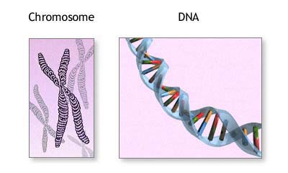
What are genetic disorders?
A genetic disorder is an abnormal condition that a person inherits through their genes or chromosomes.

Slide 45
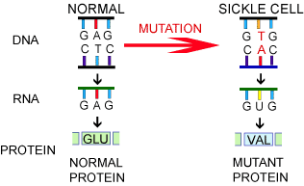
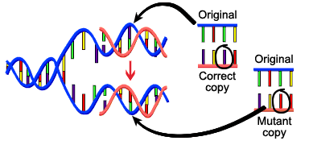
What are genetic disorders?
Some are caused by mutations in DNA.
For example, sickle cell disease which you learned about yesterday!

Slide 46
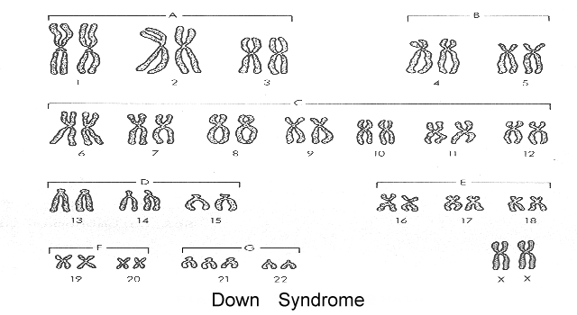
What are genetic disorders?
This is a picture of ALL your chromosomes called a “karyotype”.
Others are caused by bigger changes in the chromosome.
For example, having too many chromosomes – Down Syndrome.

Slide 47
Cystic Fibrosis
Let’s take a closer look at a genetic disorder called Cystic Fibrosis.

Slide 48

How do you get a genetic disorder?
Genetic disorders like Cystic Fibrosis are NOT contagious! You can’t catch them from someone else who is sick!
You inherit them from your parents.
How do you know which children are at risk for inheriting Cystic Fibrosis?

Slide 49
Who is affected by Cystic Fibrosis?
Overall, the probability (% chance) of inheriting CF if BOTH parents are carriers is 25% (1 in 4).

Slide 50
Can Cystic Fibrosis be cured?
People hope that gene therapy can one day provide a cure for genetic disorders like cystic fibrosis.
Gene Therapy - involves removing the mutated gene and replacing it with a healthy gene.

Slide 51
Pedigree Notes
Follow along and fill in your notes.

Slide 52
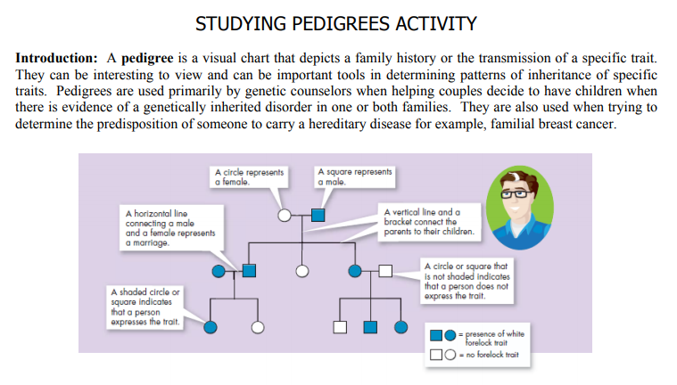

Slide 53
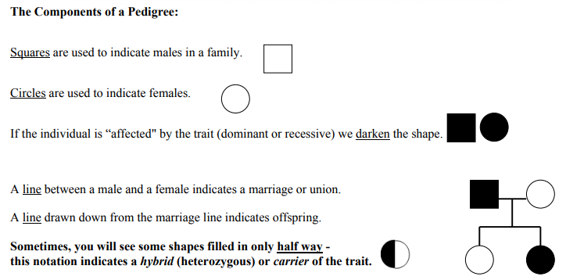

Slide 54
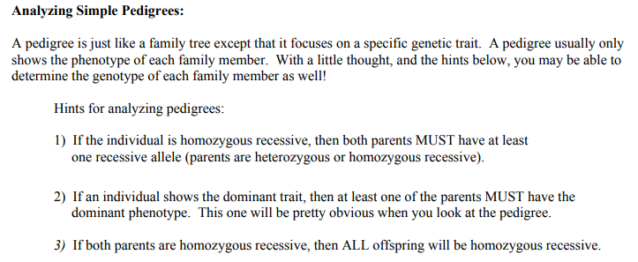
ff
Ff
ff
Ff
ff
Ff

Slide 55
NOTE:
In a pedigree, the trait of interest can be dominant or recessive. The majority of harmful genetic conditions are only seen when an individual is homozygous recessive – examples of conditions caused by recessive alleles include Cystic Fibrosis (a disease of the secretory glands, including those that make mucus and sweat), Falconi anemia (a blood disorder), and albinism (a lack of pigmentation).
Some genetic conditions are caused by dominant alleles (and may therefore be expressed in HOMOZYGOUS DOMINANT or HETEROZYGOUS individuals). For example, achondaplasia (dwarfism).
Cystic Fibrosis
Dwarfism
ff
GG
Gg

Slide 56
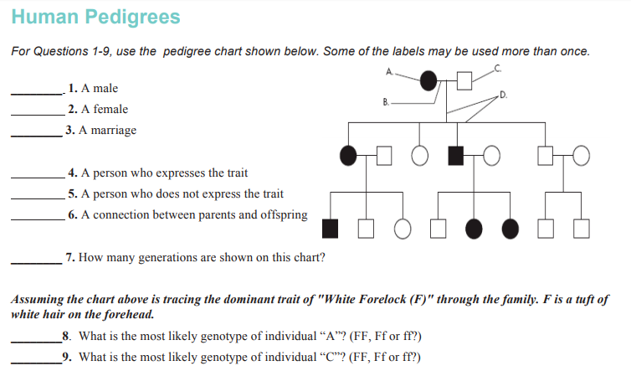

Slide 57
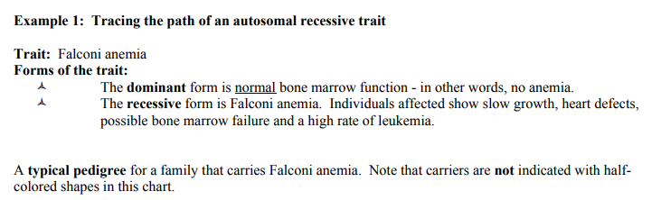
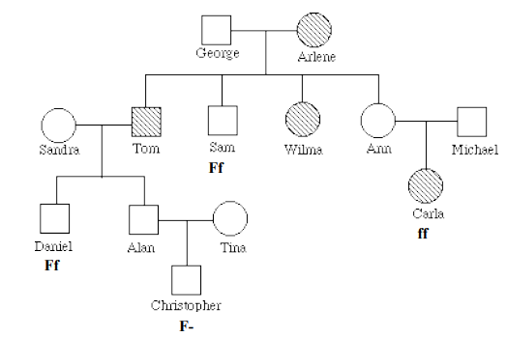

Slide 58
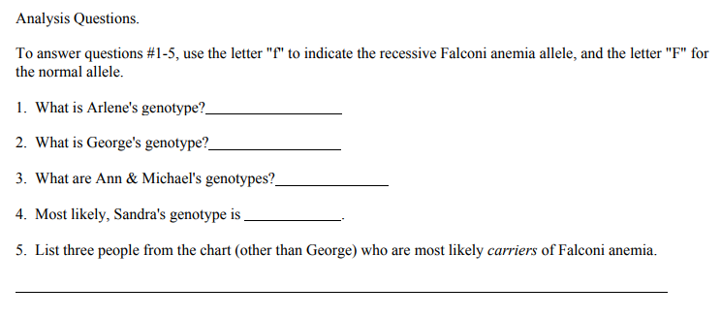

Slide 59
Remember, test Friday (11/2) – and we still have to learn about sex-linked traits.

