Slide 1
Nov. 5, 2019
You need:
Clean paper / pencil
Cells and their Organelles WS – collected
Plant and Animal Cell WS (like poster)
Warm Up:
What part of the cell helps to transport items (think “road”)?
I CAN: determine the parts of the Cell and Microscope!

Slide 2
Review
What is Spontaneous Generation?
- the idea that life could suddenly come from non-living stuff
-an old belief
-a belief disproven by Francesco Redi and Louis Pasteur

Slide 3
Cell Theory
Eventually people were able to create the Cell Theory…Schleiden, Schwann, and Virchow are credited.
All living things are composed of cells
Cells are the basic structure of all living things
Cells can only come from other living cells

Slide 4
Robert Hooke (1665)
Used a COMPOUND microscope
Saw cork (dead plant cells)
Described the cell walls (boxes) as “CELLS”
Anton van Leeuwenhoek (1670)
Looked at pond water…living cells
Described the moving beings as “animal-cules”

Slide 5
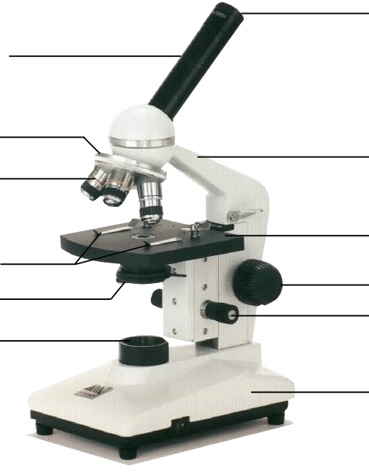
Compound Microscope
1. Eye Piece or Ocular – lens closest to the eye.
2. Body Tube – gives distance between eyepiece and objective.
3. Nose Piece – holds the objectives.
4. Arm – holds the tube and lenses.
5. Objective lenses –
lens closest to the slide.
6. Stage – platform for the slides.
7. Stage clips –
Holds the slide in place.
8. Coarse Adjustment knob –
Moves stage up/down (to focus).
9. Diaphragm / IRIS –
Controls the amount of light.
11. Light –
Shines light through the slide, lens, tube.
10. Fine Adjustment knob –
Moves stage up/down slightly
12. Base – Holds up the entire microscope.

Slide 6
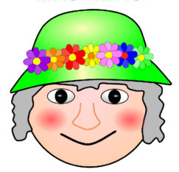
MRS. NERG-C
The list of characteristics something MUST have to be considered LIVING…!
Movement
Respiration
Sensory
Nutrients (6)
Excretion
Reproduction
Growth
Cells
So if cells are helping to do so many different jobs (movement, respiration, etc)…are they all alike?
Notes:
We know that MRS NERGC isn’t a real person, but tells us what living things are constantly having to do…and one is they are made of cells. So these cells must be helping to accomplish the tasks like movement, respiration, etc.

Slide 7
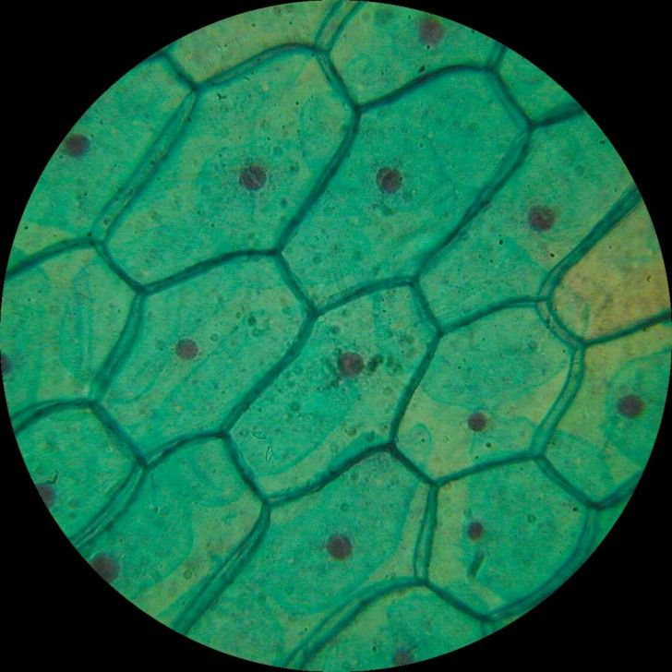
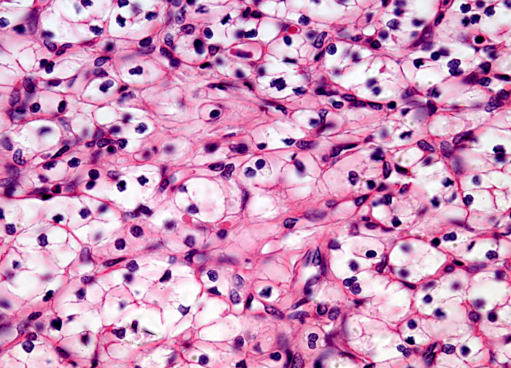
General observations?
Alike?
Different?
Notes:
Plants tend to have “boxy” shape. They have a cell wall to hold them up – since they don’t have bones. Those on the right were “stained” pink/purple. They are animal, slightly rounded, and blob-like.

Slide 8
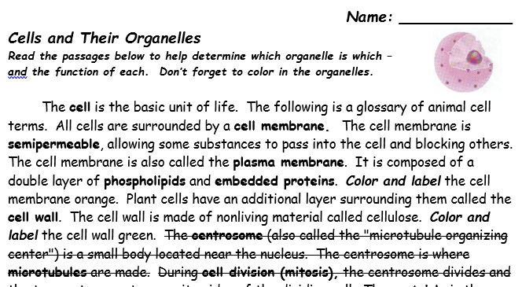
Read and annotate
Find and color
Those parts marked out – are not needed.

Slide 9
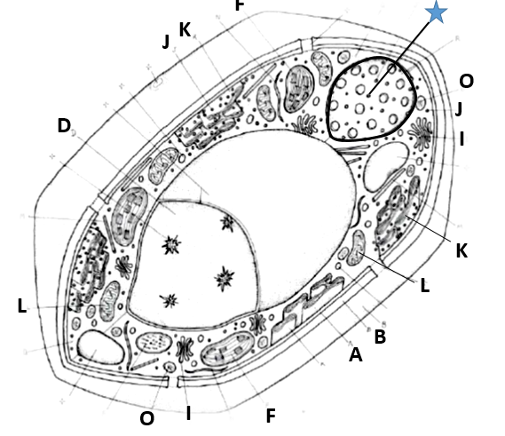
Notes:
We have these in coloring pages. I HIGHLY recommend that students color in the word with whatever color – but then use the SAME color to color in the organelle within the cell.
This is plant. It’s boxy, has chloroplast, and its vacuole is large (due to limited mobility).

Slide 10
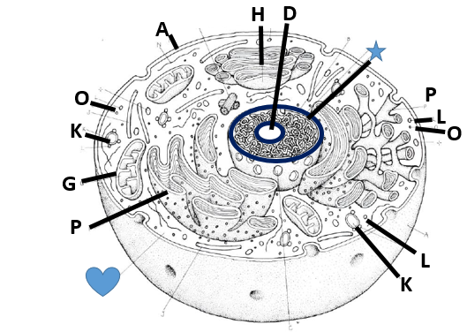
Notes:
Animal cell – I love the coloring pages.

Slide 11
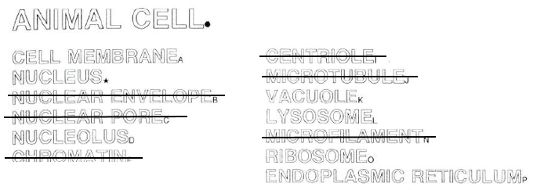
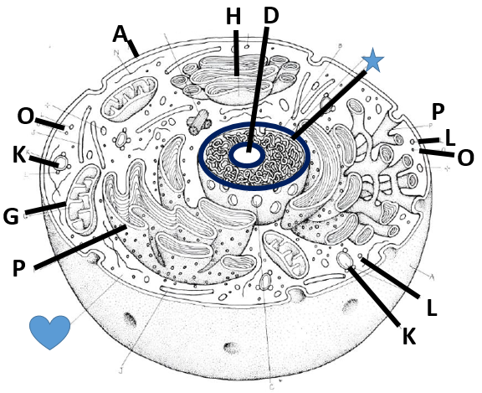

Slide 12
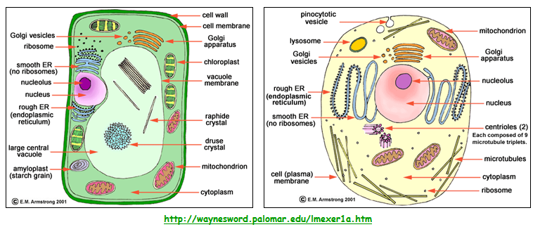
CELLS

Slide 13
If more is needed…
BrainPop video – the cell (one video) and cell structures (another video)…you’ll have to login. Login = carrington1; password = cougars (each is about 2.5 min)
Amoeba sister video – the grand tour of the cell (about 9 min)

Slide 14
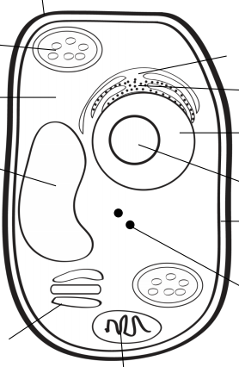
A
B
G
H
C
I
D
J
K
L
E
F

Slide 15
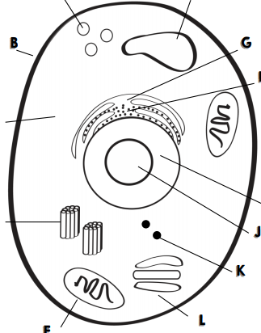
A
F
B
G
H
C
I
D
J
K
L
E

Slide 16
City jobs
Gate/wall around the city
City hall / government building
Mayor
City parks
Building company
Power Plant (factory)
Waste management
Storage facility
Gate keeper / guard
Solar energy farm
Transportation dept.
Post office

Slide 17
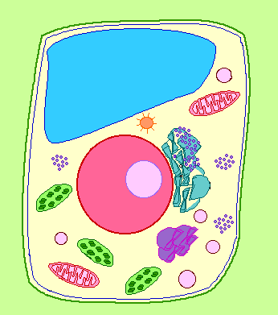
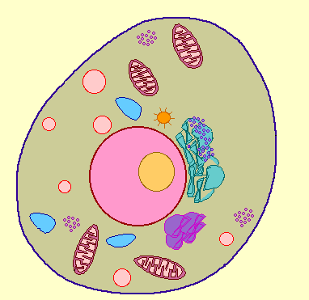
Cell Membrane
BOTH Plant and Animal Cells
Function: controls what substances enter and exit the cell
Analogy to City: City “Gate Keeper”

Slide 18
Cell Wall
PLANT CELLS ONLY
Function: surrounds plants to protect and support the cell
Analogy to City: City Border

Slide 19
Nucleus
BOTH Plant and Animal Cells
Function: directs all the cells activities (brain of cell)
Analogy to City: City Hall

Slide 20
Nucleolus
BOTH Plant and Animal Cells
Function: makes ribosomes inside the nucleus
Analogy to City: Copy Machine Inside City Hall

Slide 21
Nuclear Membrane
BOTH Plant and Animal Cells
Function: controls what enters and leaves the nucleus, protects
Analogy to City: gate around City Hall

Slide 22
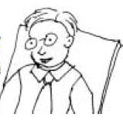
Chromosomes
BOTH Plant and Animal Cells
Function: contains the important blueprints of the cell or DNA
Analogy to City: City Mayor

Slide 23
Vacuole
BOTH Plant and Animal Cells
Function: stores food, water, waste, and other materials
Analogy to City: Warehouses, Water Towers, etc.

Slide 24
Chloroplast
PLANT CELLS ONLY
Function: captures energy from sunlight and produces food
Analogy to City: Solar Energy Plant

Slide 25
Endoplasmic Reticulum
BOTH Plant and Animal Cells
Function: built proteins and move them throughout cell or out of cell (Smooth – no ribosomes, Rough – ribosomes)
Analogy to City: City Transportation Department

Slide 26
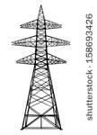
Cytoplasm
BOTH Plant and Animal Cells
Function: gel-like fluid between cell membrane and nucleus, allows other organelles to float freely through cell
Analogy to City: City Yards

Slide 27
Ribosomes
BOTH Plant and Animal Cells
Function: produce proteins
Analogy to City: Construction Company

Slide 28
Lysosomes
ANIMAL CELLS ONLY
Function: contain chemicals that break down food particles and worn out cell parts
Analogy to City: Recycle or Waste Management Company

Slide 29
Mitochondria
BOTH Plant and Animal Cells
Function: rod-shaped organelle that produce energy (powerhouse)
Analogy to City: Energy Plant

Slide 30
Golgi Body
BOTH Plant and Animal Cells
Function: receives materials from the endoplasmic reticulum and sends them to other parts of the cell
Analogy to City: Post Office
Post Office

Slide 31
The Whole City…
Post Office

Slide 32
1. Choose the wrong statement from the following.
a) Mitochondria produces most of the energy for the cell.
b) Chloroplasts are “food producers.”
c) Cell wall controls the movements of materials into and out of the cell.
d) Nucleus regulates and controls all cell activities, acting as the “brain” of the cell.

Slide 33
2. Match the cell part to the nickname.
1) Cytoplasm
2) Nuclear membrane
3) Vacuoles
a. Gate of the nucleus
b. Area of movement where cell parts move
c. Storage tanks

Slide 34
School analogy
Cut the doors/windows – just three sides.
Put the schoolhouse onto colorful paper and trace the box space.
Remove the schoolhouse and cut out the square place descriptions.
Determine where each square goes – and then glue!
Put schoolhouse over top and glue.

Slide 35
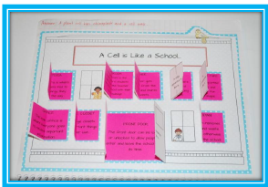

Slide 36
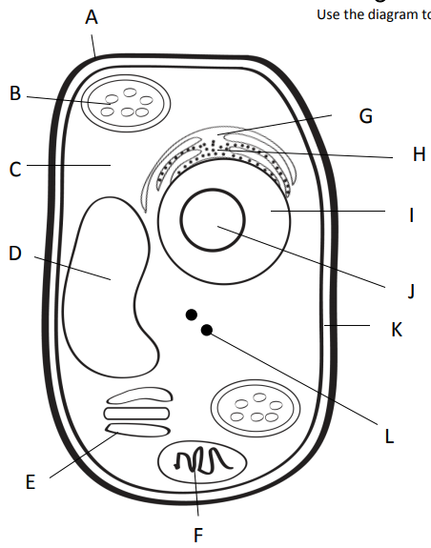
Outer most part of plant cell.
Makes food from sunlight
Road (smooth)
Road (rough)
Gel surrounding all
Controls cell
Storage
Copies ribosomes
Inner part of outer covering of plant cell.
Protein factory
Packaging plant
Power factory

Slide 37
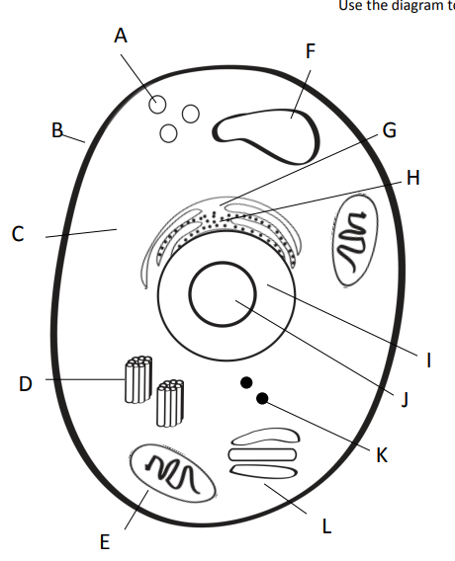
Clean up (pac-man)
Storage
Outer covering of an animal cell.
Road (smooth)
Road (rough)
Gel surrounding all
Controls cell
Copies ribosomes
Centrioles = help in cell division (reproduction)
Protein factory
Power factory
Packaging plant

