Slide 1
Nov. 15, 2019
You need:
Clean paper / pencil
Protist chart and WS
Warm Up:
How does each protist group reproduce?
I CAN: define protists and their characteristics.

Slide 2
Review
-Spontaneous Generation
-Cell theory (Schleiden, Schwann, Virchow)
-Cells – Robert Hooke
-”Animal-cules” – Anton van Leeuwenhoek

Slide 3
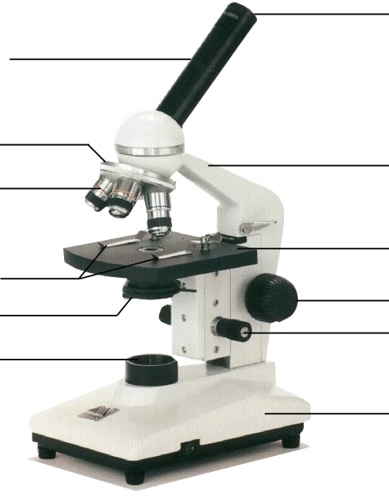
Compound Microscope
1. Eye Piece or Ocular – lens closest to the eye.
2. Body Tube – gives distance between eyepiece and objective.
3. Nose Piece – holds the objectives.
4. Arm – holds the tube and lenses.
5. Objective lenses –
lens closest to the slide.
6. Stage – platform for the slides.
7. Stage clips –
Holds the slide in place.
8. Coarse Adjustment knob –
Moves stage up/down (to focus).
9. Diaphragm / IRIS –
Controls the amount of light.
11. Light –
Shines light through the slide, lens, tube.
10. Fine Adjustment knob –
Moves stage up/down slightly
12. Base – Holds up the entire microscope.

Slide 4
MRS. NERG-C
The list of characteristics something MUST have to be considered LIVING…!
Movement
Respiration
Sensory
Nutrients (6)
Excretion
Reproduction
Growth
Cells
So if cells are helping to do so many different jobs (movement, respiration, etc)…are they all alike?
Notes:
We know that MRS NERGC isn’t a real person, but tells us what living things are constantly having to do…and one is they are made of cells. So these cells must be helping to accomplish the tasks like movement, respiration, etc.

Slide 5
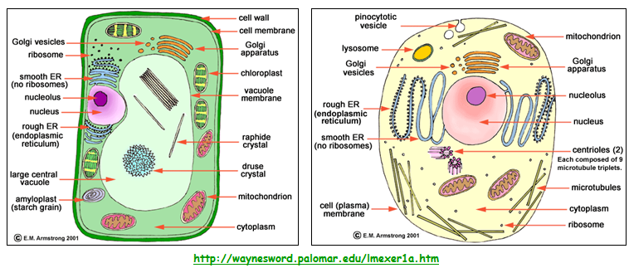
CELLS

Slide 6
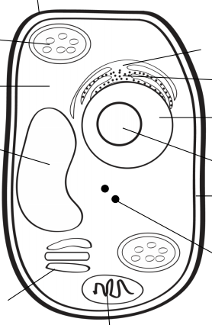
A
B
G
H
C
I
D
J
K
L
E
F

Slide 7
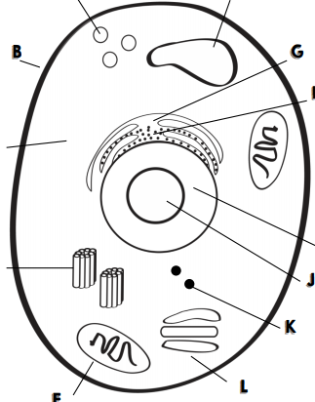
A
F
B
G
H
C
I
D
J
K
L
E

Slide 8
City jobs
Gate/wall around the city
City hall / government building
Mayor
City parks
Building company
Power Plant (factory)
Waste management
Storage facility
Gate keeper / guard
Solar energy farm
Transportation dept.
Post office

Slide 9
Cells
PROKARYOTIC and EUKARYOTIC
Has organelles, but they are not membrane-bound (kinda messy)
Has organelles that ARE membrane-bound (more neat and contained)
Bacteria
Plants
Protists
Animals

Slide 10
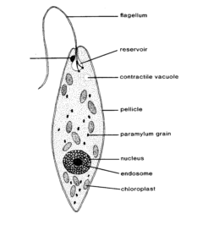
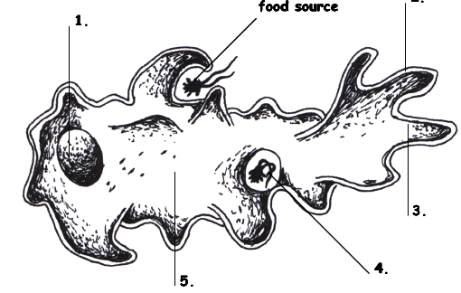
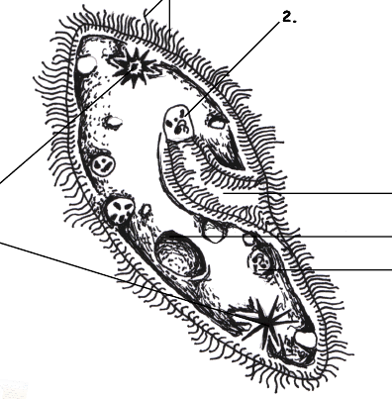
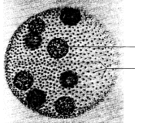
Protists…
Euglena, Amoeba,
Paramecium, and Volvox

Slide 11
Protists
Uni-cellular
____________________ - one celled organisms.
Some have animal – like qualities (_____________ means “first animal” in Greek)
Some have plant-like qualities like _______________
Some are like fungi
Protozoa
Chlorophyll to use in photosynthesis

Slide 12
Protists – finding food
Those who can feed themselves with photosynthesis are called ________________
Those who must find food in the environment around them (or move to find food) are called ________________________.
Autotrophs
Heterotrophs

Slide 13
Video review
https://youtu.be/fcGDUcGjcyk

Slide 14
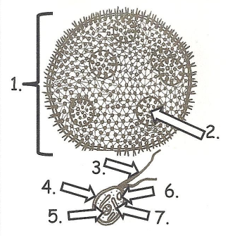
Volvox

Slide 15
Protists - locomotion
Some work with each other – combining flagella and teamwork…
One example is the _____________________
Volvox

Slide 16
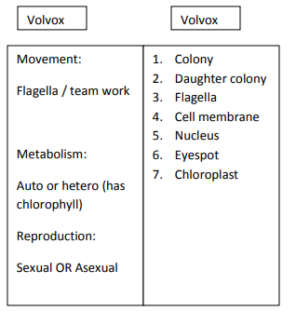
Volvox
Daughter colony
Eyespot
Colony
Flagella
Cell membrane
Chloroplast
Nucleus

Slide 17
Volvox
1. Colony
2. Daughter colony
3. Flagella
4. Cell membrane
6. Eyespot
5. Nucleus
7. Chloroplast

Slide 18
Locomotion:
Volvox
Reproduction:
Metabolism:

Slide 19
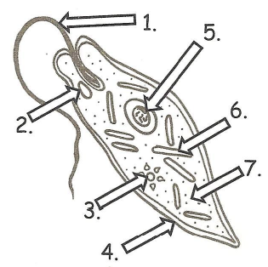
Euglena

Slide 20
Protists - locomotion
Some use a whip-like tail known as a ____________________
One example of this is the __________________
Flagellum
Euglena

Slide 21
Euglena
Contractile vacuole
Flagella
Nucleus
Cytoplasm
Eye spot
Cell membrane
Chloroplast

Slide 22
Euglena
1. Flagella
5. Nucleus
6. Chloroplast
2. Eye spot
7. Cytoplasm
3. Contractile vacuole
4. Cell membrane

Slide 23
Euglena
Locomotion:
Reproduction:
Metabolism:

Slide 24
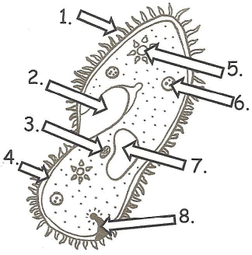
Paramecium

Slide 25
Protists - locomotion
Some have small, hair-like structures that come out of the membrane all over the organism… __________________
One example is the _____________________
Cilia
Paramecium

Slide 26
Paramecium
micronucleus
Macronucleus
Oral groove
Contractile vacuole
Food vacuole
Cell membrane
Anal pore
cilia

Slide 27
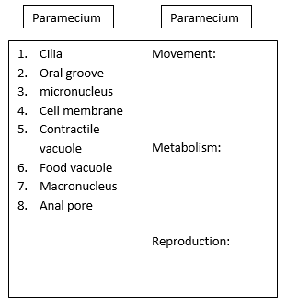
Paramecium
1. cilia
2. Oral groove
5. Contractile vacuole
3. micronucleus
6. Food vacuole
4. Cell membrane
7. Macronucleus
8. Anal pore

Slide 28
Locomotion:
Paramecium
Reproduction:
Metabolism:

Slide 29
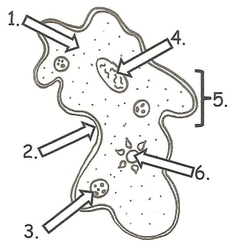
Amoeba

Slide 30
Protists - locomotion
Some use a fake foot that they ooze outward to move, its called a … __________________
One example is the _____________________
Pseudopod
Amoeba

Slide 31
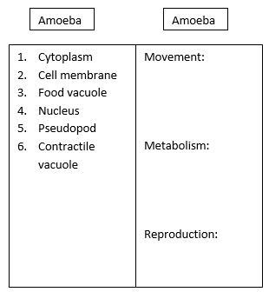
Amoeba
Contractile vacuole
Pseudopod
Cytoplasm
Cell membrane
Food vacuole
Nucleus

Slide 32
Amoeba
1. Cytoplasm
4. Nucleus
5. Pseudopod
2. Cell membrane
6. Contractile vacuole
3. Food vacuole

Slide 33
Locomotion:
Amoeba
Reproduction:
Metabolism:

Slide 34
Amoeba
Some use a fake foot that they ooze outward to move, its called a … __________________
Single celled or ___________________
They must find food in the environment so they are ________________________________
They reproduce through _____________ which means they simply split into two cells.
Pseudopod
Uni-cellular
Heterotrophs
Fission
Amoeba Feeds! Youtube link

Slide 35
Paramecium
Some have small, hair-like structures that come out of the membrane all over the organism… __________________
Single-celled or ______________________
Collect food from the environment so they must be _____________________
Reproduce through ________________________
Cilia
Uni-cellular
Heterotrophs
Asexual means most often, but sexual reproduction is possible, too
Amazing Microscopic HD Video! Paramecium Feeding!

Slide 36
Euglena
Some use a whip-like tail known as a ____________________
Single celled or ______________________
Can either use photosynthesis OR collect food from the environment so a ________________
Reproduces through _____________________
Flagellum
Uni-cellular
Heterotroph
Fission
Euglena
EUGLENA

Slide 37
Volvox
Some work with each other – combining flagella and teamwork…
Volvox is actually many cells but each is an individual organism – they simply live together in a colony for the ease of life.
Contain chlorophyll so must be _______________ but can also collect NUTRIENTS from the environment so considered both ________________________________
Plant-like
Auto and heterotroph

Slide 38
Volvox
Each of the cells have two flagella and they must coordinate them to cause motion for the entire colony.
They have a red “eye” spot that can help determine light.
They work together but seem to have poles (so they know forward and back.
The volvox colony will reproduce new cells through asexual reproduction, but also has the ability to go to sexual reproduction so two separate colonies would be needed.
Volvox Dances!

Slide 39
After completing your quiz – on the scantron, please use the computer to complete the cell CDA.
Log-in with school information
Go to Powerschool and/or Schoolnet
Use this code: NA7NU8PU5
When you finish, log off the computer.

