Slide 1
Nov. 13, 2019
You need:
Clean paper / pencil
Protist chart
Old warm up to turn in
Warm Up:
Which protist(s) uses chloroplast? Why do you think so?
I CAN: define protists and their characteristics.

Slide 2
Review
-Spontaneous Generation
-Cell theory (Schleiden, Schwann, Virchow)
-Cells – Robert Hooke
-”Animal-cules” – Anton van Leeuwenhoek

Slide 3
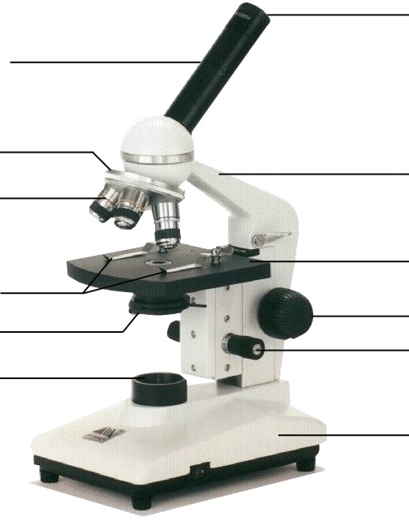
Compound Microscope
1. Eye Piece or Ocular – lens closest to the eye.
2. Body Tube – gives distance between eyepiece and objective.
3. Nose Piece – holds the objectives.
4. Arm – holds the tube and lenses.
5. Objective lenses –
lens closest to the slide.
6. Stage – platform for the slides.
7. Stage clips –
Holds the slide in place.
8. Coarse Adjustment knob –
Moves stage up/down (to focus).
9. Diaphragm / IRIS –
Controls the amount of light.
11. Light –
Shines light through the slide, lens, tube.
10. Fine Adjustment knob –
Moves stage up/down slightly
12. Base – Holds up the entire microscope.

Slide 4
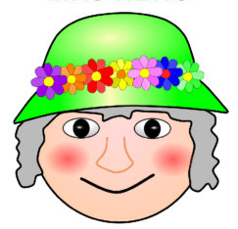
MRS. NERG-C
The list of characteristics something MUST have to be considered LIVING…!
Movement
Respiration
Sensory
Nutrients (6)
Excretion
Reproduction
Growth
Cells
So if cells are helping to do so many different jobs (movement, respiration, etc)…are they all alike?
Notes:
We know that MRS NERGC isn’t a real person, but tells us what living things are constantly having to do…and one is they are made of cells. So these cells must be helping to accomplish the tasks like movement, respiration, etc.

Slide 5
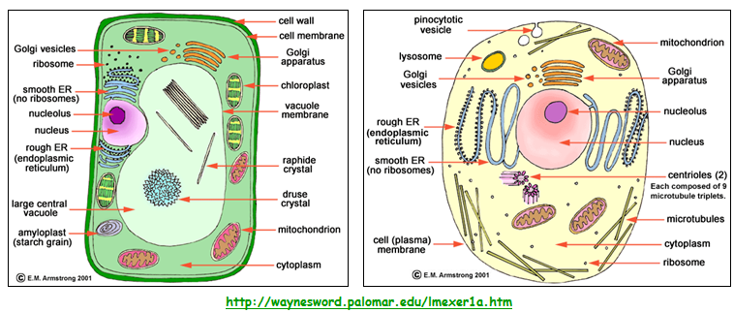
CELLS

Slide 6
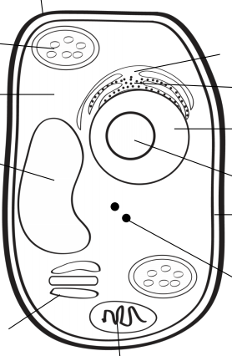
A
B
G
H
C
I
D
J
K
L
E
F

Slide 7
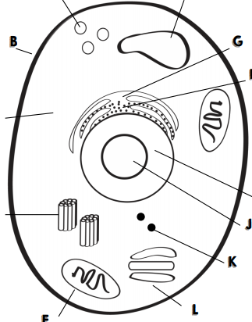
A
F
B
G
H
C
I
D
J
K
L
E

Slide 8
City jobs
Gate/wall around the city
City hall / government building
Mayor
City parks
Building company
Power Plant (factory)
Waste management
Storage facility
Gate keeper / guard
Solar energy farm
Transportation dept.
Post office

Slide 9
Cells
PROKARYOTIC and EUKARYOTIC
Has organelles, but they are not membrane-bound (kinda messy)
Has organelles that ARE membrane-bound (more neat and contained)
Bacteria
Plants
Protists
Animals

Slide 10
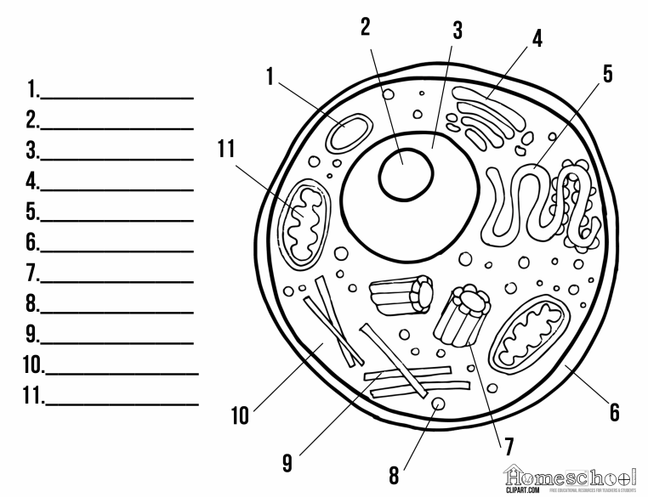
Freebie
Freebie
Freebie

Slide 11
Lysosome
Freebie
Nucleus
Golgi body
Endoplasmic Reticulum
Cell membrane
Freebie
Ribosome
Freebie
Cytoplasm
Mitochondria

Slide 12
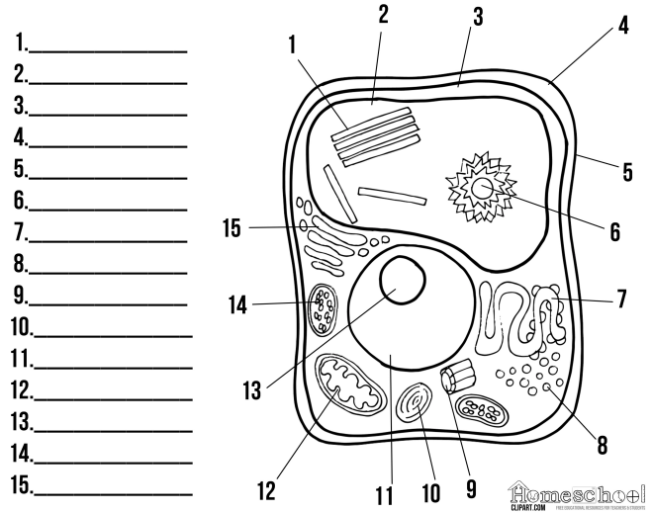
Freebie
Freebie
Freebie
Freebie

Slide 13
Freebie
Vacuole
Cytoplasm
Cell membrane
Cell wall
Freebie
Endoplasmic reticulum
Ribosomes
Freebie
Freebie
Nucleus
Mitochondria
Freebie
Chloroplast
Golgi body

Slide 14
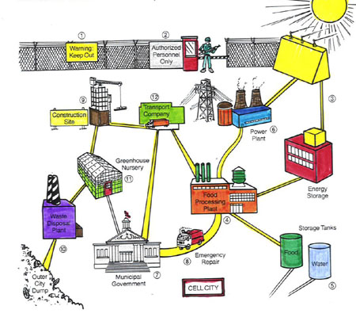
Cell membrane
Cell wall
Endoplasmic Reticulum
Ribosomes
Mitochondria
Cytoplasm
Chloroplast
Golgi body
Chromosomes
Post Office
Lysosome
Nucleus
Vacuole
Nuclear membrane

Slide 15
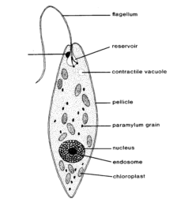
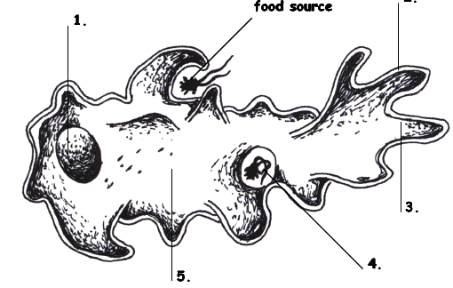
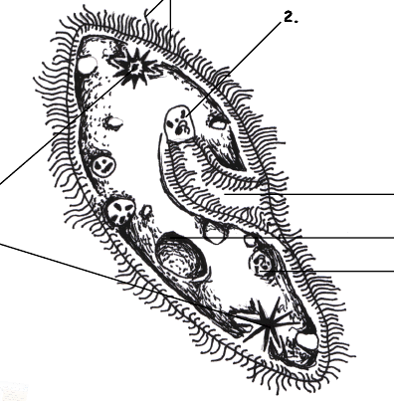
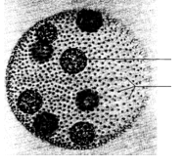
Protists…
Euglena, Amoeba,
Paramecium, and Volvox

Slide 16
Protists…Animal? Plant? Fungus?
Protists are a mix of organisms that don’t exactly fit into the animal, plant, or fungus kingdoms…and sort of fits into all of them!
Protists are __________________ - which means they have a nucleus and other membrane bound organelles. The other category would be prokaryotic. What are we?
eukaryotes

Slide 17
Protists
Uni-cellular
____________________ - one celled organisms.
Some have animal – like qualities (_____________ means “first animal” in Greek)
Some have plant-like qualities like _______________
Some are like fungi
Protozoa
Chlorophyll to use in photosynthesis

Slide 18
Protists – finding food
Those who can feed themselves with photosynthesis are called ________________
Those who must find food in the environment around them (or move to find food) are called ________________________.
Autotrophs
Heterotrophs

Slide 19
Google classroom
Log into the computer using your normal school log in.
Go to the Carrington website and find “departments”
Find the Hornets team page.
Click on Ms.Garris’s science homework page (top right)
Use the links from Ms.Garris’s page only!

Slide 20
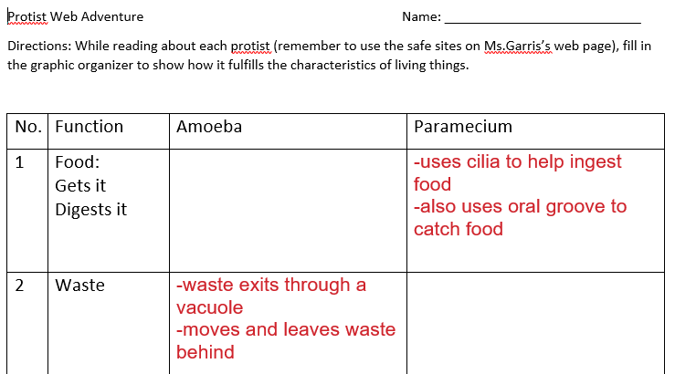

Slide 21
Species | Locomotion | Description | Autotroph or heterotroph | Reproduction
Amoeba
Paramecium
Euglena
Volvox
Protist Notes WS –
Not the same as the
Protist Web Adventure.

Slide 22
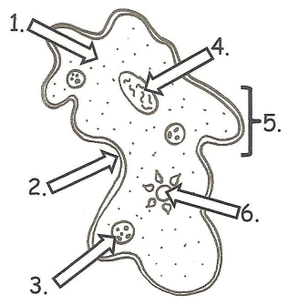
Amoeba

Slide 23
Protists - locomotion
Some use a fake foot that they ooze outward to move, its called a … __________________
One example is the _____________________
Pseudopod
Amoeba

Slide 24
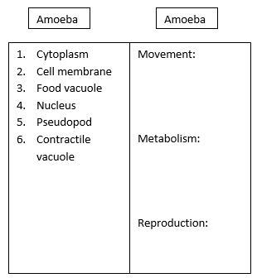
Amoeba
Contractile vacuole
Pseudopod
Cytoplasm
Cell membrane
Food vacuole
Nucleus

Slide 25
Amoeba
1. Cytoplasm
4. Nucleus
5. Pseudopod
2. Cell membrane
6. Contractile vacuole
3. Food vacuole

Slide 26
Locomotion:
Amoeba
Reproduction:
Metabolism:

Slide 27
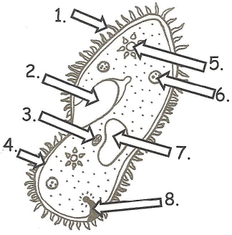
Paramecium

Slide 28
Protists - locomotion
Some have small, hair-like structures that come out of the membrane all over the organism… __________________
One example is the _____________________
Cilia
Paramecium

Slide 29
Paramecium
micronucleus
Macronucleus
Oral groove
Contractile vacuole
Food vacuole
Cell membrane
Anal pore
cilia

Slide 30
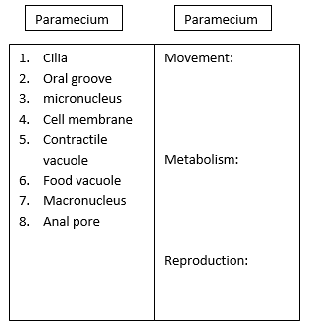
Paramecium
1. cilia
2. Oral groove
5. Contractile vacuole
3. micronucleus
6. Food vacuole
4. Cell membrane
7. Macronucleus
8. Anal pore

Slide 31
Locomotion:
Paramecium
Reproduction:
Metabolism:

Slide 32
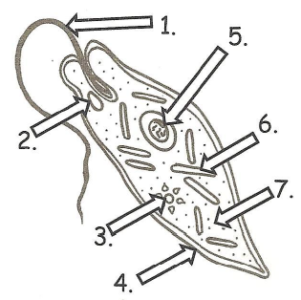
Euglena

Slide 33
Protists - locomotion
Some use a whip-like tail known as a ____________________
One example of this is the __________________
Flagellum
Euglena

Slide 34
Euglena
Contractile vacuole
Flagella
Nucleus
Cytoplasm
Eye spot
Cell membrane
Chloroplast

Slide 35
Euglena
1. Flagella
5. Nucleus
6. Chloroplast
2. Eye spot
7. Cytoplasm
3. Contractile vacuole
4. Cell membrane

Slide 36
Euglena
Locomotion:
Reproduction:
Metabolism:

Slide 37
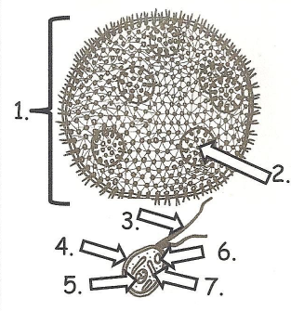
Volvox

Slide 38
Protists - locomotion
Some work with each other – combining flagella and teamwork…
One example is the _____________________
Volvox

Slide 39
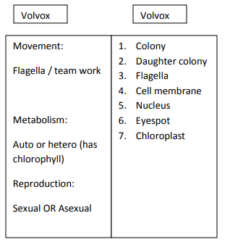
Volvox
Daughter colony
Eyespot
Colony
Flagella
Cell membrane
Chloroplast
Nucleus

Slide 40
Volvox
1. Colony
2. Daughter colony
3. Flagella
4. Cell membrane
6. Eyespot
5. Nucleus
7. Chloroplast

Slide 41
Locomotion:
Volvox
Reproduction:
Metabolism:

Slide 42
Amoeba
Some use a fake foot that they ooze outward to move, its called a … __________________
Single celled or ___________________
They must find food in the environment so they are ________________________________
They reproduce through _____________ which means they simply split into two cells.
Pseudopod
Uni-cellular
Heterotrophs
Fission
Amoeba Feeds! Youtube link

Slide 43
Paramecium
Some have small, hair-like structures that come out of the membrane all over the organism… __________________
Single-celled or ______________________
Collect food from the environment so they must be _____________________
Reproduce through ________________________
Cilia
Uni-cellular
Heterotrophs
Asexual means most often, but sexual reproduction is possible, too
Amazing Microscopic HD Video! Paramecium Feeding!

Slide 44
Euglena
Some use a whip-like tail known as a ____________________
Single celled or ______________________
Can either use photosynthesis OR collect food from the environment so a ________________
Reproduces through _____________________
Flagellum
Uni-cellular
Heterotroph
Fission
Euglena
EUGLENA

Slide 45
Volvox
Some work with each other – combining flagella and teamwork…
Volvox is actually many cells but each is an individual organism – they simply live together in a colony for the ease of life.
Contain chlorophyll so must be _______________ but can also collect NUTRIENTS from the environment so considered both ________________________________
Plant-like
Auto and heterotroph

Slide 46
Volvox
Each of the cells have two flagella and they must coordinate them to cause motion for the entire colony.
They have a red “eye” spot that can help determine light.
They work together but seem to have poles (so they know forward and back.
The volvox colony will reproduce new cells through asexual reproduction, but also has the ability to go to sexual reproduction so two separate colonies would be needed.
Volvox Dances!

Slide 47
All of our protists…Review at this site!
http://www.harcourtschool.com/activity/science_up_close/602/deploy/interface.html

Slide 48
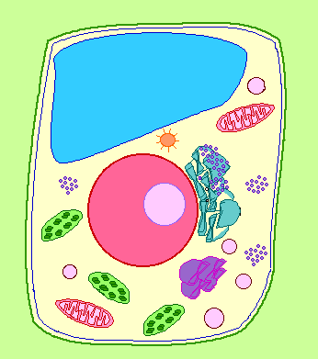
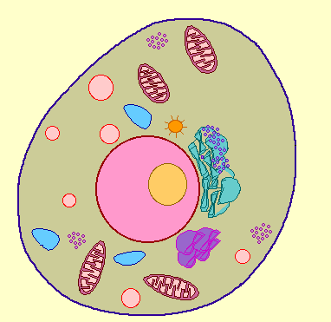
Cell Membrane
BOTH Plant and Animal Cells
Function: controls what substances enter and exit the cell
Analogy to City: City “Gate Keeper”

Slide 49
Cell Wall
PLANT CELLS ONLY
Function: surrounds plants to protect and support the cell
Analogy to City: City Border

Slide 50
Nucleus
BOTH Plant and Animal Cells
Function: directs all the cells activities (brain of cell)
Analogy to City: City Hall

Slide 51
Nucleolus
BOTH Plant and Animal Cells
Function: makes ribosomes inside the nucleus
Analogy to City: Copy Machine Inside City Hall

Slide 52
Nuclear Membrane
BOTH Plant and Animal Cells
Function: controls what enters and leaves the nucleus, protects
Analogy to City: gate around City Hall

Slide 53
Chromosomes
BOTH Plant and Animal Cells
Function: contains the important blueprints of the cell or DNA
Analogy to City: City Mayor

Slide 54
Vacuole
BOTH Plant and Animal Cells
Function: stores food, water, waste, and other materials
Analogy to City: Warehouses, Water Towers, etc.

Slide 55
Chloroplast
PLANT CELLS ONLY
Function: captures energy from sunlight and produces food
Analogy to City: Solar Energy Plant

Slide 56
Endoplasmic Reticulum
BOTH Plant and Animal Cells
Function: built proteins and move them throughout cell or out of cell (Smooth – no ribosomes, Rough – ribosomes)
Analogy to City: City Transportation Department

Slide 57
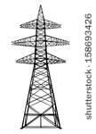
Cytoplasm
BOTH Plant and Animal Cells
Function: gel-like fluid between cell membrane and nucleus, allows other organelles to float freely through cell
Analogy to City: City Yards

Slide 58
Ribosomes
BOTH Plant and Animal Cells
Function: produce proteins
Analogy to City: Construction Company

Slide 59
Lysosomes
ANIMAL CELLS ONLY
Function: contain chemicals that break down food particles and worn out cell parts
Analogy to City: Recycle or Waste Management Company

Slide 60
Mitochondria
BOTH Plant and Animal Cells
Function: rod-shaped organelle that produce energy (powerhouse)
Analogy to City: Energy Plant

Slide 61
Golgi Body
BOTH Plant and Animal Cells
Function: receives materials from the endoplasmic reticulum and sends them to other parts of the cell
Analogy to City: Post Office
Post Office

Slide 62
The Whole City…
Post Office

Slide 63
1. Choose the wrong statement from the following.
a) Mitochondria produces most of the energy for the cell.
b) Chloroplasts are “food producers.”
c) Cell wall controls the movements of materials into and out of the cell.
d) Nucleus regulates and controls all cell activities, acting as the “brain” of the cell.

Slide 64
2. Match the cell part to the nickname.
1) Cytoplasm
2) Nuclear membrane
3) Vacuoles
a. Gate of the nucleus
b. Area of movement where cell parts move
c. Storage tanks

Slide 65
School analogy
Cut the doors/windows – just three sides.
Put the schoolhouse onto colorful paper and trace the box space.
Remove the schoolhouse and cut out the square place descriptions.
Determine where each square goes – and then glue!
Put schoolhouse over top and glue.

Slide 66
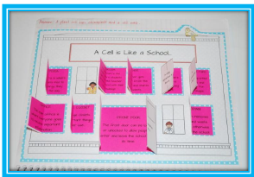

Slide 67
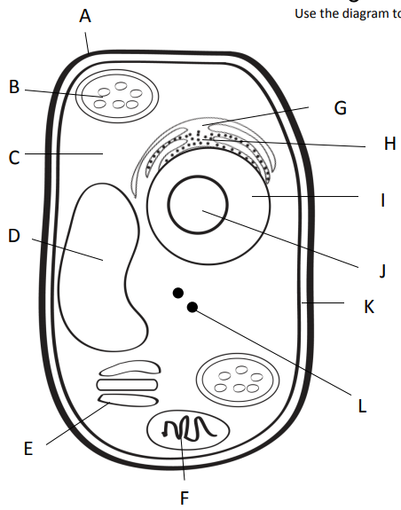
Outer most part of plant cell.
Makes food from sunlight
Road (smooth)
Road (rough)
Gel surrounding all
Controls cell
Storage
Copies ribosomes
Inner part of outer covering of plant cell.
Protein factory
Packaging plant
Power factory

Slide 68
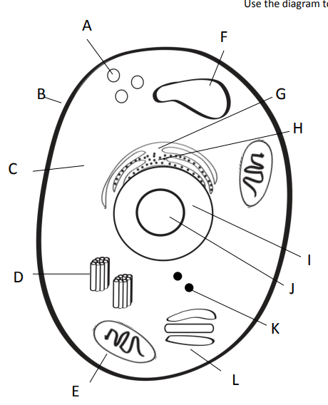
Clean up (pac-man)
Storage
Outer covering of an animal cell.
Road (smooth)
Road (rough)
Gel surrounding all
Controls cell
Copies ribosomes
Centrioles = help in cell division (reproduction)
Protein factory
Power factory
Packaging plant

