Slide 1
Oct. 16, 2019
You need:
Clean paper / pencil
Papers to turn in
Warm Up:
What the characteristics shown in MRS NERG-C?
I CAN: identify the influence of microscopes
I CAN: determine the parts of the Cell Theory

Slide 2
Checklist:
Zoom
Reminder of cells in hierarchy
Spontaneous generation
Cell theory
Can’t see cells without scopes
MICRO-SCOPE
Scope stations? Sciencespot.net
Leeuwenhoek and Hooke

Slide 4
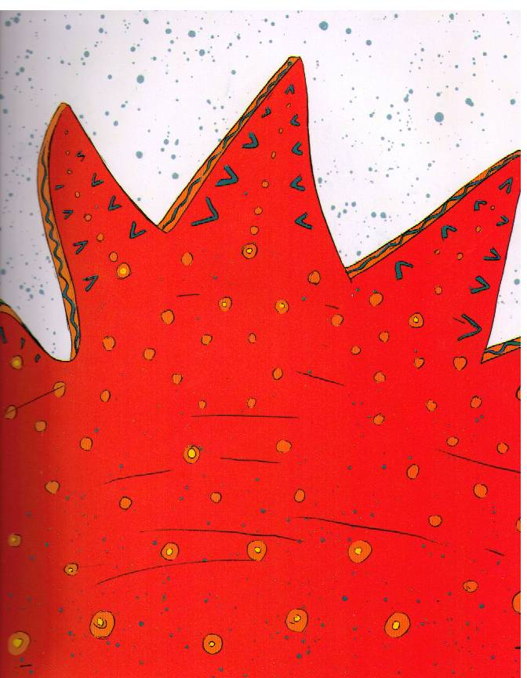

Slide 5
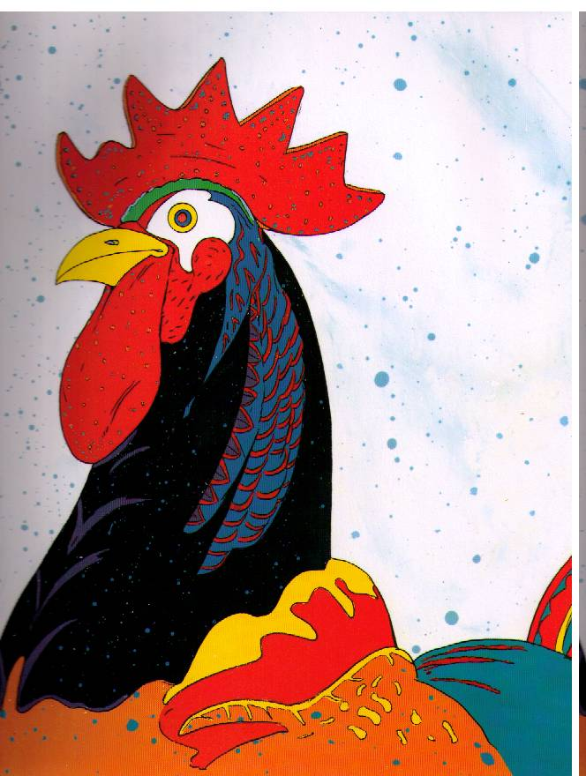

Slide 6
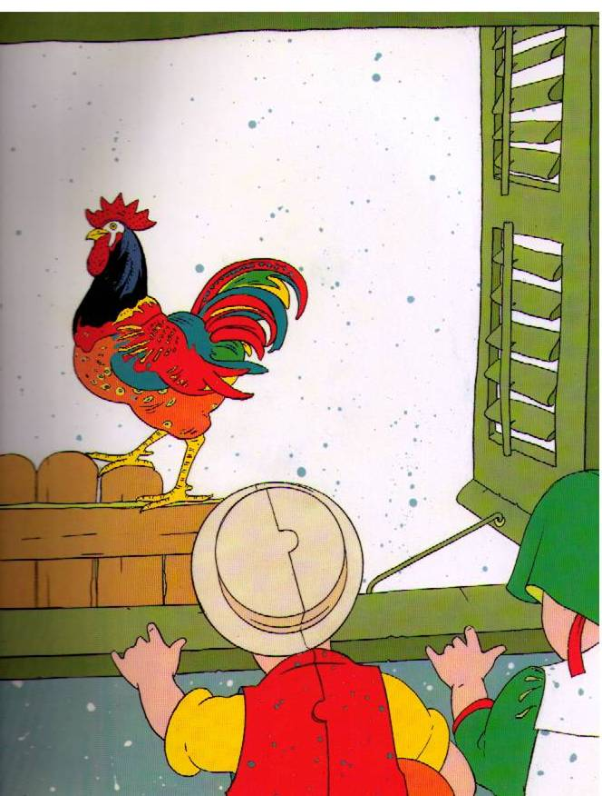

Slide 7
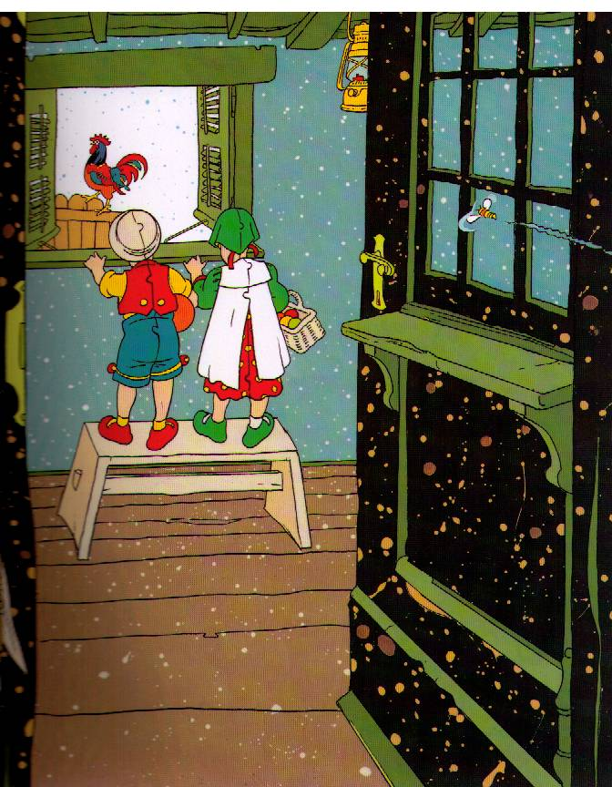

Slide 8
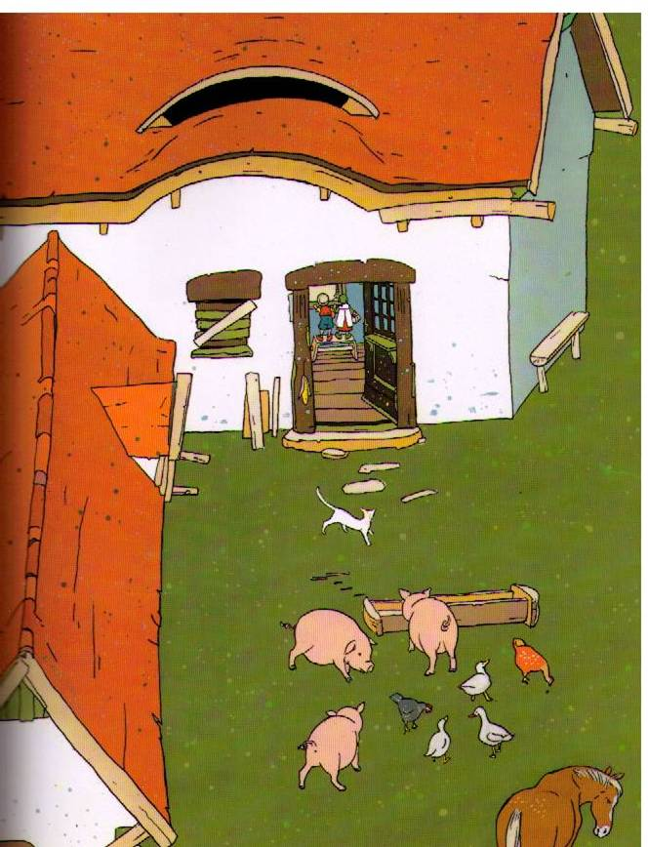

Slide 9
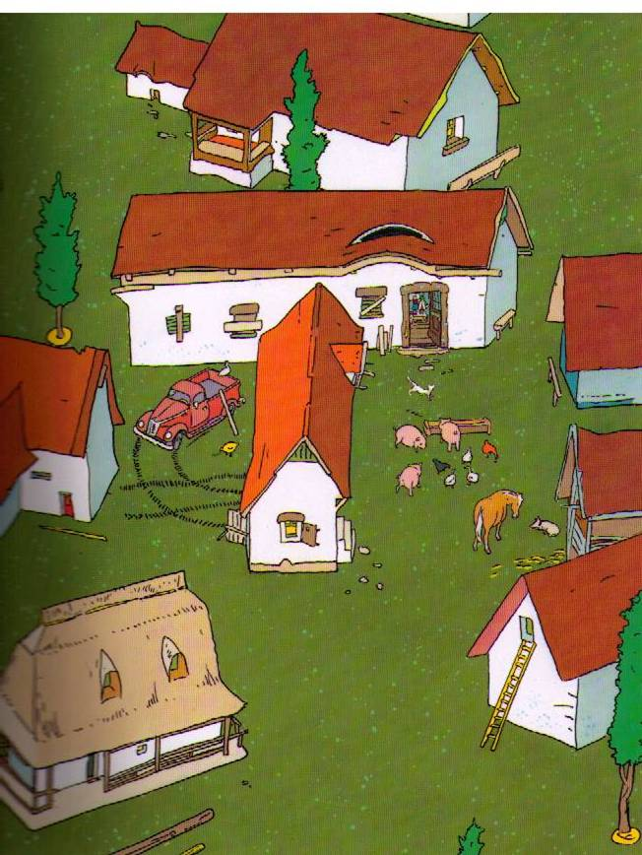

Slide 10
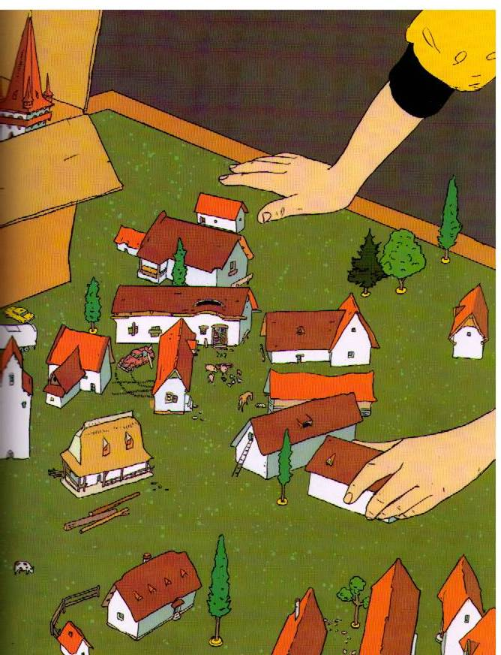

Slide 11
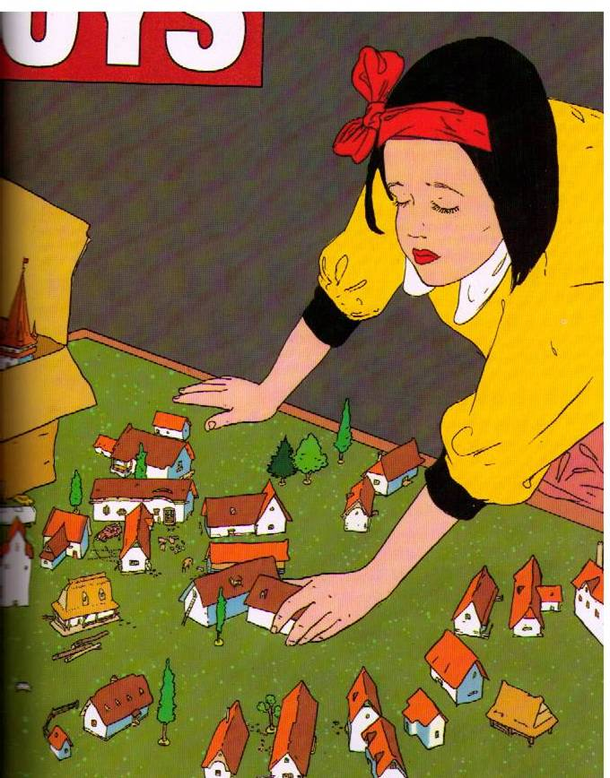

Slide 12
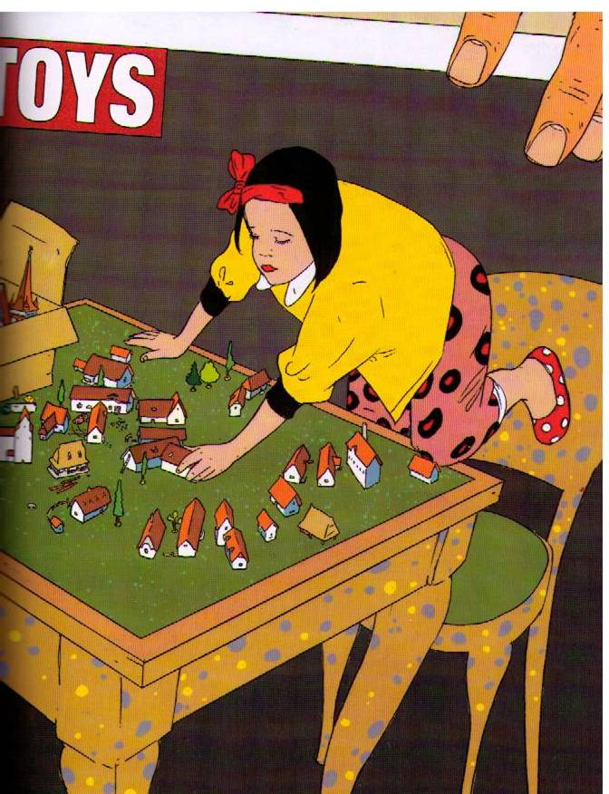

Slide 14
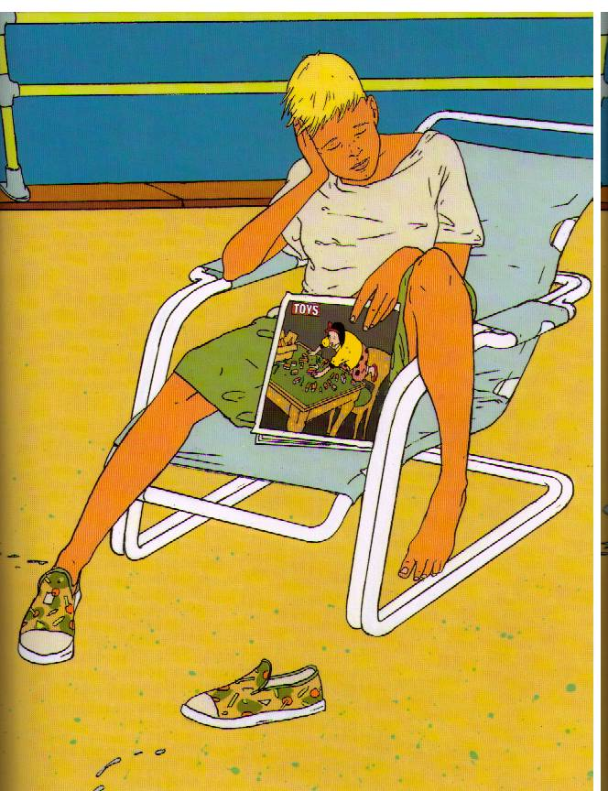

Slide 15
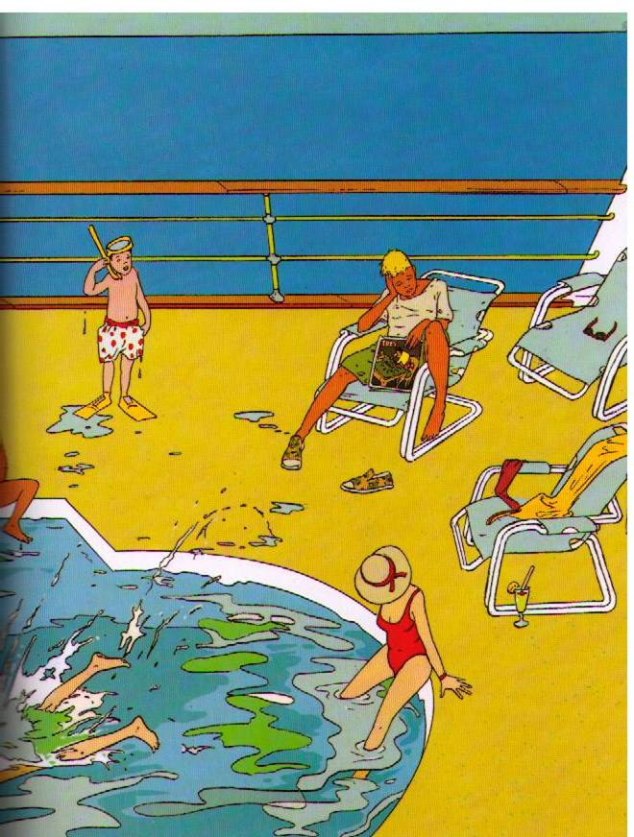

Slide 16
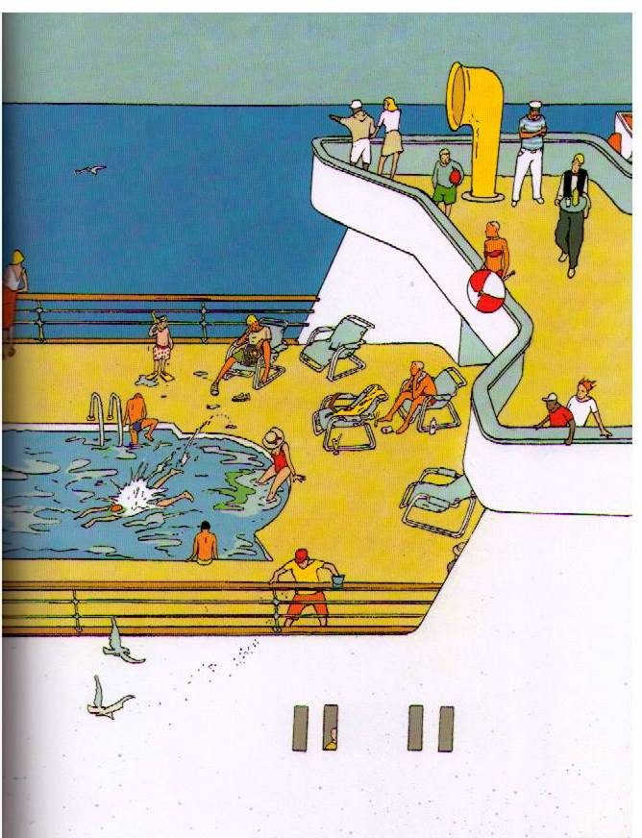

Slide 17
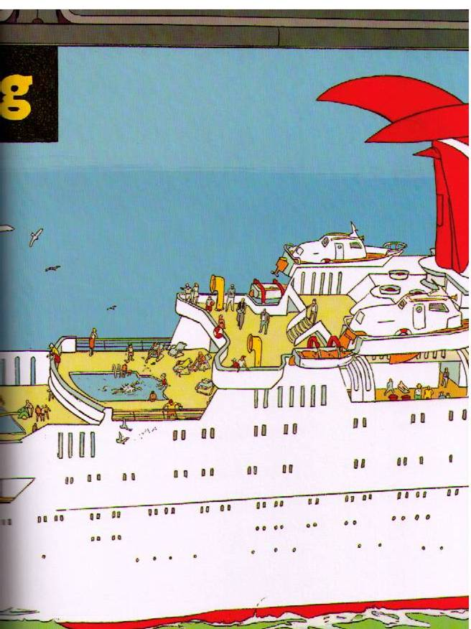

Slide 18
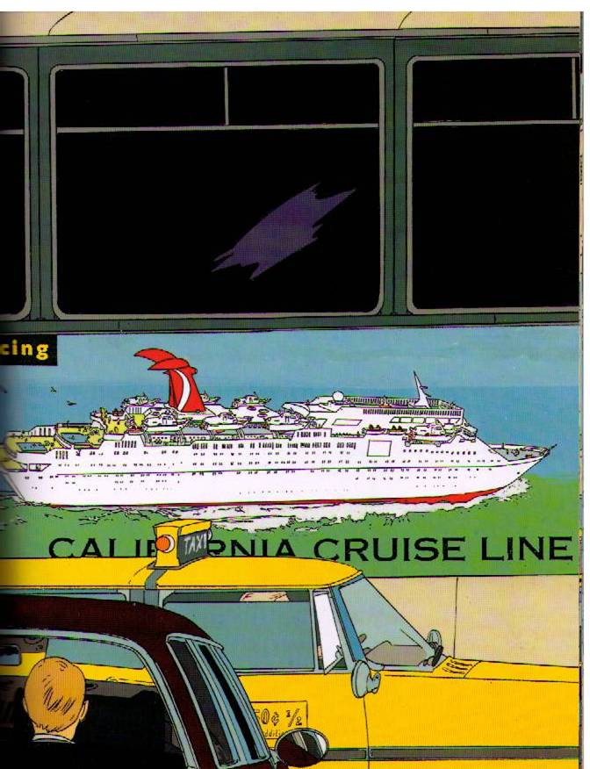

Slide 19
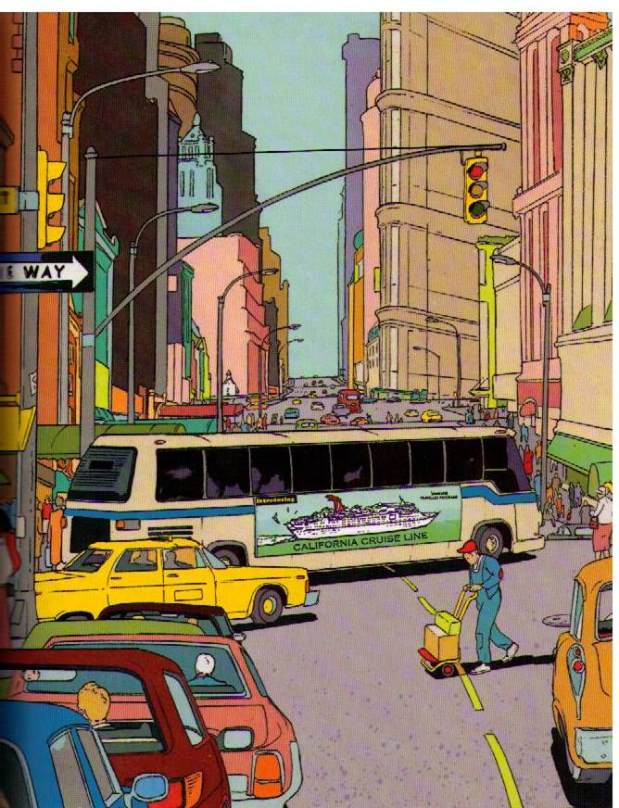

Slide 20
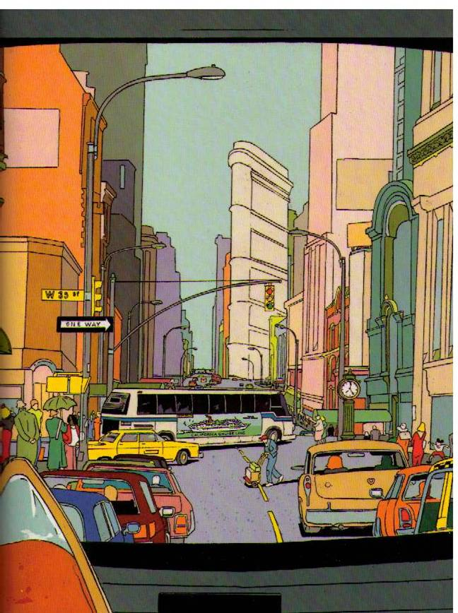

Slide 21
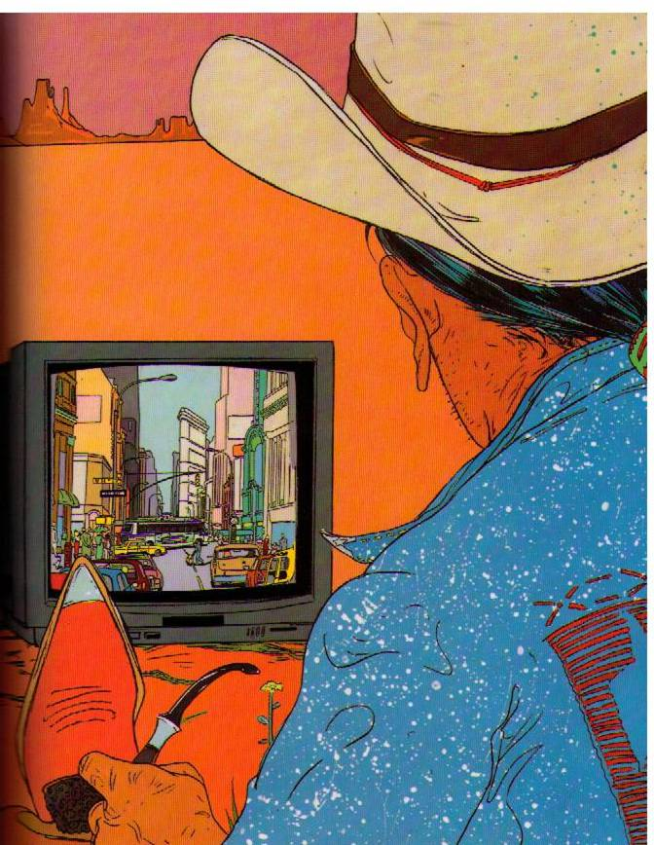

Slide 22
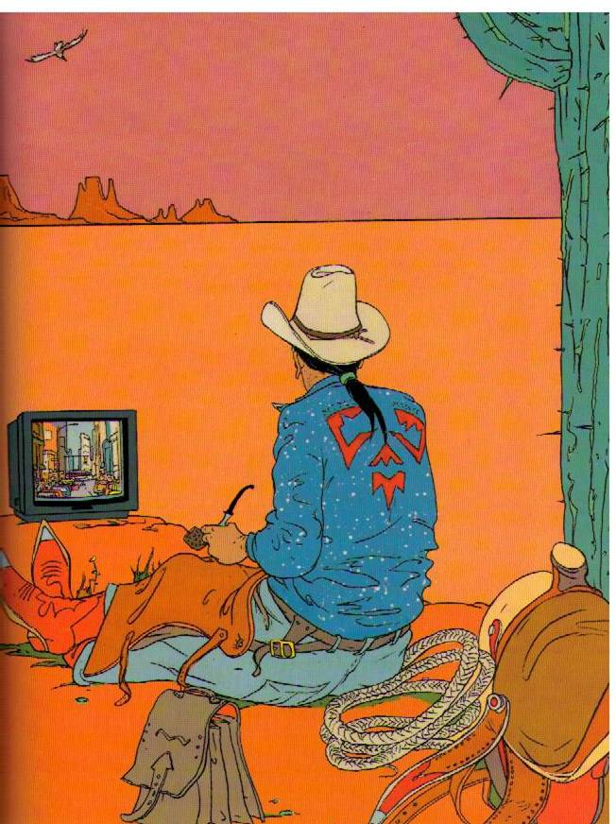

Slide 23
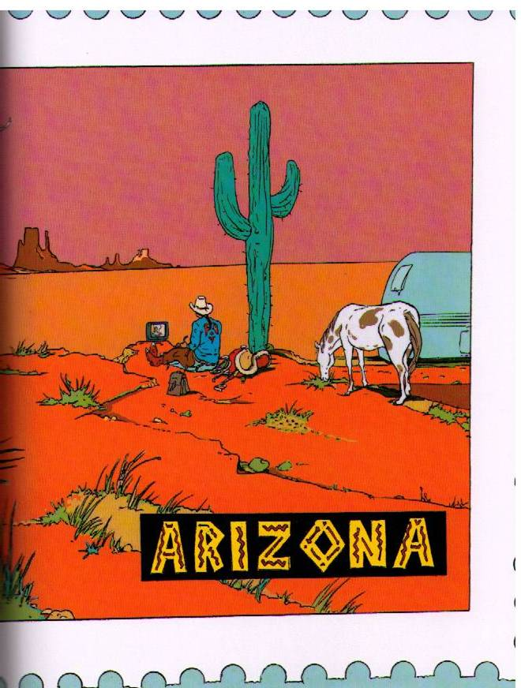

Slide 24
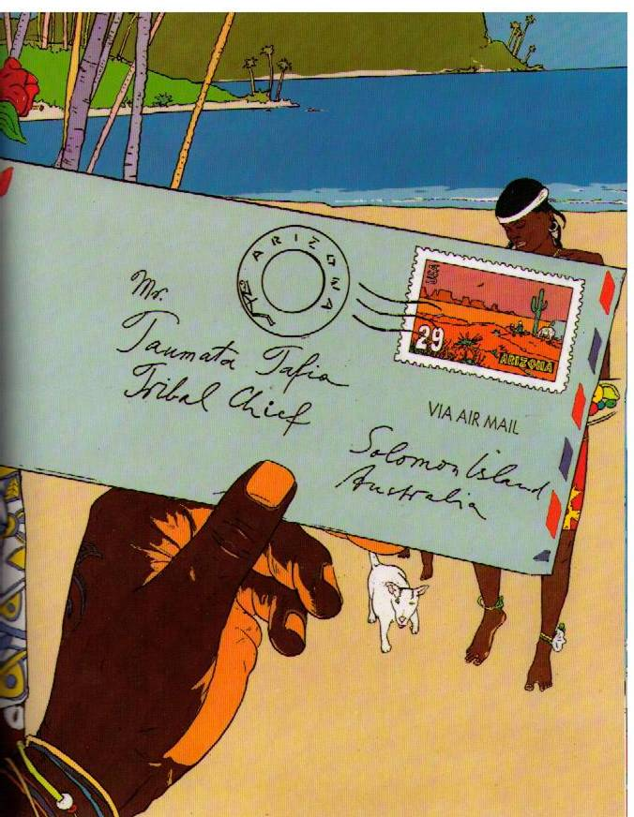

Slide 25
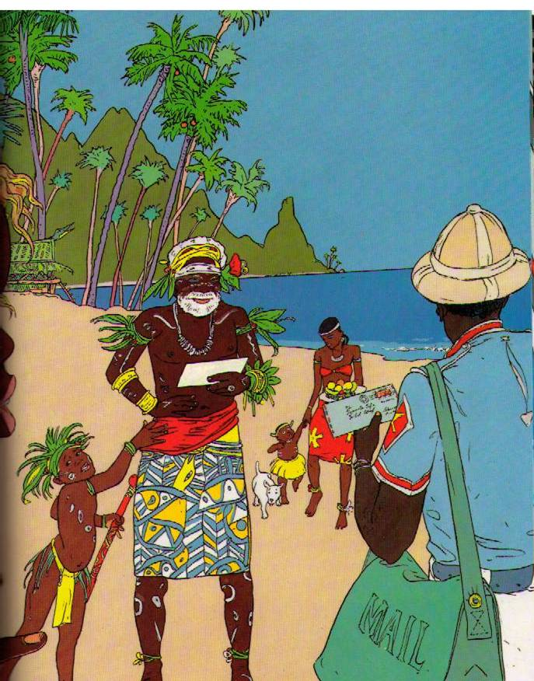

Slide 26
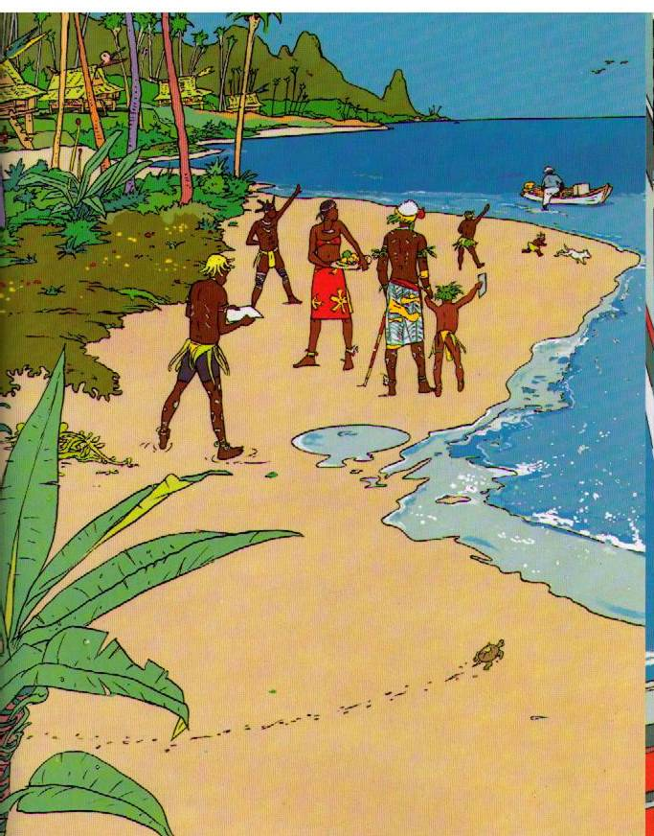

Slide 27
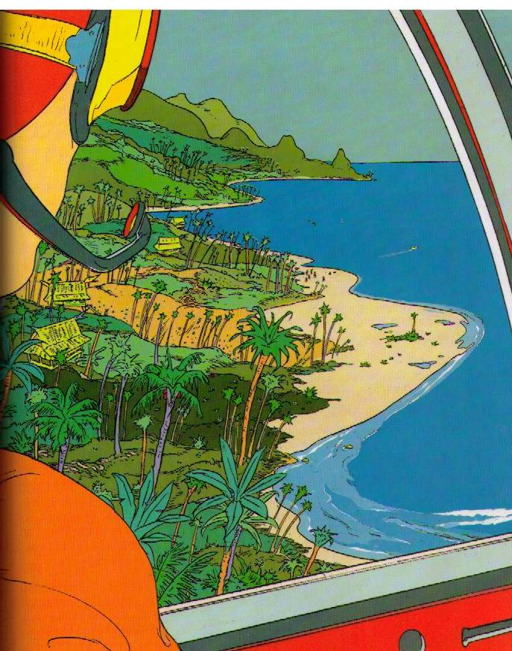

Slide 28
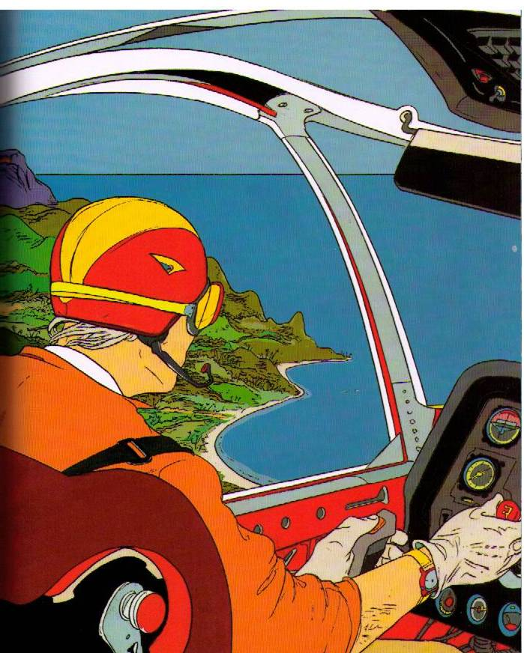

Slide 29
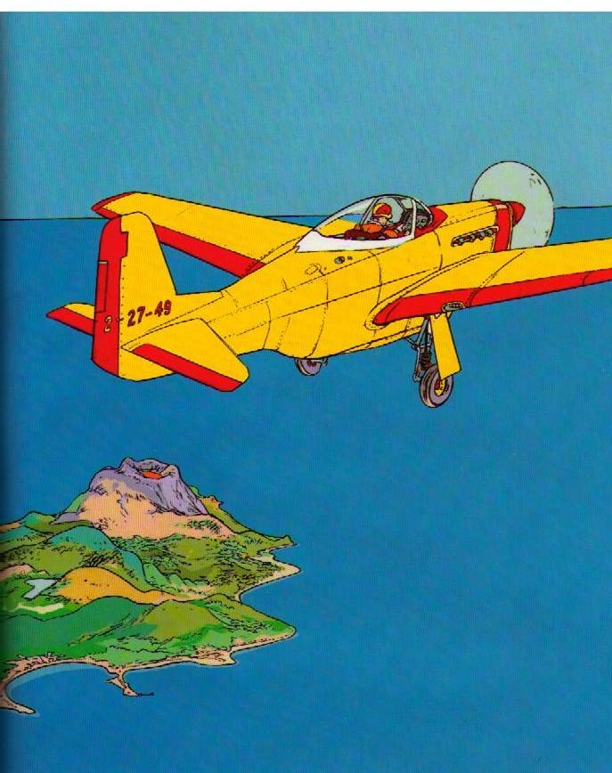

Slide 30
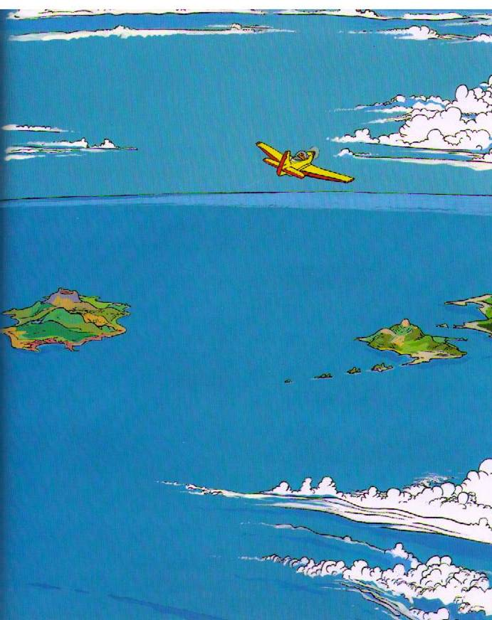

Slide 31
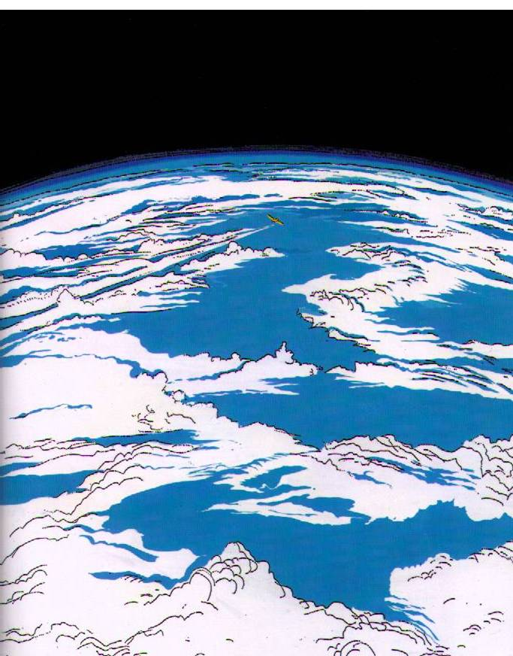

Slide 32
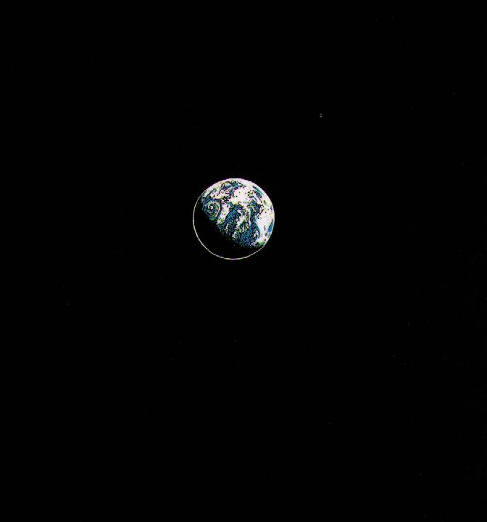

Slide 34
Spontaneous Generation
NOW we know that isn’t the way mice are created…right?

Slide 35
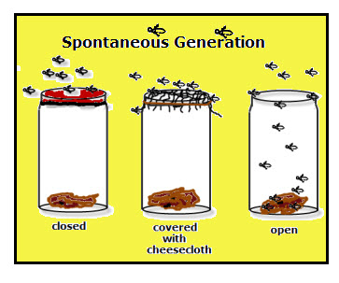
Spontaneous Generation
Francesco Redi designed an experiment…

Slide 36
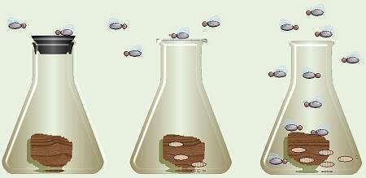
Francesco Redi – (1668)
People believed flies spontaneously came from meat… “Spontaneous Generation”
Redi covered one flask, left one open to air.
Observed flies laying eggs on meat.
Flies come from flies. Life comes from life.
Copyright © 2010 Ryan P. Murphy

Slide 37
Cell Theory
Eventually people were able to create the Cell Theory…Schleiden, Schwann, and Virchow are credited.
All living things are composed of cells
Cells are the basic structure of all living things
Cells can only come from other living cells

Slide 38
Francesco Redi (1668)
Life comes from life.
Schleiden (1838)
Plants are made of cells…cells are basic building block of all plants.
Schwann (1839)
Animals are made of cells…cells are basic building block of all living things.
Virchow (1850)
Cells come from other living cells.

Slide 39
A short video
https://youtu.be/Dlbh6024R1c (has Bill Nye)
About spontaneous generation…which led to other discoveries…which led to the CELL THEORY!
Another quick video about the crazy history of the Cell Theory. https://youtu.be/4OpBylwH9DU
Notes:
Two different videos – neither is a must, but both are cute. First is older, second is Ted Ed and cartoon with narration.

Slide 40
Microscope…Micro / Scope
In order to learn about cells, folks had to be able to see them.
We credit: Robert Hooke AND Anton van Leeuwenhoek

Slide 41
Robert Hooke (1665)
Used a COMPOUND microscope
Saw cork (dead plant cells)
Described the cell walls (boxes) as “CELLS”
Anton van Leeuwenhoek (1670)
Looked at pond water…living cells
Described the moving beings as “animal-cules”

Slide 42
Stations?
Sciencespot.net stations are awesome
Station #1 – Mystery Pix / What are looking at?
Station #2 – Making a slide (“e”)
Station #3 – Select a slide (already prepared)
Station #4 – What’s in pond water?
Station #5 - Microscope basics
Stations #6 – online microscopes
Notes:
Sciencespot.net
Look in the biology section for Microscope Mania. Answer documents, pictures, instructions, links – all done. You have to set up the station with the microscope and the supplies…some supplies to make a letter “e” slide, some prepared/glued/store bought, some well slides with pond water.
The Mystery Pix, Microscope basics are things done at their own seat – no computer or microscope needed.
The online microscope requires a computer and internet access.

Slide 43
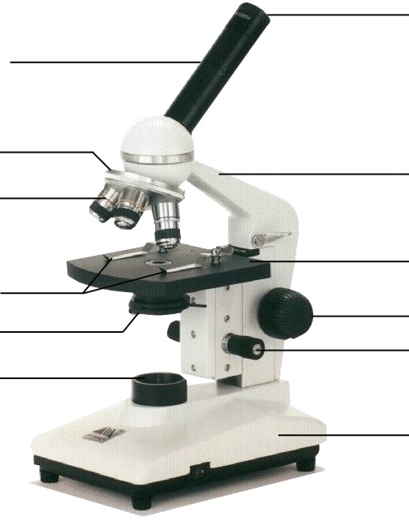
Compound Microscope
1. Eye Piece or Ocular – lens closest to the eye.
2. Body Tube – gives distance between eyepiece and objective.
3. Nose Piece – holds the objectives.
4. Arm – holds the tube and lenses.
5. Objective lenses –
lens closest to the slide.
6. Stage – platform for the slides.
7. Stage clips –
Holds the slide in place.
8. Coarse Adjustment knob –
Moves stage up/down (to focus).
9. Diaphragm / IRIS –
Controls the amount of light.
11. Light –
Shines light through the slide, lens, tube.
10. Fine Adjustment knob –
Moves stage up/down slightly
12. Base – Holds up the entire microscope.

Slide 44
MRS. NERG-C
The list of characteristics something MUST have to be considered LIVING…!
Movement
Respiration
Sensory
Nutrients (6)
Excretion
Reproduction
Growth
Cells

Slide 45
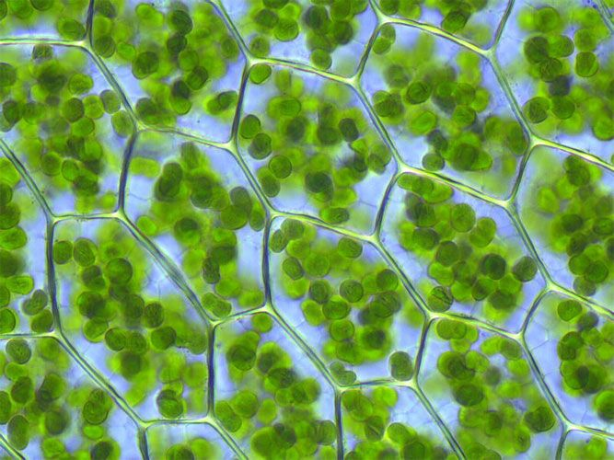
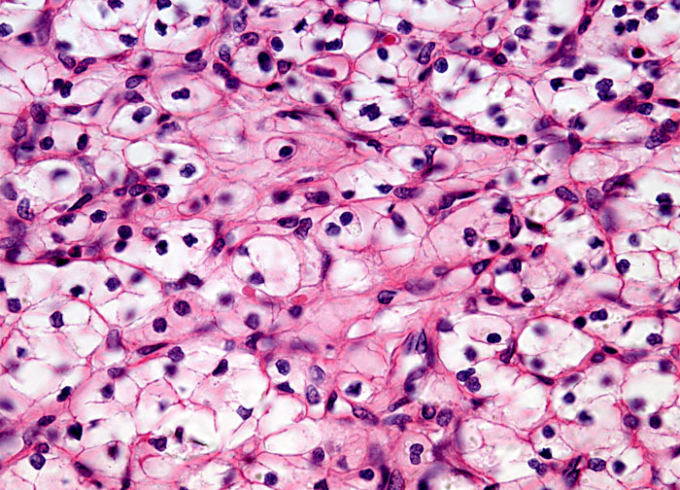
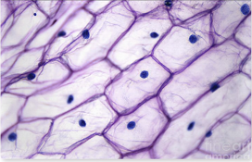
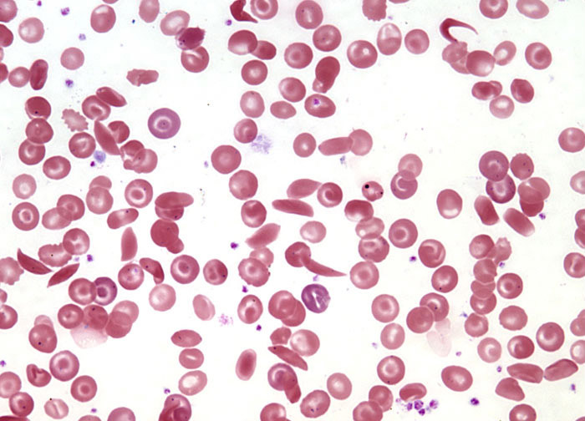
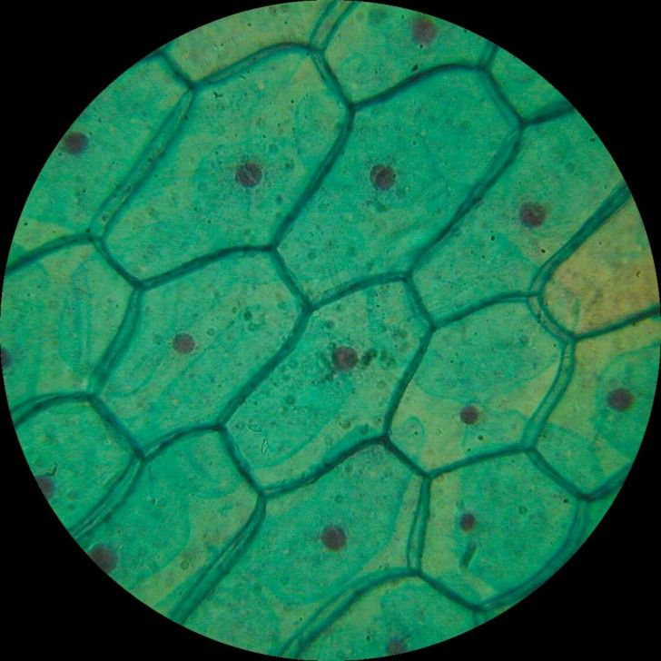
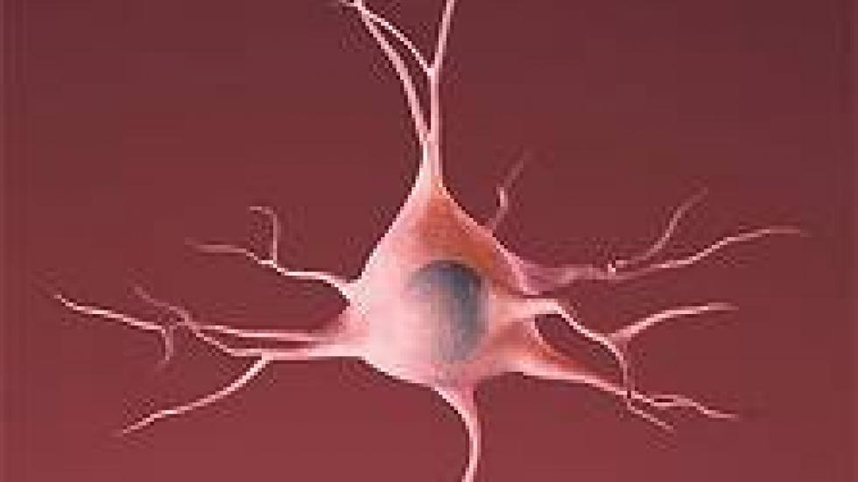

Slide 46
General observations?
Alike?
Different?

Slide 47
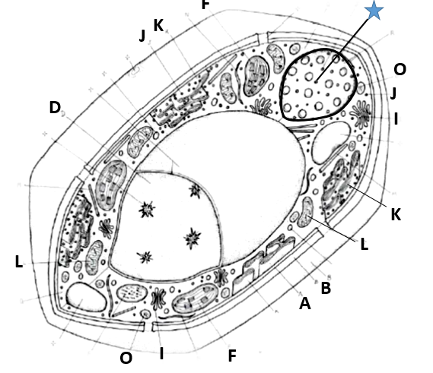
Notes:
We have these in coloring pages. I HIGHLY recommend that students color in the word with whatever color – but then use the SAME color to color in the organelle within the cell. We also have cell and organelle notes – if needed.
This is plant. It’s boxy, has chloroplast, and its vacuole is large (due to limited mobility).

Slide 48
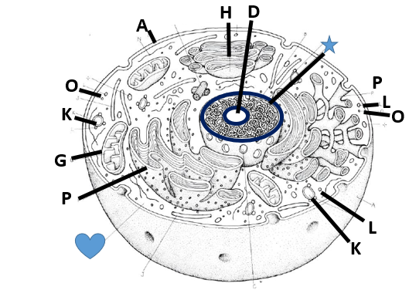
Notes:
Animal cell – I love the coloring pages.

Slide 49
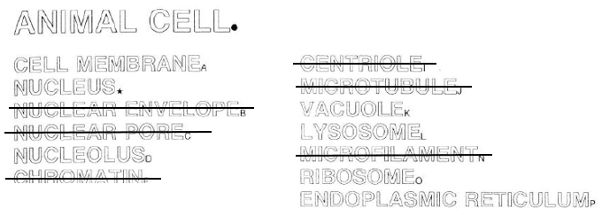
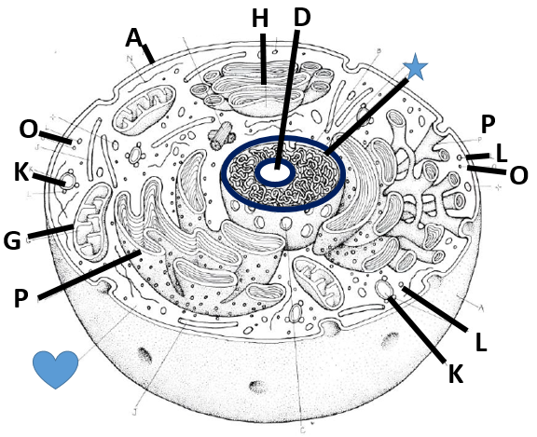

Slide 50
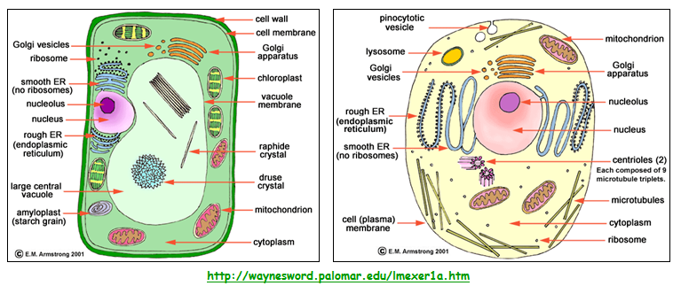
CELLS

Slide 51
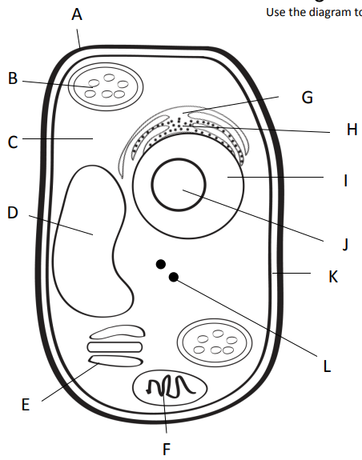
Outer most part of plant cell.
Makes food from sunlight
Road (smooth)
Road (rough)
Gel surrounding all
Controls cell
Storage
Copies ribosomes
Inner part of outer covering of plant cell.
Protein factory
Packaging plant
Power factory

Slide 52
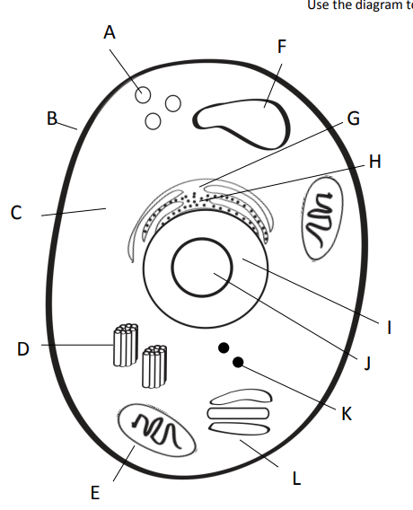
Clean up (pac-man)
Storage
Outer covering of an animal cell.
Road (smooth)
Road (rough)
Gel surrounding all
Controls cell
Copies ribosomes
Centrioles = help in cell division (reproduction)
Protein factory
Power factory
Packaging plant

Slide 53
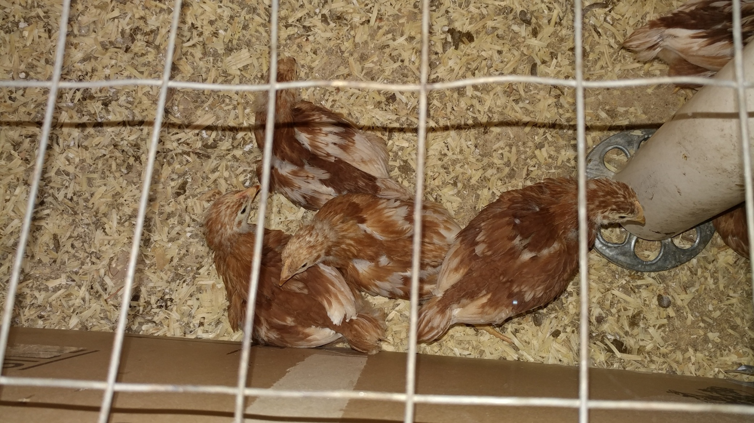

Slide 54
Egg | Water | Corn syrup | Blue paint | Blue food color
Color
Shape
Size
Texture/feel
weight
Write your hypothesis!

Slide 55
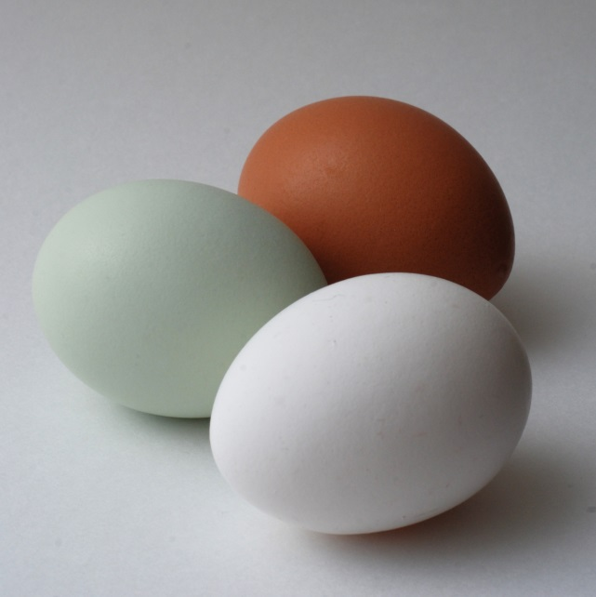
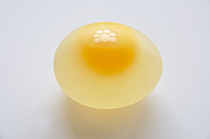
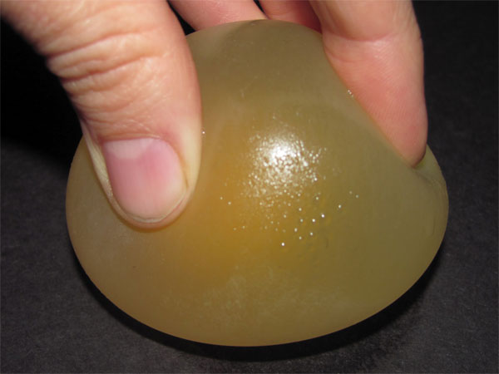
Observations of an egg
Observations of “de-shelled” egg

Slide 56
Eggs – let’s egg-speriment!!!
What will happen to the egg if…?
Write what you think will happen to the egg’s:
Color
Shape
Size
Texture/feel
weight

Slide 57
Egg | Water | Corn syrup | Blue paint | Blue food color
Color
Shape
Size
Texture/feel
weight

Slide 58
Check your chart
Soaking liquid | Initial Mass | Hypothesis | Mass after soak | Net change | Observations
No liquid
No liquid
water
water
Corn syrup
Corn syrup
Paint
Paint
Food color
Food color
85.2g
Mass
83.2 g
2.0 g
81.9g
80.0g
1.9 g
87.4g
88.6 g
1.2 g
86.6g
88.0 g
1.4 g
89.8g
85.4 g
4.4 g
88.7g
86.5 g
2.2 g
86.1g
88.4 g
2.3 g
85.6g
86.5 g
0.9 g
92.0g
93.4 g
1.4 g
87.0g
89.1 g
2.1 g

Slide 59
CELLS
Even if cells are very tiny, they are made up of smaller parts, and the parts do different jobs.
Cell membrane
Nucleus

Slide 60
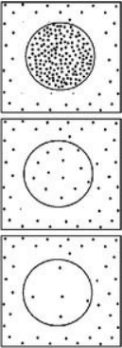
Osmosis – “osmos” is Greek…to push
Movement of WATER through a semi-permeable membrane…for balance.
Diffusion – mvmt of particles

Slide 61
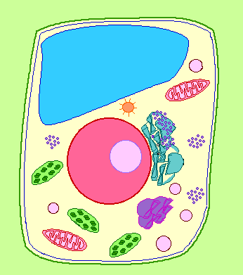
Cell Membrane
BOTH Plant and Animal Cells
Function: controls what substances enter and exit the cell
Analogy to City: City “Gate Keeper”

Slide 62
Cell Wall
PLANT CELLS ONLY
Function: surrounds plants to protect and support the cell
Analogy to City: City Border

Slide 63
Nucleus
BOTH Plant and Animal Cells
Function: directs all the cells activities (brain of cell)
Analogy to City: City Hall

Slide 64
Nucleolus
BOTH Plant and Animal Cells
Function: makes ribosomes inside the nucleus
Analogy to City: Copy Machine Inside City Hall

Slide 65
Nuclear Membrane
BOTH Plant and Animal Cells
Function: controls what enters and leaves the nucleus, protects
Analogy to City: gate around City Hall

Slide 66
Chromosomes
BOTH Plant and Animal Cells
Function: contains the important blueprints of the cell or DNA
Analogy to City: City Mayor

Slide 67
Vacuole
BOTH Plant and Animal Cells
Function: stores food, water, waste, and other materials
Analogy to City: Warehouses, Water Towers, etc.

Slide 68
Chloroplast
PLANT CELLS ONLY
Function: captures energy from sunlight and produces food
Analogy to City: Solar Energy Plant

Slide 69
Endoplasmic Reticulum
BOTH Plant and Animal Cells
Function: built proteins and move them throughout cell or out of cell (Smooth – no ribosomes, Rough – ribosomes)
Analogy to City: City Transportation Department

Slide 70
Cytoplasm
BOTH Plant and Animal Cells
Function: gel-like fluid between cell membrane and nucleus, allows other organelles to float freely through cell
Analogy to City: City Yards

Slide 71
Ribosomes
BOTH Plant and Animal Cells
Function: produce proteins
Analogy to City: Construction Company

Slide 72
Lysosomes
ANIMAL CELLS ONLY
Function: contain chemicals that break down food particles and worn out cell parts
Analogy to City: Recycle or Waste Management Company

Slide 73
Mitochondria
BOTH Plant and Animal Cells
Function: rod-shaped organelle that produce energy (powerhouse)
Analogy to City: Energy Plant

Slide 74
Golgi Body
BOTH Plant and Animal Cells
Function: receives materials from the endoplasmic reticulum and sends them to other parts of the cell
Analogy to City: Post Office
Post Office

Slide 75
The Whole City…
Post Office

Slide 76
1. Choose the wrong statement from the following.
a) Mitochondria produces most of the energy for the cell.
b) Chloroplasts are “food producers.”
c) Cell wall controls the movements of materials into and out of the cell.
d) Nucleus regulates and controls all cell activities, acting as the “brain” of the cell.

Slide 77
2. Match the cell part to the nickname.
1) Cytoplasm
2) Nuclear membrane
3) Vacuoles
a. Gate of the nucleus
b. Area of movement where cell parts move
c. Storage tanks

Slide 78
School analogy
Cut the doors/windows – just three sides.
Put the schoolhouse onto colorful paper and trace the box space.
Remove the schoolhouse and cut out the square place descriptions.
Determine where each square goes – and then glue!
Put schoolhouse over top and glue.

