Slide 1
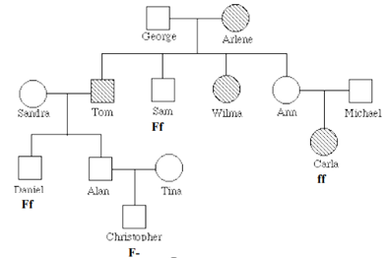
Jan. 9, 2020
You need:
Clean paper (2) / pencil
Spongebob: Blood type & Sex-Linked WS
Snowman Project (lab and new picture)
Studying Pedigree WS
Warm Up:
What is the GENOTYPE
of Alan?
I CAN: interpret a pedigree and identify genetic disorders.

Slide 2
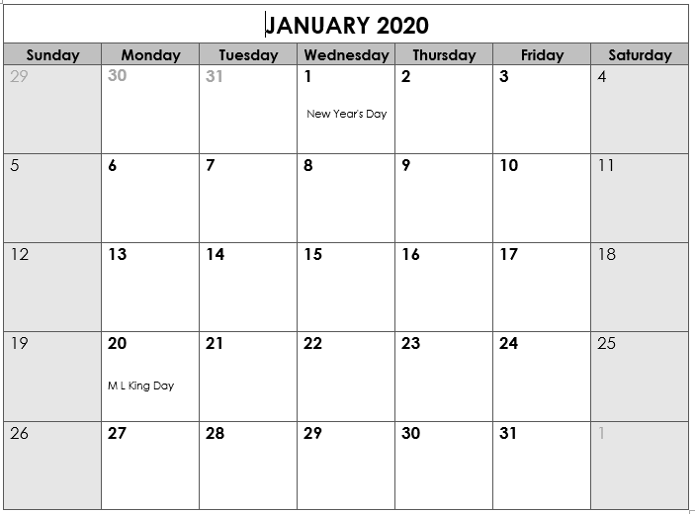
Back to School
“B” day
No elective 1A…stay with homebase
6th grade SWAGbrrr
Benchmark ELA
@ 11:30
Benchmark Math @ 11:30
Genetics TEST
*End Qtr 2
Teacher Workday
Teacher Workday (Weather?)
School Holiday
8th grade SWAGbrrr
7th grade SWAGbrrr

Slide 3
Today’s agenda
Review notes on genetics
Snowman PROJECT
Pedigree

Slide 4
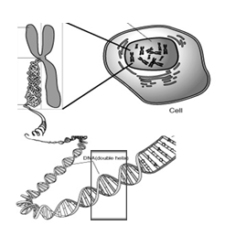
Nucleus
Chromosome
Cell
Gene
DNA

Slide 5
Vocabulary
Chromosomes – DNA wound into cute pkg
Genes – section of DNA/chromosome that codes for a specific trait
Traits – an organism’s physical features
Phenotype – the way something looks on the outside (based on DNA)
Genotype – the genes inside (usually represented with two letters – LL, Ll, ll)

Slide 6
Vocabulary
Dominant allele – the version of a gene that WILL show if present.
Recessive allele – the version of a gene that may get hidden. Only shows if there is nothing to cover it.
HOMOzygous – an organism with two of the SAME alleles for a specific trait.
HETEROzygous – an organism with DIFFERENT alleles for a specific trait.

Slide 7
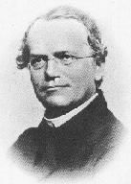
Gregor Mendel
1822-1884
“Father of Genetics”

Slide 8
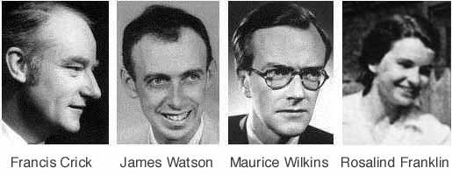

Nobel Prize 1962
1920-1958

Slide 9
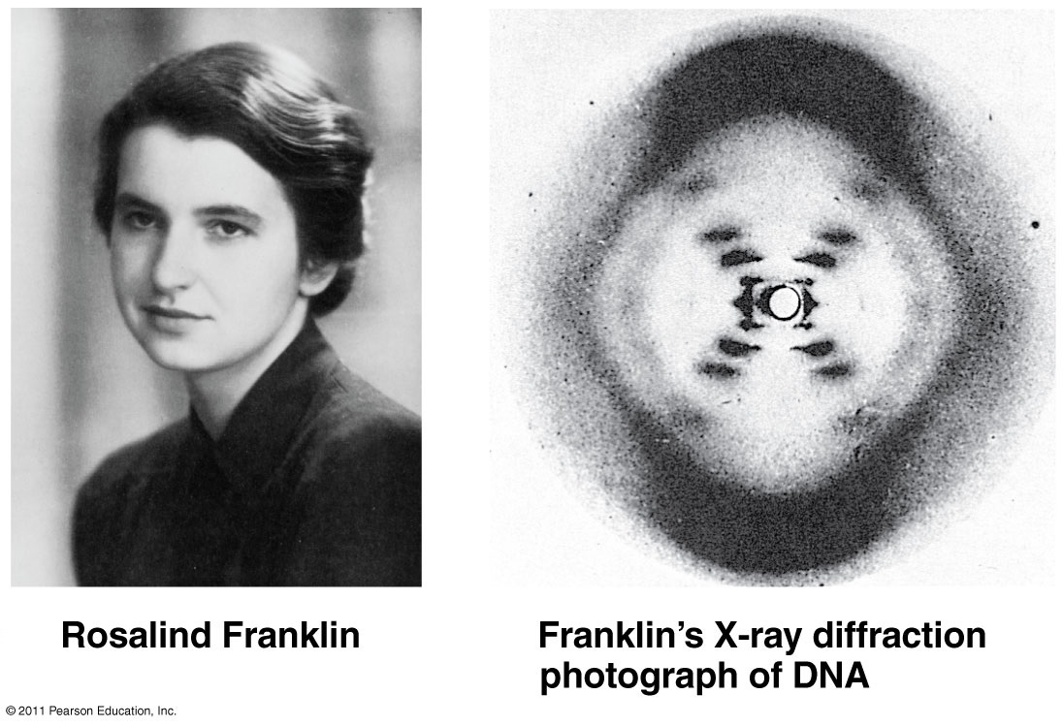

Slide 10
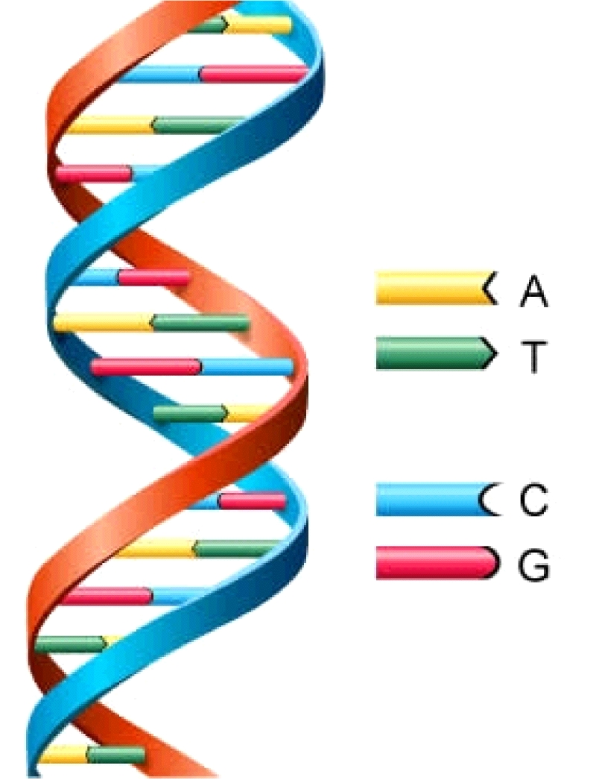
DNA
Deoxyribonucleic Acid
Double Helix (twisted ladder) shape

Slide 11
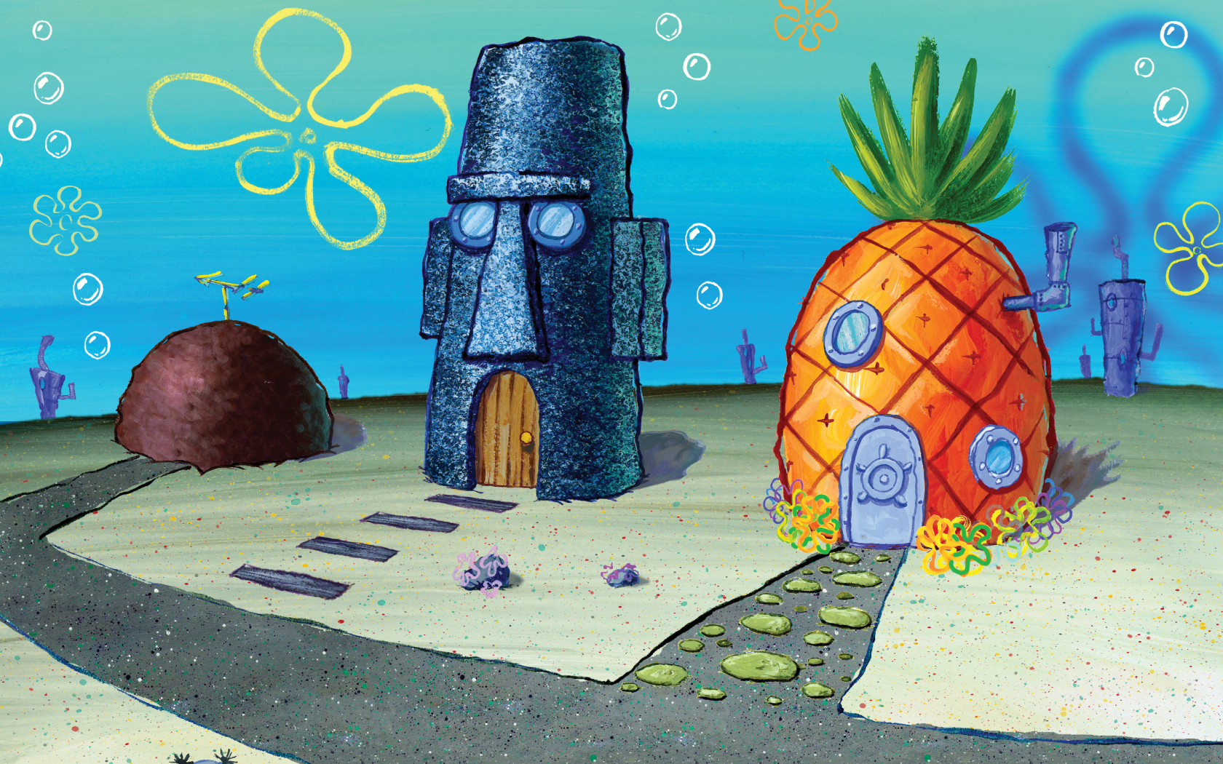
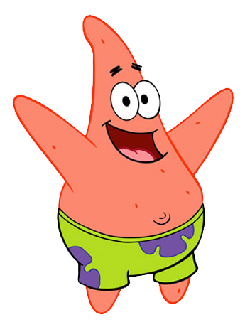
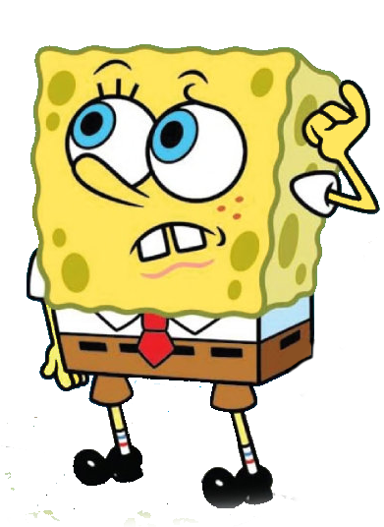
More practice problems…
Bikini Bottom Genetics!

Slide 12
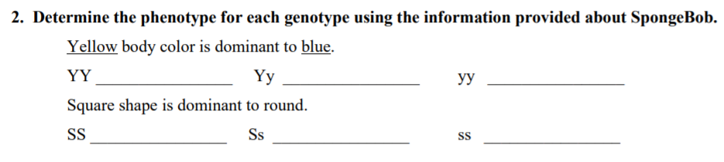
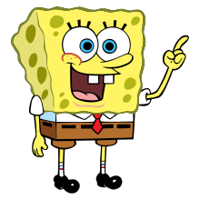
SpongeBob
YELLOW
YELLOW
blue
PHENO-type = the way it looks on the outside (based on genetics)
GENO-type = the genes on the inside

Slide 13
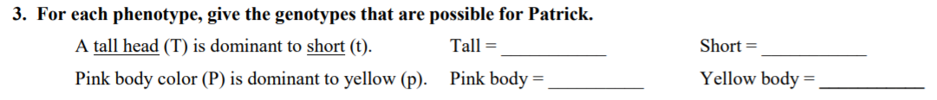
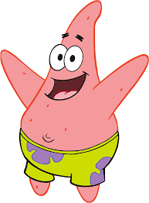
SpongeBob
TT
or Tt
Wait, so SpongeBob said
“GENO-type = the genes on the inside”
So I need to tell what genes are possible if they have a tall head?

Slide 14
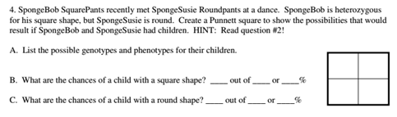
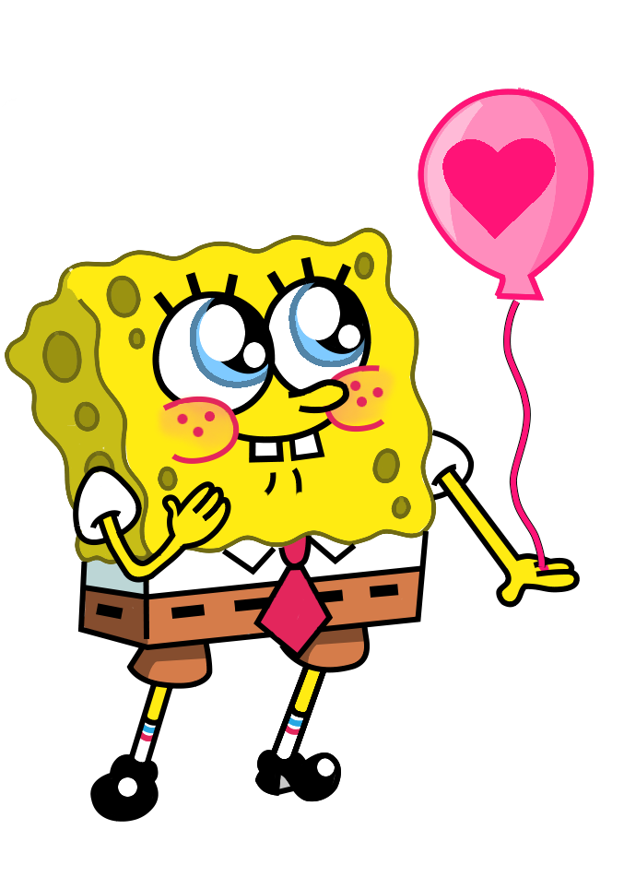
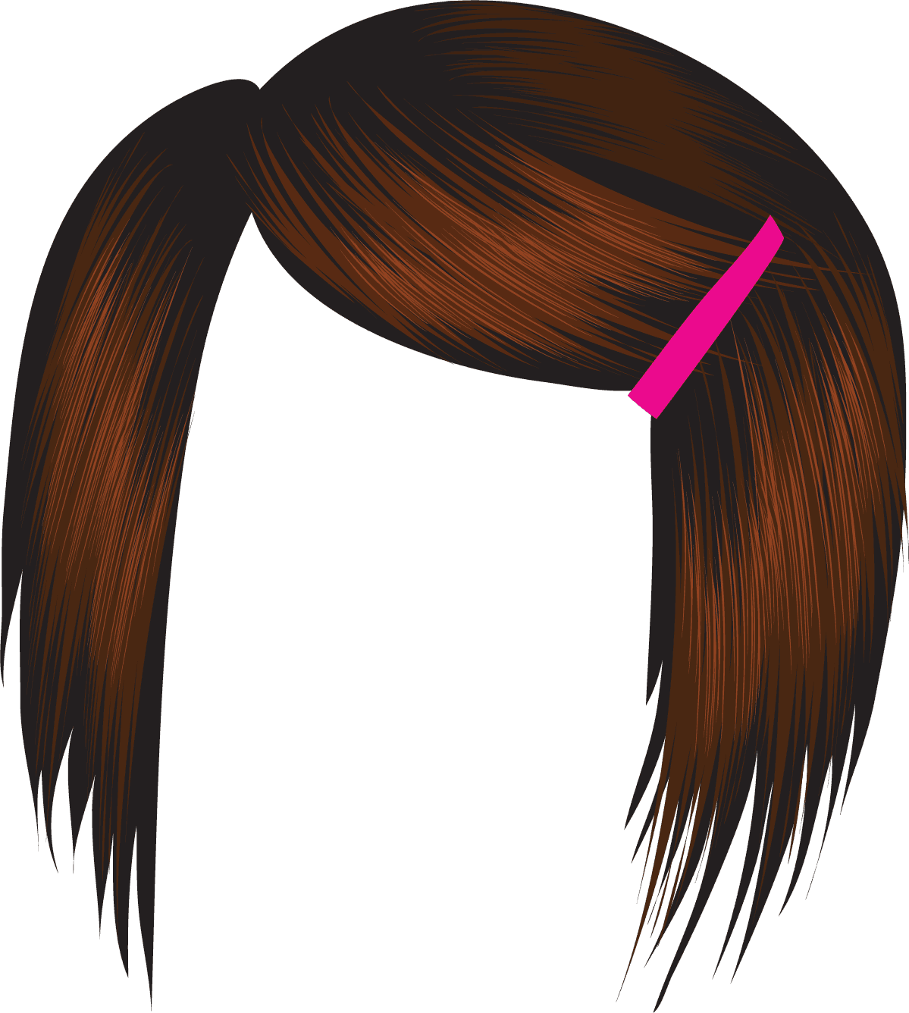
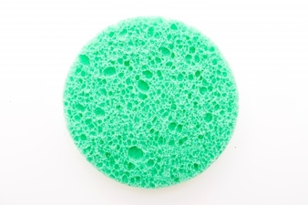
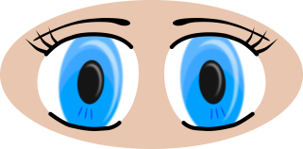

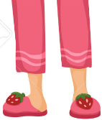
Susie = ss
Bob = Ss

Slide 15
s
S
Bob
Heterozygous
Homozygous
recessive
s
s
s
s
S
Square
Round
Homozygous
recessive
Heterozygous
s
s
s
s
S
Square
Round
Susie

Slide 16
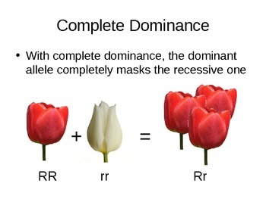
Complete Dominance = ONE WINNER

Slide 17
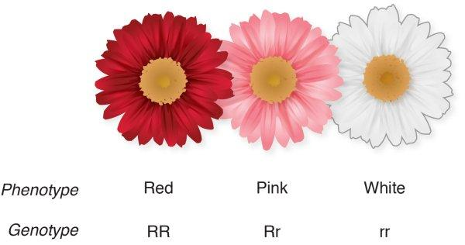
Incomplete Dominance = Blending

Slide 18
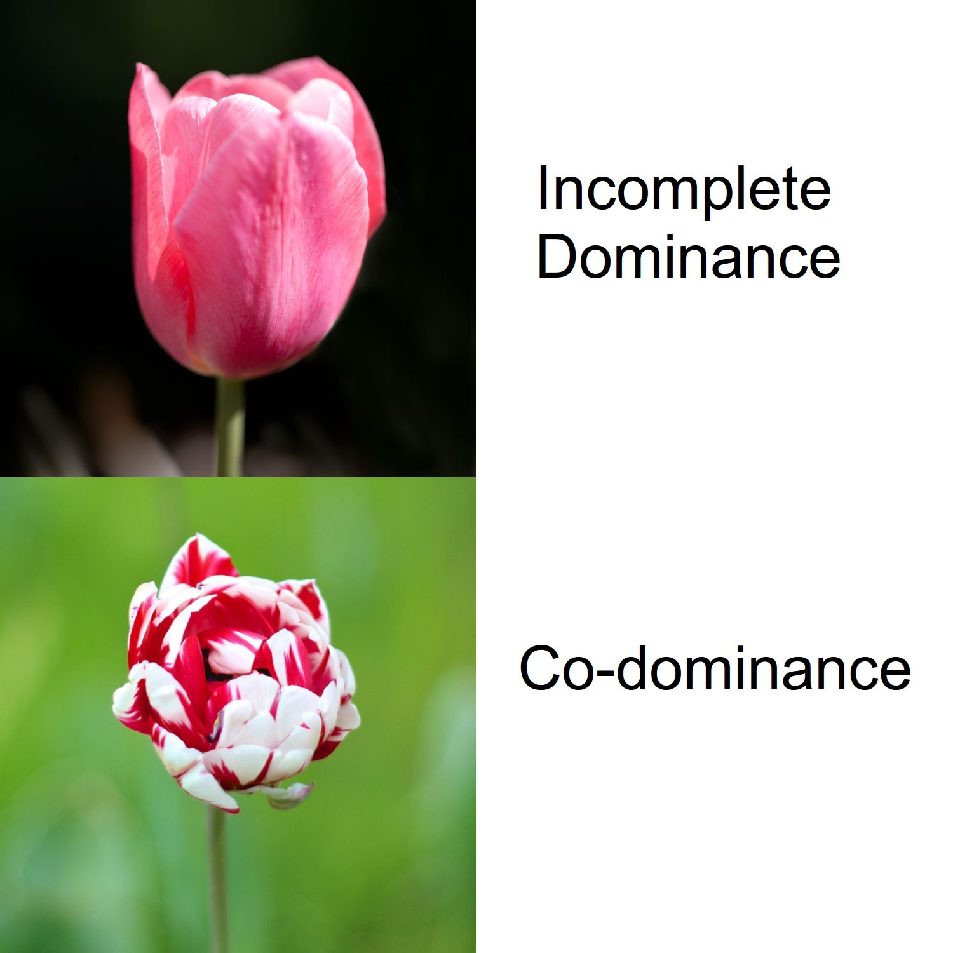

Slide 19
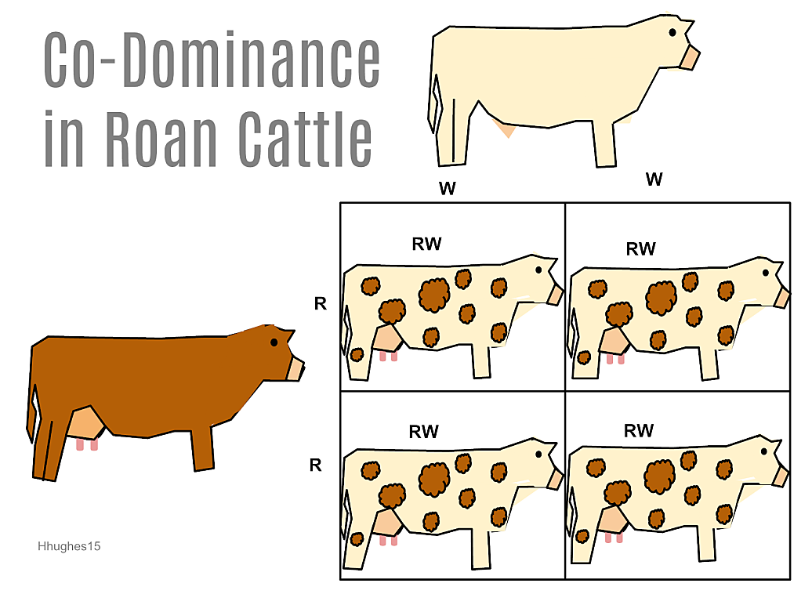
CoDominance = both show

Slide 20
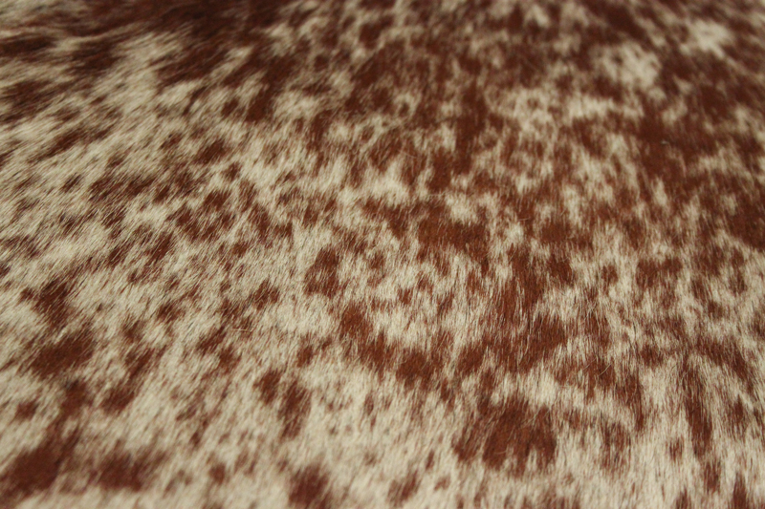
CoDominance = both show
ROAN

Slide 21
CoDominance = both show
Blood type
Phenotype
Genotype
Type A
AA
AO
Type B
BB
BO
Type AB
AB
Type O
OO

Slide 22
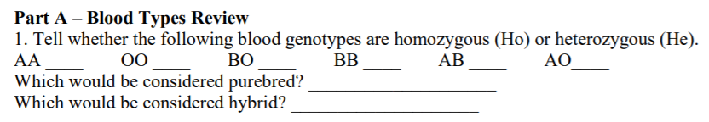

Slide 23
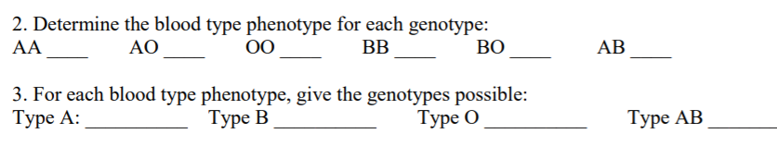

Slide 24


Slide 25
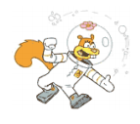
O
O
A
A
O
A
O
B
B
O
B
O

Slide 26

A
A
B
B
A
B
A
O
O
A
O
A

Slide 27
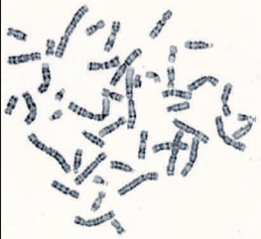
Karyotype – a picture of the actual chromosomes of an organism. Typically used for genetic research.

Slide 28
Snowman Genetics
First – find a partner…any “buddy” but make sure you are working or you’ll have to work alone.
Two – determine who is “Parent 1” and who is “Parent 2” (we aren’t using Mom and Dad – and there’s a reason!)

Slide 29
Snowman Genetics
Each parent will flip a coin to determine alleles for the offspring (2 parents so each offspring must have TWO alleles – one from each parent). If you flip heads, circle the dominant allele. If you flip tails, circle the recessive allele.
Based on the alleles, determine the traits for your snowman.
Draw/color your creation – it will be a PROJECT.

Slide 30
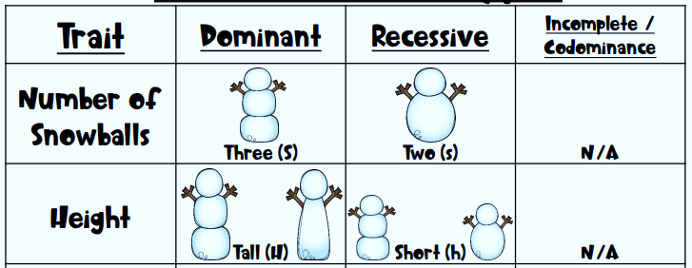


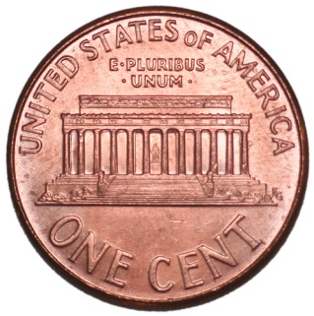
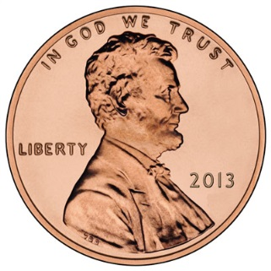
Snowman Genetics
Three – body segments
Flip a coin
Heads = Dominant
Tails = Recessive
Circle what you “flipped” into the Genotype box.
Repeat

Slide 31
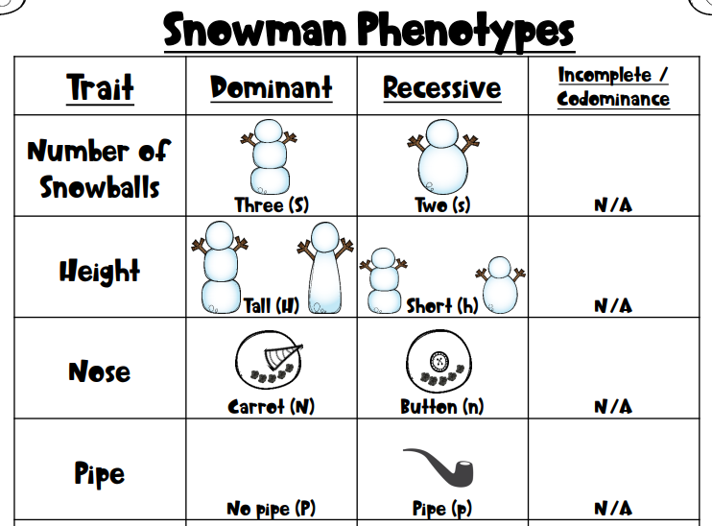

Slide 32
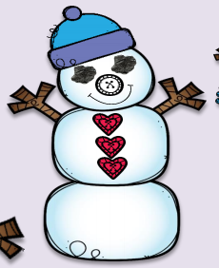

Slide 33
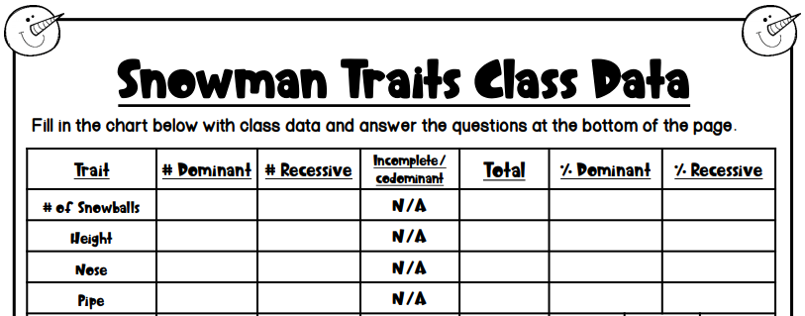

Slide 34
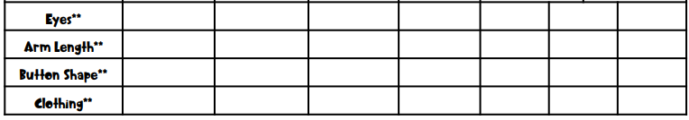

Slide 35
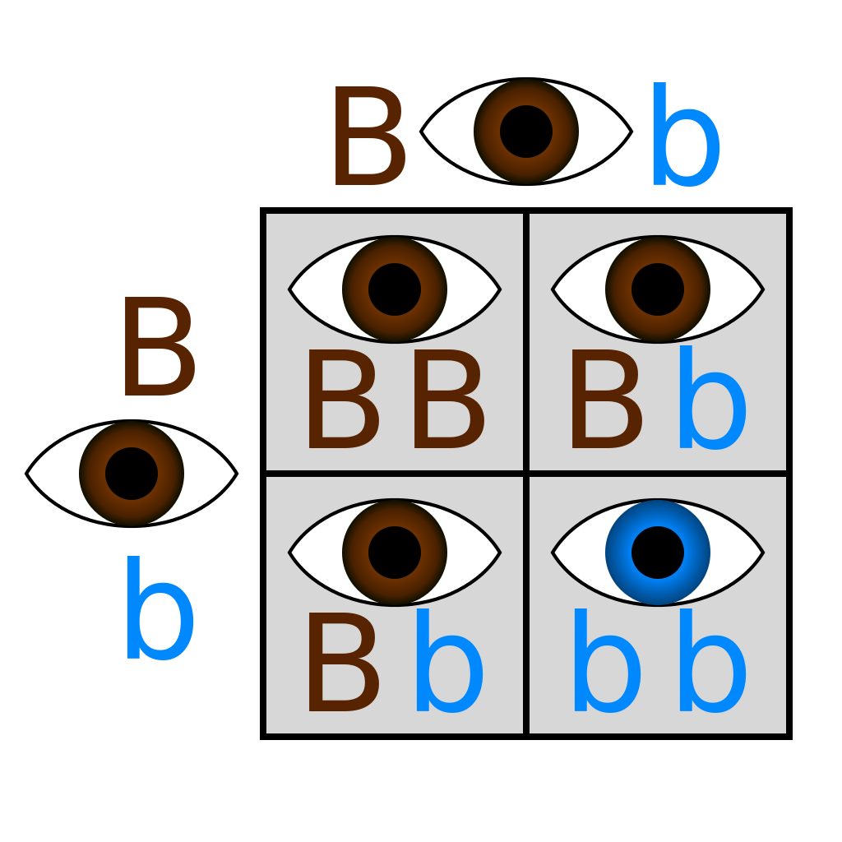
Bikini Bottom –
Dihybrid crosses
Monohybrid = ONE trait…crossed
-Punnett with FOUR boxes

Slide 36
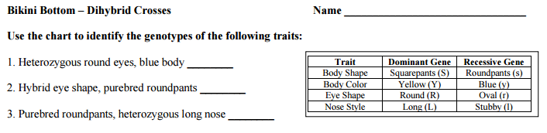
Bikini Bottom-
Dihybrid crosses

Slide 37
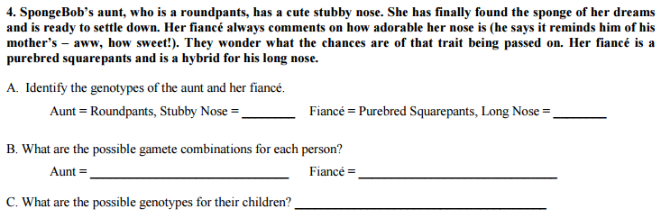
Bikini Bottom-
Dihybrid crosses

Slide 38
Bikini Bottom-
Dihybrid crosses
Dihybrid = TWO traits…crossed
-Punnett with _________________boxes
SIXTEEN

Slide 39
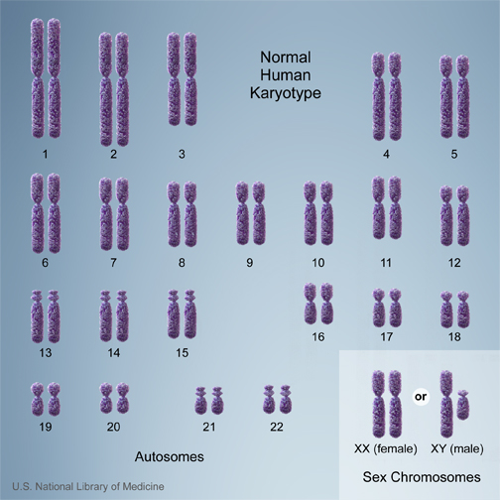
Types of Chromosomes
Humans have 23 pairs of chromosomes
  22 – autosomes
  1 – sex chromosome (X & Y)

Slide 40
Sex-Linked Traits
Traits that affect genes on the X chromosome
      Females: XX Males: XY
There are X-linked dominant and X-linked recessive traits
Males only have to inherit one version for it to show
  Females can have a copy of the affected allele on 1 X chromosome and NOT have the disorder (carrier)
Examples of X-linked dominant disorders: Vitamin D rickets
Examples of X-linked recessive disorders: Color blindness, hemophilia, Duchenne muscular dystrophy

Slide 41
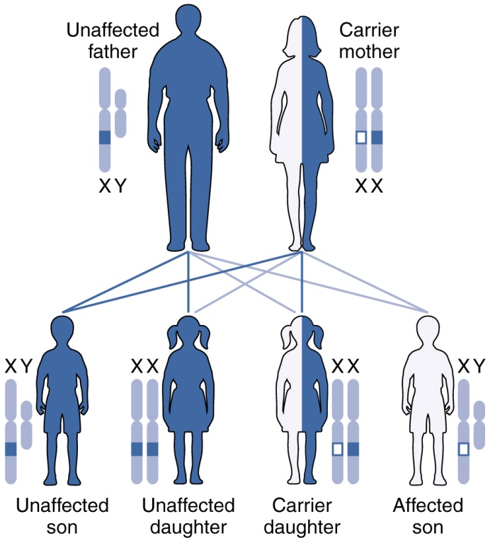
X-linked Recessive

Slide 42
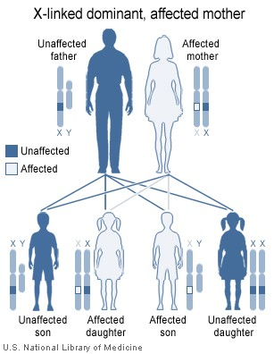
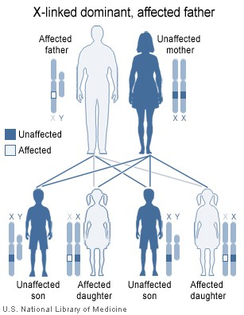
X-linked Dominant

Slide 43
Are you colorblind??

Slide 44
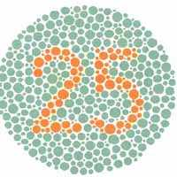
What do you see?
Answer: 25

Slide 45
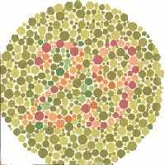
What do you see?
Answer: 29

Slide 46
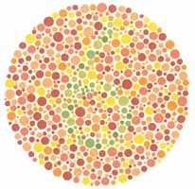
What do you see?
Answer: 32
Just kidding – the answer is 6

Slide 47
Punnett Squares for the sex-linked trait hemophilia
Cross a heterozygous (carrier) female for hemophilia with a normal male:
X^{N}X^{n} x X^{N}Y
N = Normal
n = hemophilia
X^{N}
X^{n}
X^{N}
X^{N}
X^{N}
X^{N}
X^{n}
Girl - Normal
Girl – Normal/carrier
X^{n}
Y
Y
X^{N}
Y
Boy - Normal
Boy - Hemophilia

Slide 48
Colorblindness is inherited as a sex-linked recessive disease. An affected male marries a heterozygous female. Draw a Punnett square of the possible offspring. What is the chance that they will have an affected child? Could any of their daughters be affected?
You try!

Slide 49
Colorblindness is inherited as a sex-linked recessive disease. An affected male marries a heterozygous female. Draw a Punnett square of the possible offspring. What is the chance that they will have an affected child?
Could any of their daughters be affected?
50%
50%
Yes – homozygous recessive
X^{B}
X^{b}
Daughter - hetero
Daughter – homo/rec
X^{b}
X^{B}
X^{b}
X^{b}
X^{b}
Colorblind
NORMAL -carrier
Son - hetero
Son – homo/rec
Y
X^{B}
Y
X^{b}
Y
NORMAL
Colorblind

Slide 50
A certain form of muscular dystrophy is inherited as a sex-linked, recessive gene. Jack has muscular dystrophy. Jane, Jack’s wife, is a carrier for muscular dystrophy. What fraction of their daughters would you expect to have muscular dystrophy? Sons?
CARRIER = Heterozygous = “carries” the allele without having the disorder.
X^{D}
X^{d}
Daughter - hetero
Daughter – homo/rec
X^{D}
X^{d}
X^{d}
X^{d}
X^{d}
NORMAL
Muscular dystrophy
Son – hetero
Son – homo/rec
Y
X^{D}
Y
X^{d}
Y
NORMAL
Muscular dystrophy

Slide 51
Sex-Linked Practice Problems
A father with hemophilia (recessive) crossed with a normal mother.
A carrier mother for colorblindness crossed with a colorblind father.

Slide 52
A normal father crossed with a mother that is a carrier for muscular dystrophy.
A father with hemophilia crossed with a normal mother.
If you write out
these problems (1-4)
and get them right,
I will offer a
free HW pass!

Slide 53
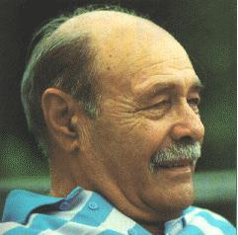
Sex-Influenced Traits
Trait expressed differently in males and females
Not X-linked
Ex: Male-pattern baldness
  BB – full hair
  bb – bald
  Bb – hair for girl, bald for guy

Slide 54
Pedigree Notes
Follow along and fill in your notes.

Slide 55
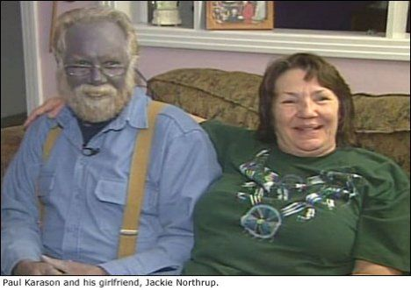
Pedigree – chart to show relationships AND track genetic traits.
Notes:
Please note that Paul Karason is NOT suffering from methemoglobinemia – he turned himself blue by drinking a silver solution. It makes a good attention getting picture for the “Blue People of Kentucky” which IS the genetic disorder methemoglobinemia.

Slide 56
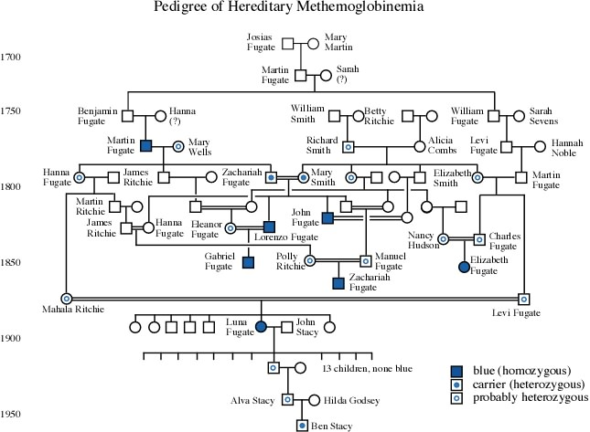

Slide 57
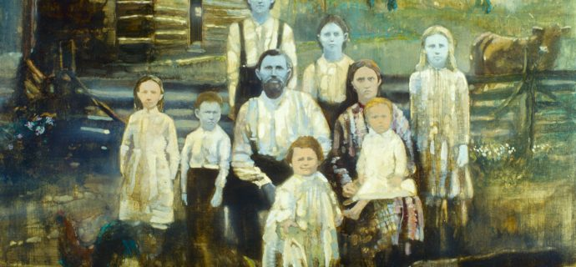
The Blue People of Kentucky – the Fugates
Methemoglobinemia

Slide 58


Slide 59


Slide 60

ff
Ff
ff
Ff
ff
Ff

Slide 61
ff
ff
ff
ff
ff
ff

Slide 62
NOTE:
In a pedigree, the trait of interest can be dominant or recessive. The majority of harmful genetic conditions are only seen when an individual is homozygous recessive – examples of conditions caused by recessive alleles include Cystic Fibrosis (a disease of the secretory glands, including those that make mucus and sweat), Falconi anemia (a blood disorder), and albinism (a lack of pigmentation).
Some genetic conditions are caused by dominant alleles (and may therefore be expressed in HOMOZYGOUS DOMINANT or HETEROZYGOUS individuals). For example, achondaplasia (dwarfism).
Cystic Fibrosis
Dwarfism
ff
GG
Gg

Slide 63

C
A
B
A
C
D
3
Ff
ff

Slide 64



Slide 65


Slide 66
Inheriting a
Genetic Disorder

Slide 67

What are genetic disorders?
A genetic disorder is an abnormal condition that a person inherits through their genes or chromosomes.

Slide 68


What are genetic disorders?
Some are caused by mutations in DNA.
For example, sickle cell disease which you learned about yesterday!

Slide 69

What are genetic disorders?
This is a picture of ALL your chromosomes called a “karyotype”.
Others are caused by bigger changes in the chromosome.
For example, having too many chromosomes – Down Syndrome.

Slide 70
Cystic Fibrosis
Let’s take a closer look at a genetic disorder called Cystic Fibrosis.

Slide 71

How do you get a genetic disorder?
Genetic disorders like Cystic Fibrosis are NOT contagious! You can’t catch them from someone else who is sick!
You inherit them from your parents.
How do you know which children are at risk for inheriting Cystic Fibrosis?

Slide 72
Who is affected by Cystic Fibrosis?
Overall, the probability (% chance) of inheriting CF if BOTH parents are carriers is 25% (1 in 4).

Slide 73
Can Cystic Fibrosis be cured?
People hope that gene therapy can one day provide a cure for genetic disorders like cystic fibrosis.
Gene Therapy - involves removing the mutated gene and replacing it with a healthy gene.

Slide 74
Pedigree Notes
Follow along and fill in your notes.

Slide 77
ff
Ff
ff
Ff
ff
Ff

Slide 78
NOTE:
In a pedigree, the trait of interest can be dominant or recessive. The majority of harmful genetic conditions are only seen when an individual is homozygous recessive – examples of conditions caused by recessive alleles include Cystic Fibrosis (a disease of the secretory glands, including those that make mucus and sweat), Falconi anemia (a blood disorder), and albinism (a lack of pigmentation).
Some genetic conditions are caused by dominant alleles (and may therefore be expressed in HOMOZYGOUS DOMINANT or HETEROZYGOUS individuals). For example, achondaplasia (dwarfism).
Cystic Fibrosis
Dwarfism
ff
GG
Gg

Slide 82
Weird Genetics:
Mutants, Selective Breeding and Genetic Engineering…

Slide 83

Mutations
A change in genetic information
Can occur randomly (naturally)
Or can be deliberately caused in the laboratory by scientists
Inherited
Not always harmful (sometimes helpful, or make no difference at all!)
http://www.accessexcellence.org/

Slide 84
Natural
Mutations

Slide 85


Albino? Leucistic? Check the eyes.

Slide 86

White Bengal Tiger

Slide 87
ALBINOS
Little or no pigmentation in the eyes, skin, and hair (or in some cases in the eyes alone).
Inherited an altered copy of a gene that does not work correctly.
The altered gene does not allow the body to make the usual amounts of a pigment called "melanin".
True albinos have pink eyes and skin.

Slide 88




Slide 89


White Bluebonnets

Slide 90




Slide 91




Slide 92


Slide 93


Slide 94
HUMAN
INTERVENTION

Slide 95
SELECTIVE BREEDING
The selection of certain seeds or animals for reproduction in order to influence the traits inherited by the next generation.

Slide 96


SELECTIVE BREEDING
The Liger is the result of breeding a female Tiger to a male Lion.
The liger has both stripes and spots. The stripes are inherited from its tiger parent and the spots from the lion parent.
On their hind legs, ligers stand approximately 12 feet tall. At most, ligers may weigh up to 1,000 pounds.

Slide 97

The Cama is the result of breeding a Llama to a Camel.
Parents in background of picture.

Slide 98


The Zebroid is the result of breeding
a female Horse and a male Zebra.
The Zedonk / Zonkey is the result of breeding
a female Donkey and male Zebra.

Slide 99

The Mule is the result of breeding a female horse
(mare) to a male donkey (jack). The
mule is superior to the horse in strength,
endurance, intelligence and disease resistance.

Slide 100
Looking a bit more into the genetics involved, horses
have 32 pairs of chromosomes while donkeys have
only 31 pairs. When a male donkey and a female
horse mate, they produce a mule (a male horse with
a female donkey produces a different creature called
a hinny).

Slide 101


Okay, Twilight fans…
How could this relate to the Vampire vs. the Werewolf story-line in the Twilight series?

Slide 102
GENETIC ENGINEERING
The selective, deliberate change of genes (genetic material) by humans.
The technique of removing, modifying or adding genes to a DNA molecule in order to change the information it contains.

Slide 103


French genetic researchers created Alba for artist Eduardo Kac. Thanks to genes borrowed from a jellyfish, the albino rabbit glows green when placed under special lighting. In regular light, Alba appears like any other furry white rabbit. But place her under a black light, and her eyes, whiskers and fur glow a otherworldly green.

Slide 104


"Glow in the dark" fish. these genetically modified fish were developed by a Taiwanese aquatic firm, Taikong Group. They are planning to reproduce these fish in numbers and sell them for pets.

Slide 105


Scientists in the agriculture department of the Hebrew University in Rehovot, have genetically engineered a chicken that has no feathers.

Slide 106
Remember, test Friday (11/2) – and we still have to learn about sex-linked traits.

