Slide 1
Jan. 7, 2020
You need:
Clean paper (2) / pencil
Spongebob Sex-Linked WS
Warm Up:
What amazing things happened during break?
I CAN: practice genetics with Snowman lab

Slide 2
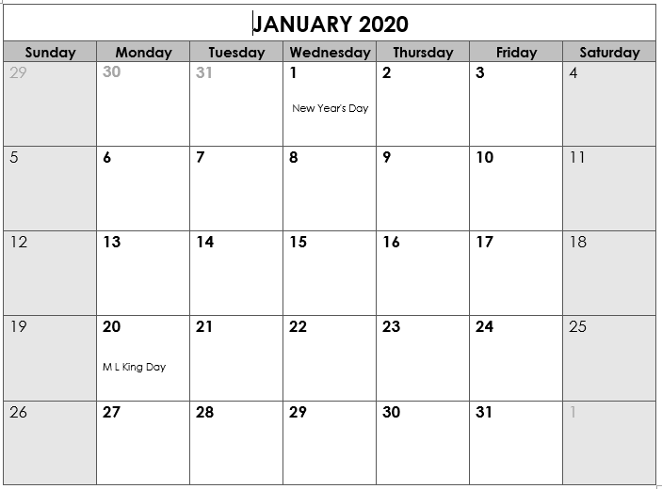
Back to School
Genetics TEST
“B” day
No elective 1A…stay with homebase
6th grade SWAGbrrr
Benchmark ELA
@ 11:30
Benchmark Math @ 11:30
*End Qtr 2
Teacher Workday
Teacher Workday (Weather?)
School Holiday
8th grade SWAGbrrr
7th grade SWAGbrrr

Slide 3
Today’s agenda
Review notes on genetics
Complete vs. Incomplete
Snowman PROJECT

Slide 4
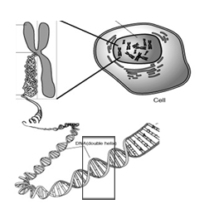
Nucleus
Chromosome
Cell
Gene
DNA

Slide 5
Vocabulary
Chromosomes – DNA wound into cute pkg
Genes – section of DNA/chromosome that codes for a specific trait
Traits – an organism’s physical features
Phenotype – the way something looks on the outside (based on DNA)
Genotype – the genes inside (usually represented with two letters – LL, Ll, ll)

Slide 6
Vocabulary
Dominant allele – the version of a gene that WILL show if present.
Recessive allele – the version of a gene that may get hidden. Only shows if there is nothing to cover it.
HOMOzygous – an organism with two of the SAME alleles for a specific trait.
HETEROzygous – an organism with DIFFERENT alleles for a specific trait.

Slide 7
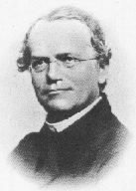
Gregor Mendel
1822-1884
“Father of Genetics”

Slide 8
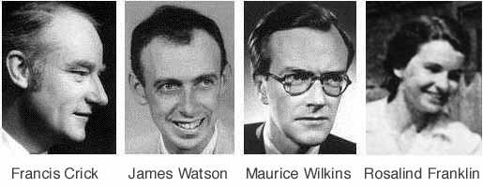

Nobel Prize 1962
1920-1958

Slide 9
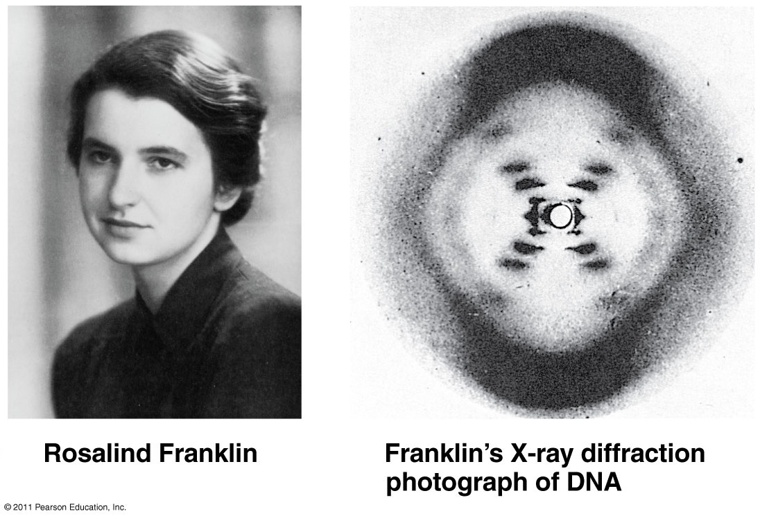

Slide 10
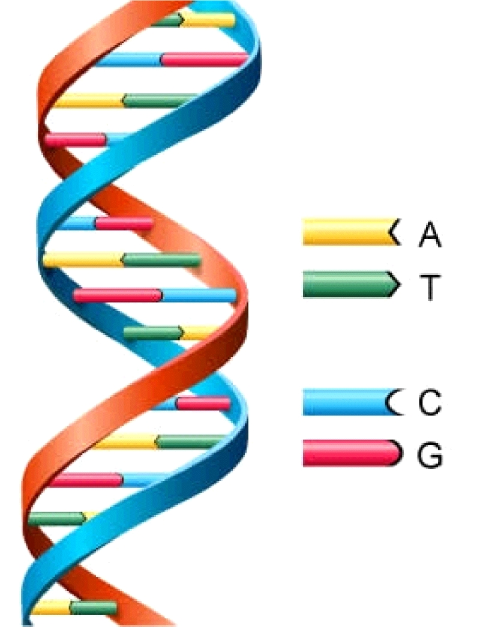
DNA
Deoxyribonucleic Acid
Double Helix (twisted ladder) shape

Slide 11
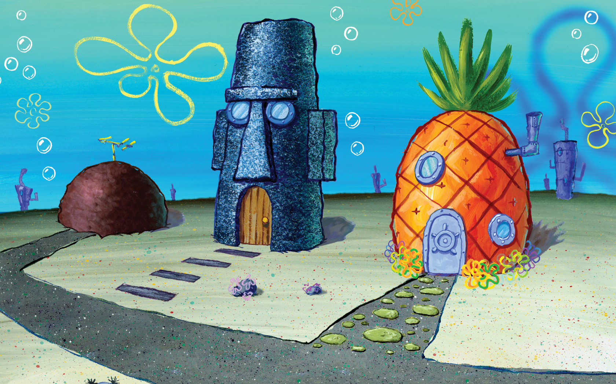
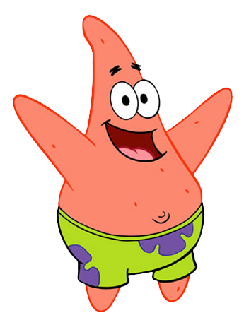
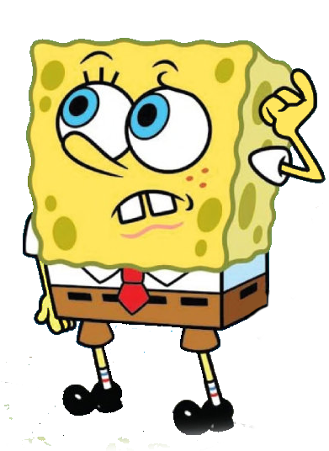
More practice problems…
Bikini Bottom Genetics!

Slide 12
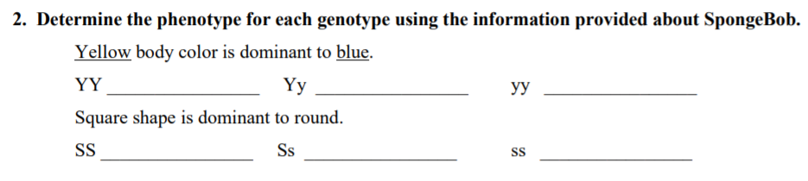
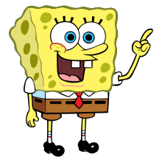
SpongeBob
YELLOW
YELLOW
blue
PHENO-type = the way it looks on the outside (based on genetics)
GENO-type = the genes on the inside

Slide 13
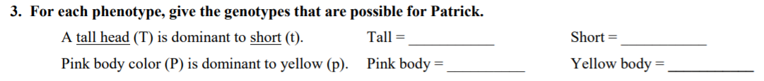
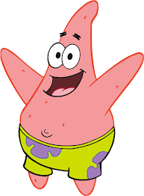
SpongeBob
TT
or Tt
Wait, so SpongeBob said
“GENO-type = the genes on the inside”
So I need to tell what genes are possible if they have a tall head?

Slide 14
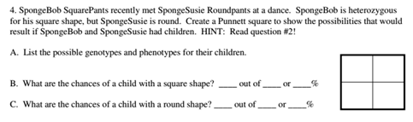
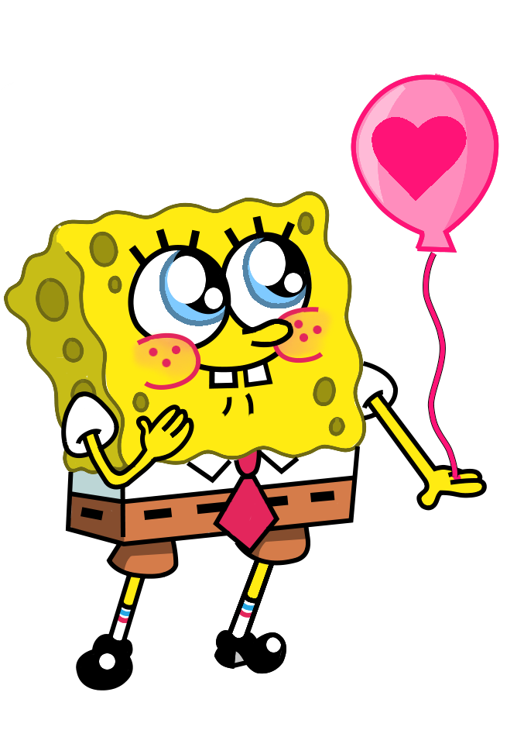
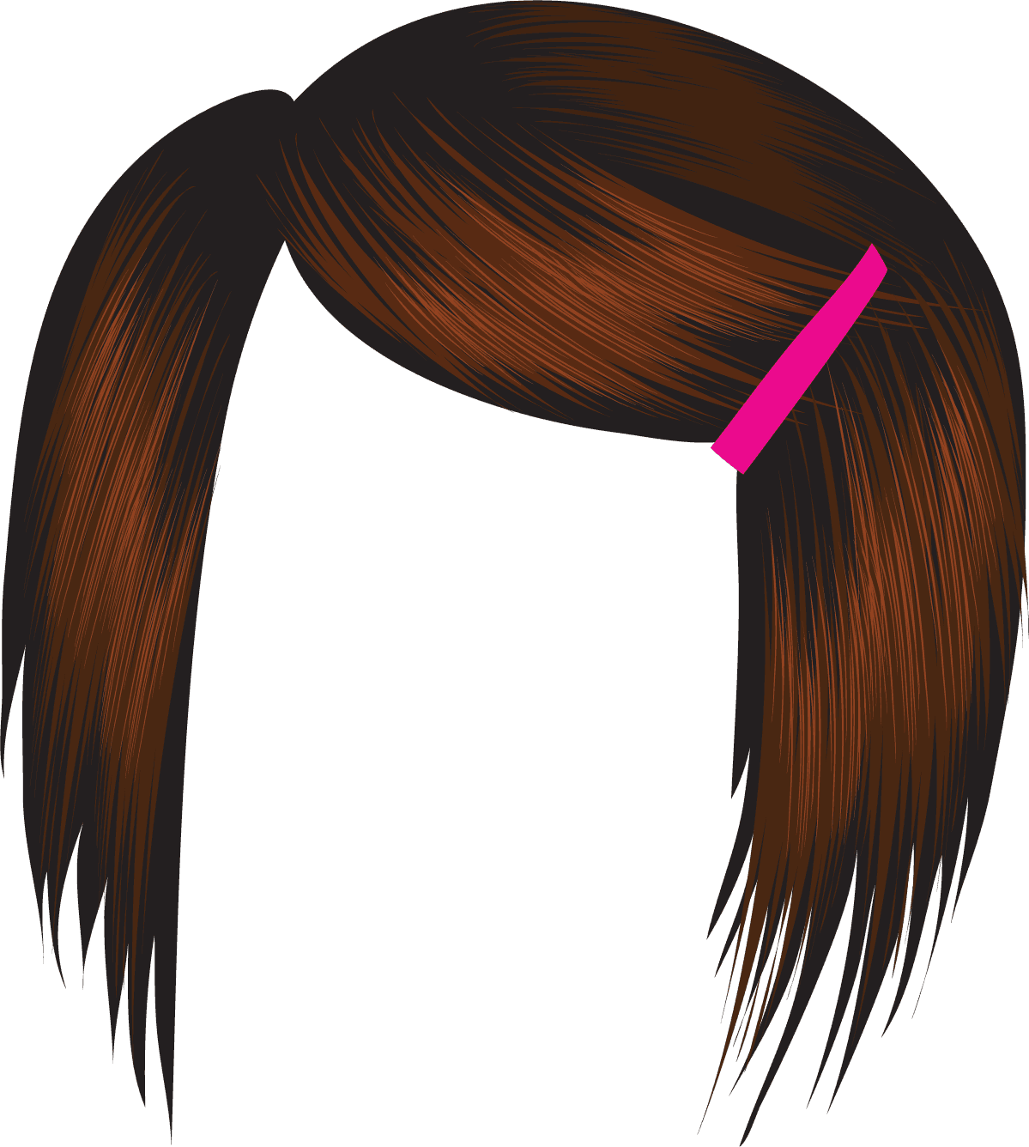
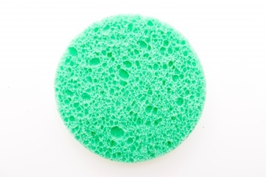
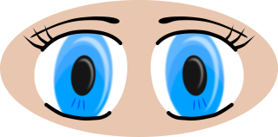

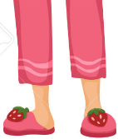
Susie = ss
Bob = Ss

Slide 15
s
S
Bob
Heterozygous
Homozygous
recessive
s
s
s
s
S
Square
Round
Homozygous
recessive
Heterozygous
s
s
s
s
S
Square
Round
Susie

Slide 16
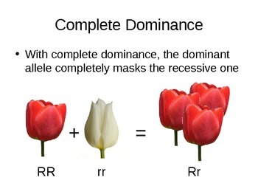
Complete Dominance = ONE WINNER

Slide 17
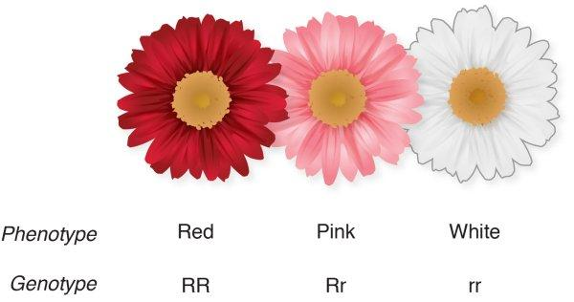
Incomplete Dominance = Blending

Slide 18
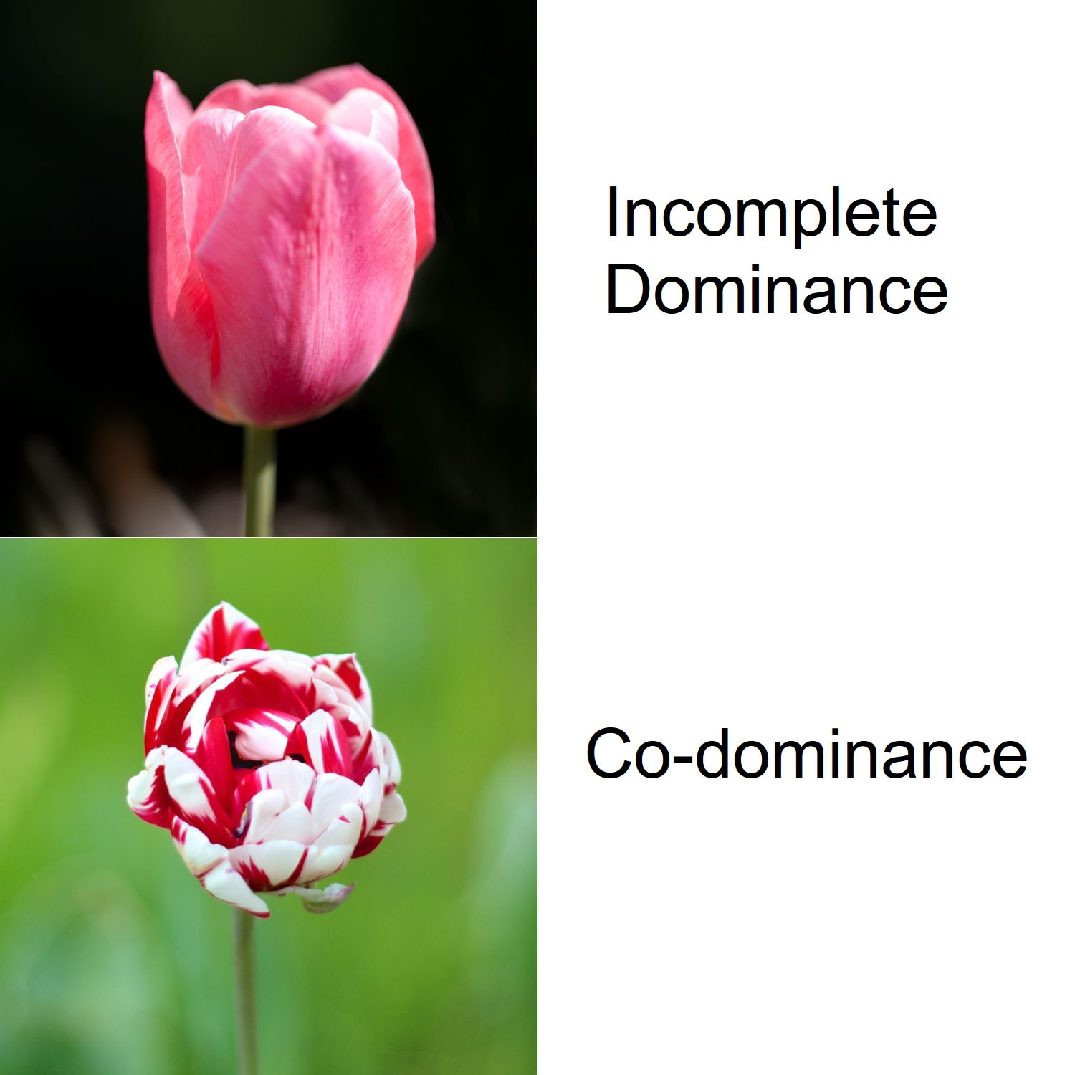

Slide 19
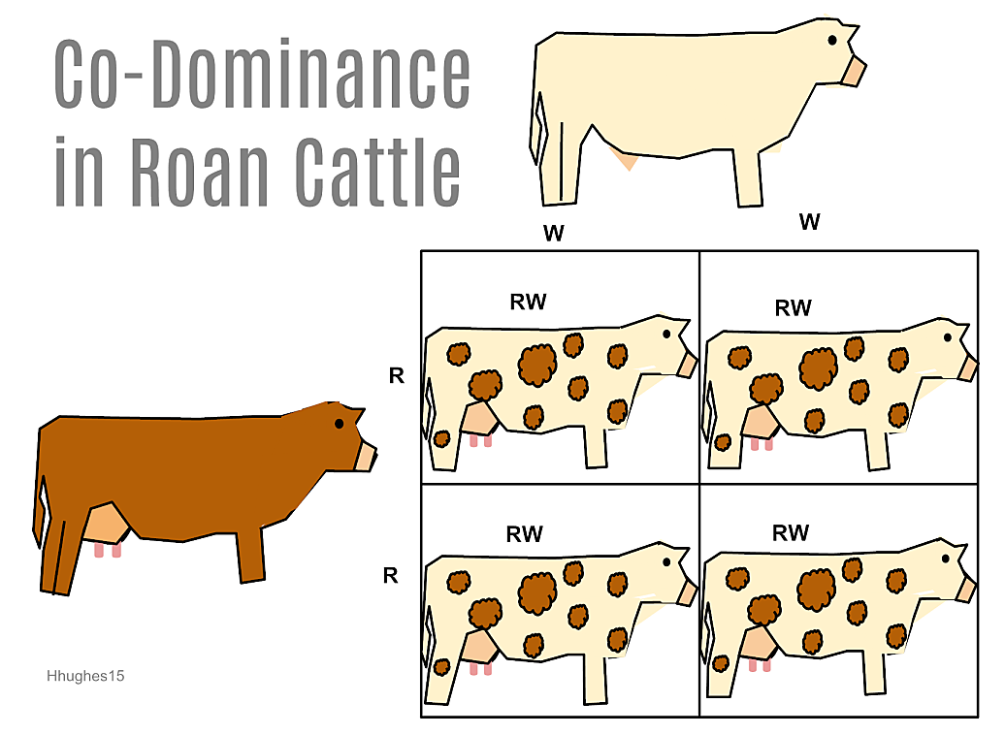
CoDominance = both show

Slide 20
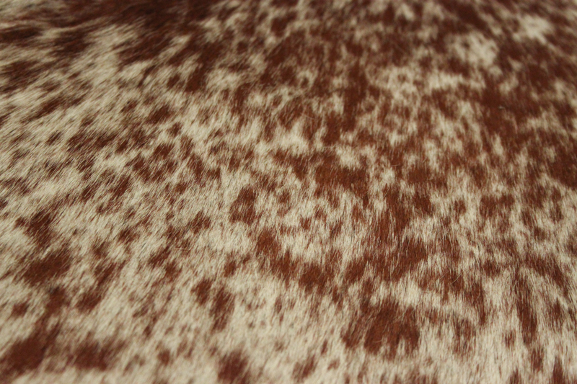
CoDominance = both show
ROAN

Slide 21
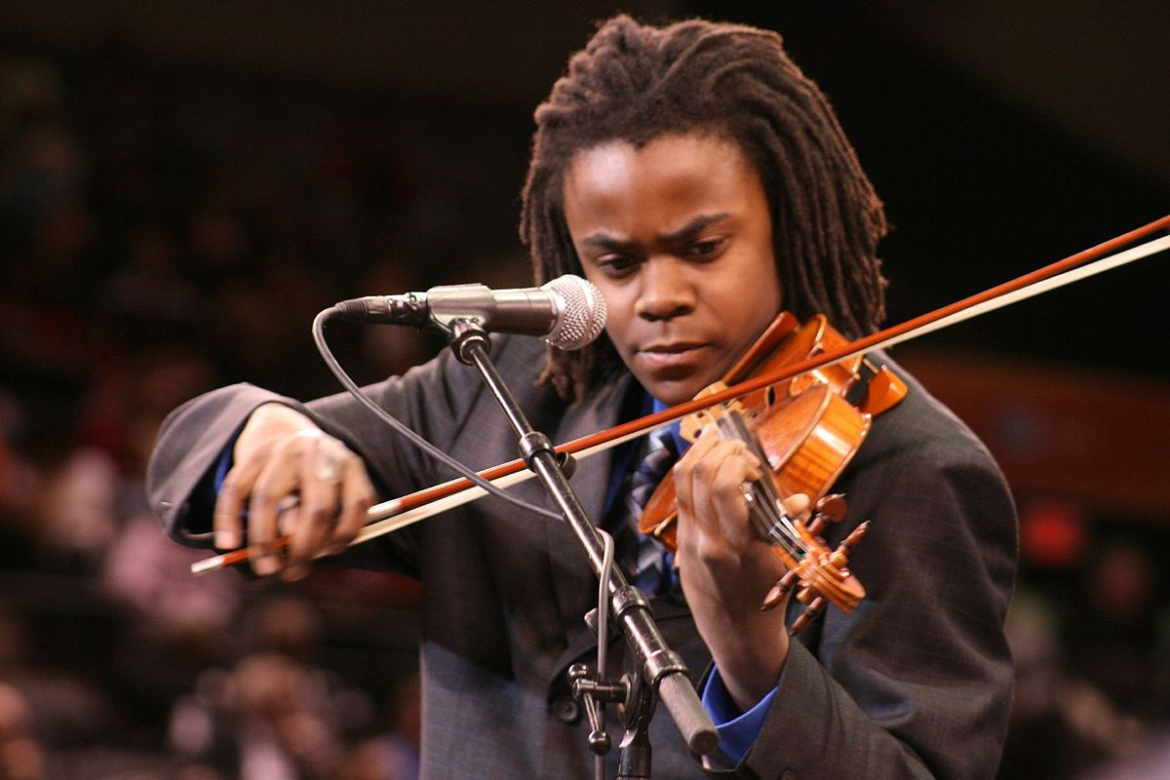
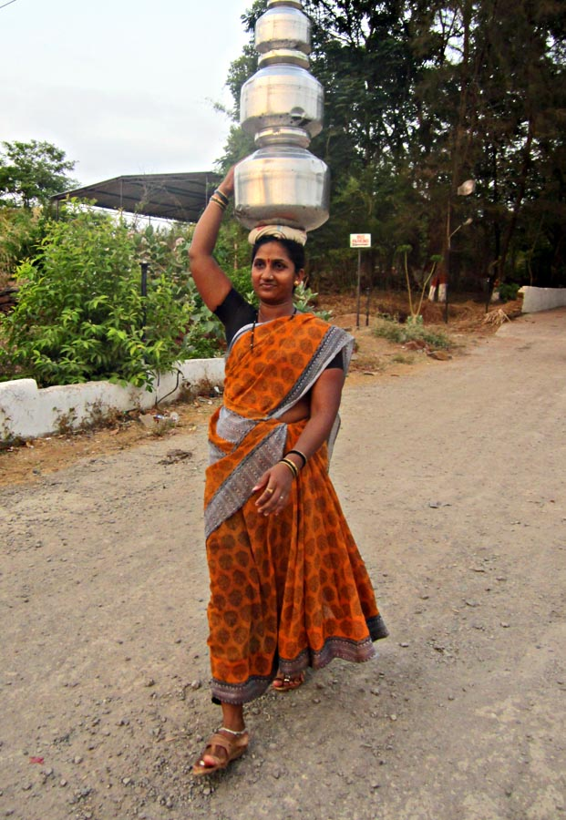
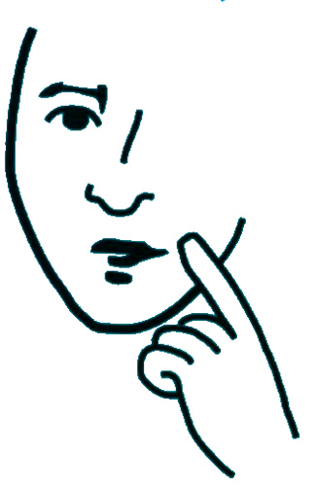

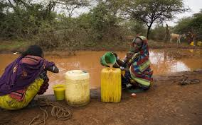
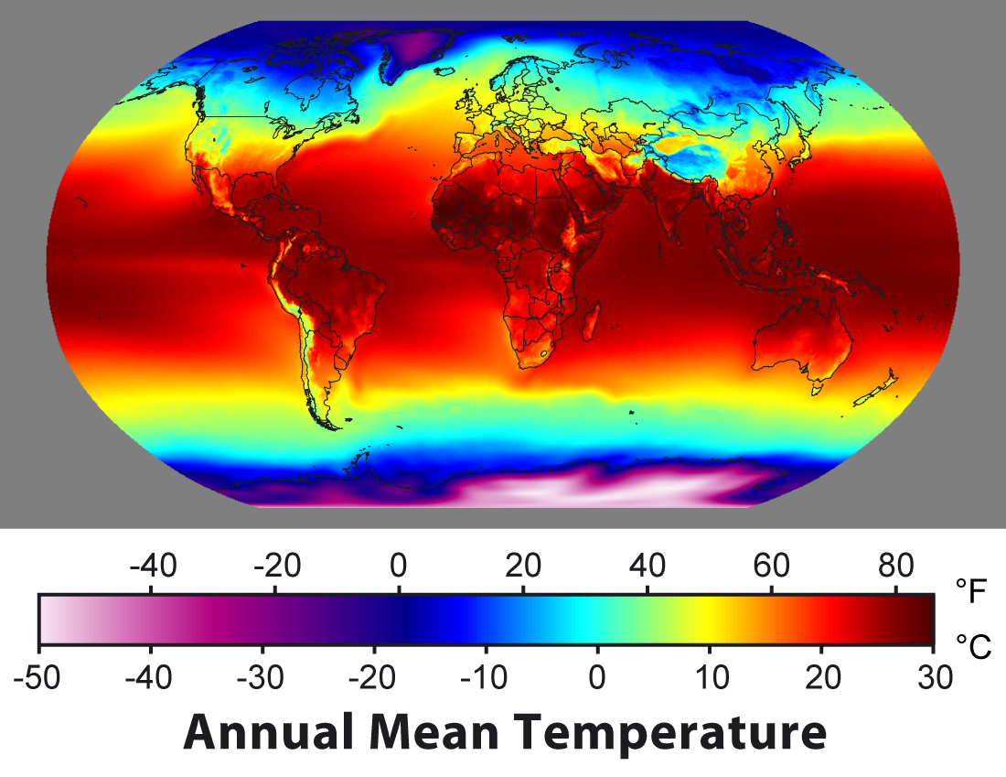
External factors?
Are there external factors that may have influenced human development?

Slide 22
Bikini Bottom – CoDominance vs. Incomplete Dominance

Slide 23
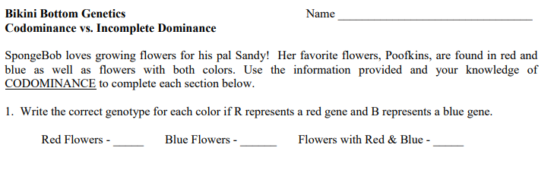

Slide 24
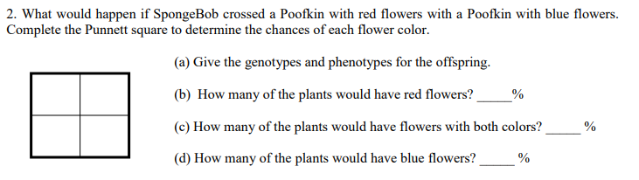

Slide 25
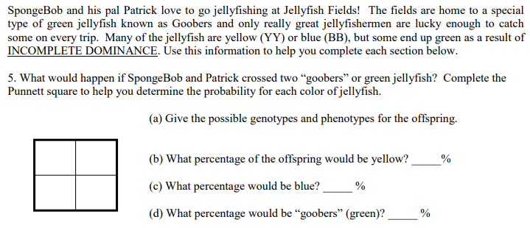

Slide 26
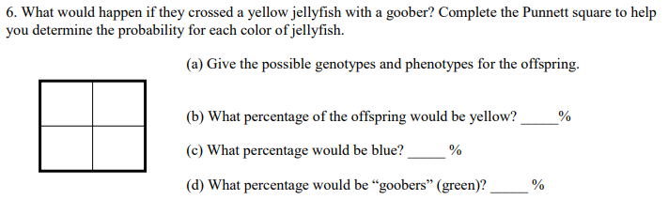

Slide 27
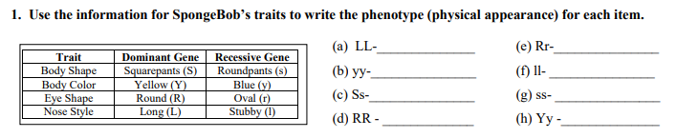
Bikini Bottom Genetics 2

Slide 28
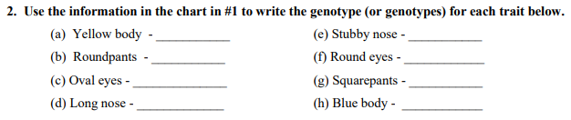
Bikini Bottom Genetics 2

Slide 29

Bikini Bottom Genetics 2

Slide 30
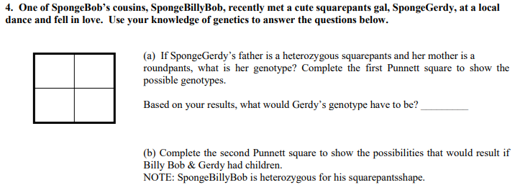
Bikini Bottom Genetics 2

Slide 31
s
S
Dad
Heterozygous
Homozygous
recessive
s
s
s
s
S
Square
Round
Homozygous
recessive
Heterozygous
s
s
s
s
S
Square
Round
Mom

Slide 32
s
S
Homozygous
dominant
Heterozygous
s
S
S
S
S
Square
Square
Homozygous
recessive
Heterozygous
s
s
s
s
S
Square
Round

Slide 33


External factors?

Slide 34
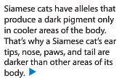
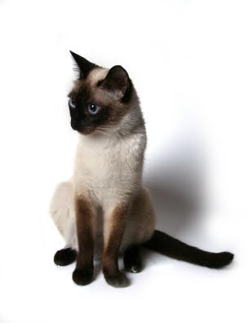
External factors?

Slide 35
Snowman Genetics
First – find a partner…any “buddy” but make sure you are working or you’ll have to work alone.
Two – determine who is “Parent 1” and who is “Parent 2” (we aren’t using Mom and Dad – and there’s a reason!)

Slide 36
Snowman Genetics
Each parent will flip a coin to determine alleles for the offspring (2 parents so each offspring must have TWO alleles – one from each parent). If you flip heads, circle the dominant allele. If you flip tails, circle the recessive allele.
Based on the alleles, determine the traits for your snowman.
Draw/color your creation – it will be a PROJECT.

Slide 37
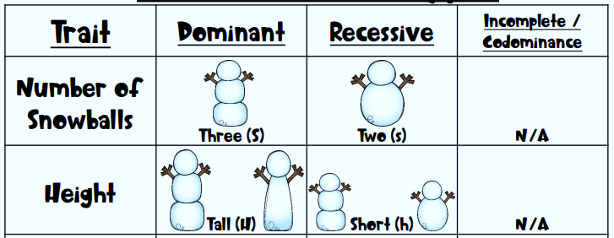


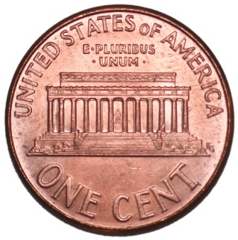
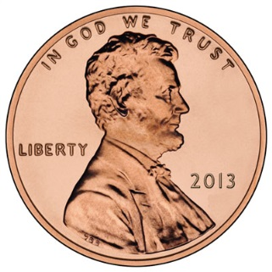
Snowman Genetics
Three – body segments
Flip a coin
Heads = Dominant
Tails = Recessive
Circle what you “flipped” into the Genotype box.
Repeat

Slide 38
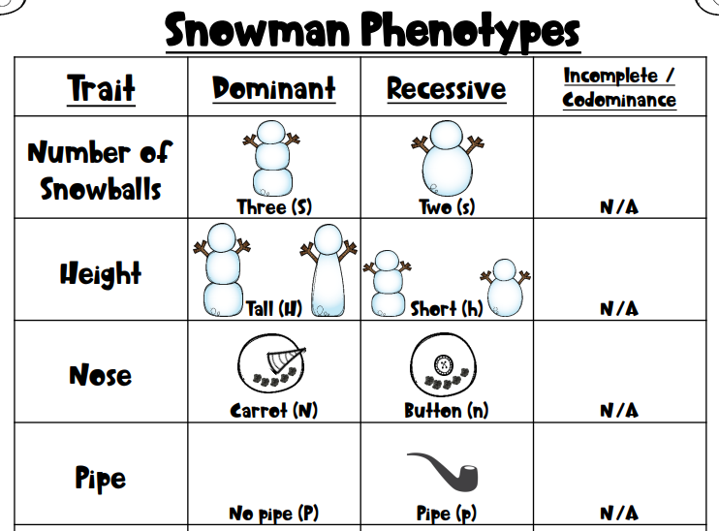

Slide 39
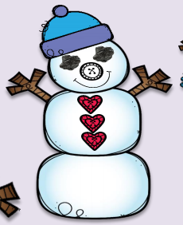
FINISH the snowman lab: genotype/phenotype, vocabulary, drawing.
Trace/cut out the parts needed to make your snowman.
Color / glue these parts onto a clean white paper.
Put your name in the upper right corner.
This is now a HW assignment AND a project grade.

Slide 40
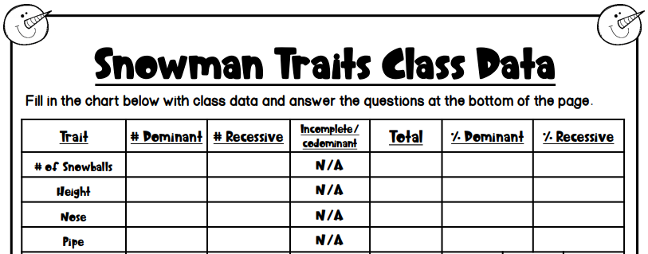

Slide 41
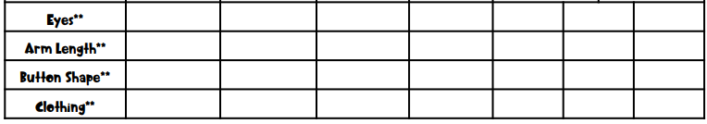

Slide 42
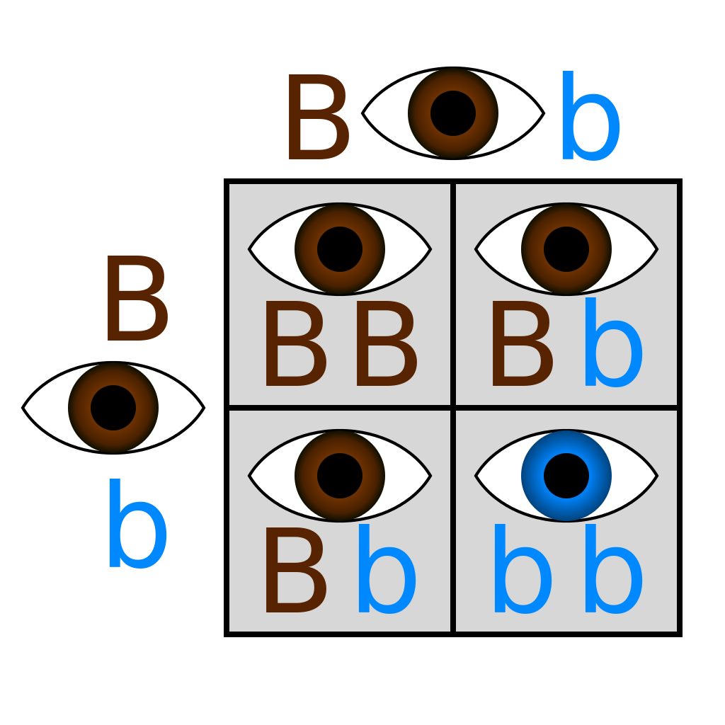
Bikini Bottom –
Dihybrid crosses
Monohybrid = ONE trait…crossed
-Punnett with FOUR boxes

Slide 43
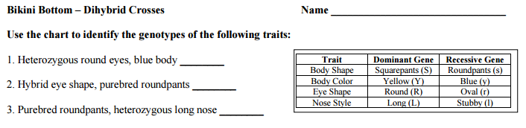
Bikini Bottom-
Dihybrid crosses

Slide 44
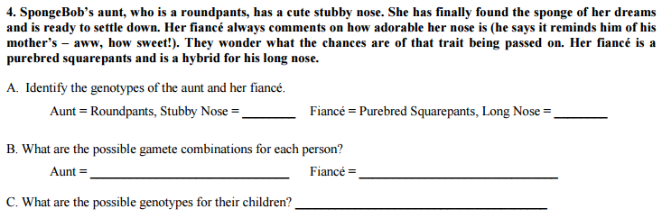
Bikini Bottom-
Dihybrid crosses

Slide 45
Bikini Bottom-
Dihybrid crosses
Dihybrid = TWO traits…crossed
-Punnett with _________________boxes
SIXTEEN

Slide 46
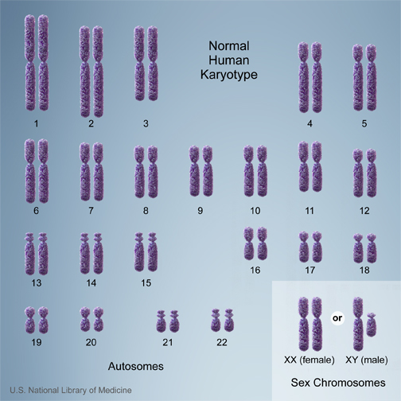
Types of Chromosomes
Humans have 23 pairs of chromosomes
  22 – autosomes
  1 – sex chromosome (X & Y)

Slide 47
Sex-Linked Traits
Traits that affect genes on the X chromosome
      Females: XX Males: XY
There are X-linked dominant and X-linked recessive traits
Males only have to inherit one version for it to show
  Females can have a copy of the affected allele on 1 X chromosome and NOT have the disorder (carrier)
Examples of X-linked dominant disorders: Vitamin D rickets
Examples of X-linked recessive disorders: Color blindness, hemophilia, Duchenne muscular dystrophy

Slide 48
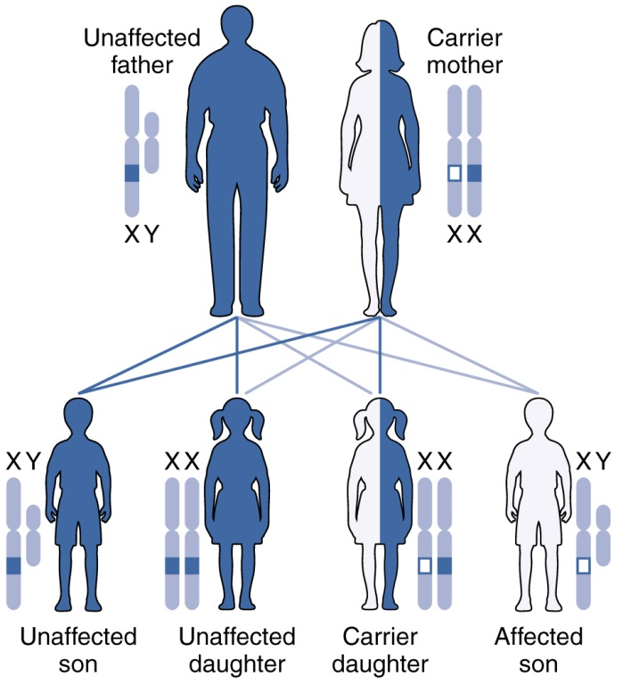
X-linked Recessive

Slide 49


X-linked Dominant

Slide 50
Are you colorblind??

Slide 51

What do you see?
Answer: 25

Slide 52

What do you see?
Answer: 29

Slide 53

What do you see?
Answer: 32
Just kidding – the answer is 6

Slide 54
Punnett Squares for the sex-linked trait hemophilia
Cross a heterozygous (carrier) female for hemophilia with a normal male:
X^{N}X^{n} x X^{N}Y
N = Normal
n = hemophilia
X^{N}
X^{n}
X^{N}
X^{N}
X^{N}
X^{N}
X^{n}
Girl - Normal
Girl – Normal/carrier
X^{n}
Y
Y
X^{N}
Y
Boy - Normal
Boy - Hemophilia

Slide 55
Colorblindness is inherited as a sex-linked recessive disease. An affected male marries a heterozygous female. Draw a Punnett square of the possible offspring. What is the chance that they will have an affected child? Could any of their daughters be affected?
You try!

Slide 56
Colorblindness is inherited as a sex-linked recessive disease. An affected male marries a heterozygous female. Draw a Punnett square of the possible offspring. What is the chance that they will have an affected child?
Could any of their daughters be affected?
50%
50%
Yes – homozygous recessive
X^{B}
X^{b}
Daughter - hetero
Daughter – homo/rec
X^{b}
X^{B}
X^{b}
X^{b}
X^{b}
Colorblind
NORMAL -carrier
Son - hetero
Son – homo/rec
Y
X^{B}
Y
X^{b}
Y
NORMAL
Colorblind

Slide 57
A certain form of muscular dystrophy is inherited as a sex-linked, recessive gene. Jack has muscular dystrophy. Jane, Jack’s wife, is a carrier for muscular dystrophy. What fraction of their daughters would you expect to have muscular dystrophy? Sons?
CARRIER = Heterozygous = “carries” the allele without having the disorder.
X^{D}
X^{d}
Daughter - hetero
Daughter – homo/rec
X^{D}
X^{d}
X^{d}
X^{d}
X^{d}
NORMAL
Muscular dystrophy
Son – hetero
Son – homo/rec
Y
X^{D}
Y
X^{d}
Y
NORMAL
Muscular dystrophy

Slide 58
Sex-Linked Practice Problems
A father with hemophilia (recessive) crossed with a normal mother.
A carrier mother for colorblindness crossed with a colorblind father.

Slide 59
A normal father crossed with a mother that is a carrier for muscular dystrophy.
A father with hemophilia crossed with a normal mother.
If you write out
these problems (1-4)
and get them right,
I will offer a
free HW pass!

Slide 60

Sex-Influenced Traits
Trait expressed differently in males and females
Not X-linked
Ex: Male-pattern baldness
  BB – full hair
  bb – bald
  Bb – hair for girl, bald for guy

Slide 61
Pedigree Notes
Follow along and fill in your notes.

Slide 62

Pedigree – chart to show relationships AND track genetic traits.
Notes:
Please note that Paul Karason is NOT suffering from methemoglobinemia – he turned himself blue by drinking a silver solution. It makes a good attention getting picture for the “Blue People of Kentucky” which IS the genetic disorder methemoglobinemia.

Slide 63


Slide 64

The Blue People of Kentucky – the Fugates
Methemoglobinemia

Slide 65


Slide 66


Slide 67

ff
Ff
ff
Ff
ff
Ff

Slide 68
ff
ff
ff
ff
ff
ff

Slide 69
NOTE:
In a pedigree, the trait of interest can be dominant or recessive. The majority of harmful genetic conditions are only seen when an individual is homozygous recessive – examples of conditions caused by recessive alleles include Cystic Fibrosis (a disease of the secretory glands, including those that make mucus and sweat), Falconi anemia (a blood disorder), and albinism (a lack of pigmentation).
Some genetic conditions are caused by dominant alleles (and may therefore be expressed in HOMOZYGOUS DOMINANT or HETEROZYGOUS individuals). For example, achondaplasia (dwarfism).
Cystic Fibrosis
Dwarfism
ff
GG
Gg

Slide 70

C
A
B
A
C
D
3
Ff
ff

Slide 71



Slide 72


Slide 73
Inheriting a
Genetic Disorder

Slide 74

What are genetic disorders?
A genetic disorder is an abnormal condition that a person inherits through their genes or chromosomes.

Slide 75


What are genetic disorders?
Some are caused by mutations in DNA.
For example, sickle cell disease which you learned about yesterday!

Slide 76

What are genetic disorders?
This is a picture of ALL your chromosomes called a “karyotype”.
Others are caused by bigger changes in the chromosome.
For example, having too many chromosomes – Down Syndrome.

Slide 77
Cystic Fibrosis
Let’s take a closer look at a genetic disorder called Cystic Fibrosis.

Slide 78

How do you get a genetic disorder?
Genetic disorders like Cystic Fibrosis are NOT contagious! You can’t catch them from someone else who is sick!
You inherit them from your parents.
How do you know which children are at risk for inheriting Cystic Fibrosis?

Slide 79
Who is affected by Cystic Fibrosis?
Overall, the probability (% chance) of inheriting CF if BOTH parents are carriers is 25% (1 in 4).

Slide 80
Can Cystic Fibrosis be cured?
People hope that gene therapy can one day provide a cure for genetic disorders like cystic fibrosis.
Gene Therapy - involves removing the mutated gene and replacing it with a healthy gene.

Slide 81
Pedigree Notes
Follow along and fill in your notes.

Slide 84
ff
Ff
ff
Ff
ff
Ff

Slide 85
NOTE:
In a pedigree, the trait of interest can be dominant or recessive. The majority of harmful genetic conditions are only seen when an individual is homozygous recessive – examples of conditions caused by recessive alleles include Cystic Fibrosis (a disease of the secretory glands, including those that make mucus and sweat), Falconi anemia (a blood disorder), and albinism (a lack of pigmentation).
Some genetic conditions are caused by dominant alleles (and may therefore be expressed in HOMOZYGOUS DOMINANT or HETEROZYGOUS individuals). For example, achondaplasia (dwarfism).
Cystic Fibrosis
Dwarfism
ff
GG
Gg

Slide 89
Remember, test Friday (11/2) – and we still have to learn about sex-linked traits.

